Slide 1
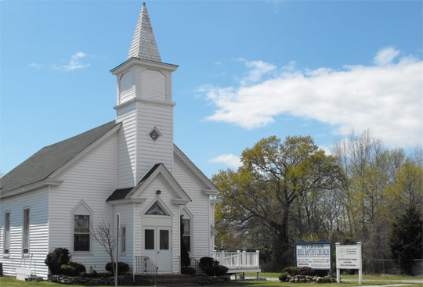
Pastor & Mrs. McLeod & Asst. Pastor Jacob Demusz Welcome YOU to Rio Grande Bible Baptist Church

Slide 2
It’s all about… GOD’S WORD – THE KING OF THE BOOKS The King James Bible We have it in writing!

Slide 3
“Where the word of a king is, there is power…” Eccl. 8:4 King James Bible

Slide 4
Our focus here at Rio Grande is always on the wonderful subject of God’s wonderful Word.

Slide 5
Heaven itself is being attacked with the multiplicity of Bible “versions” on the market today. Don’t let them steal your *Mansion! * The word “mansion” is missing from all the new Bible versions.

Slide 6
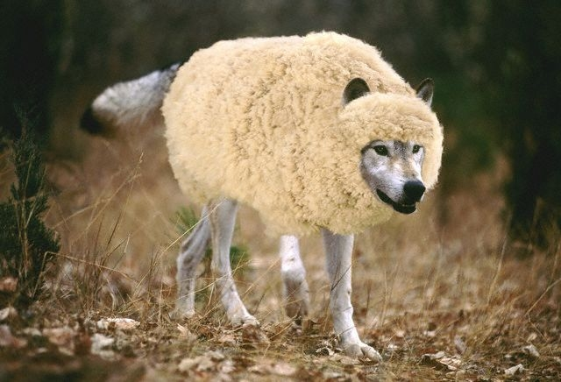
One of Satan’s ploys is to use “wolves in sheep’s clothing” to deceive people concerning God’s Word.
Today he uses “scholars” to present new “versions” of the Bible as “more up-to-date” and “more accurate.”

Slide 7
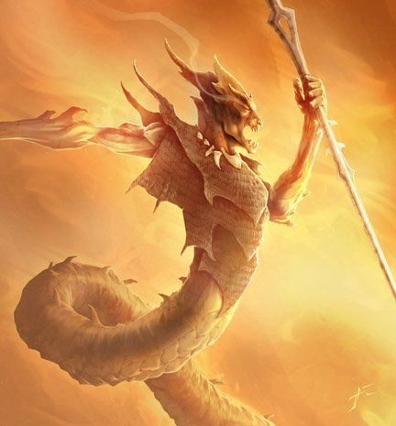
The old serpent (Satan) has effectively used this “wile” (Greek: “methodia” – English: “method”) since the Garden of Eden when he cast the first question mark over God’s Word by asking: “Yea, hath God said…?”

Slide 8
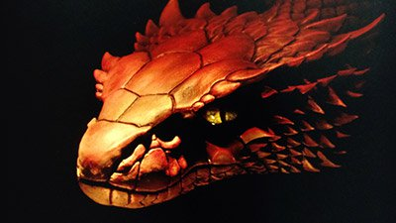
WE NEED TO BEWARE…
“Lest Satan should get an advantage over us: for we are not ignorant of his devices.”
2 Cor. 2:11

Slide 9
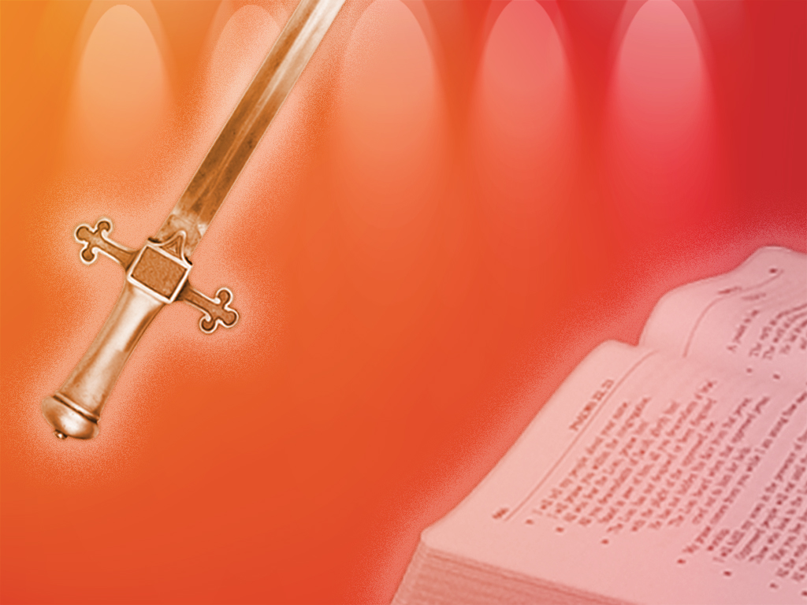
The King James Bible is the only book out of the 25 million plus books in the Library of Congress (or your library!) that doesn’t have a copyright!

Slide 10
The King James Bible is the only translation of God’s Word in English that honors the Trinity in 1 John 5:7.

Slide 11
The King James Bible is the only translation of God’s Word in English that is translated from the Traditional Text of Scripture! (All others rely upon Roman Catholic texts – mainly Sinaiticus and Vaticanus in the N.T.)

Slide 12
The King James Bible is the only translation of God’s Word in English that consistently gives the preeminent place to our Savior, the Lord Jesus Christ.

Slide 13
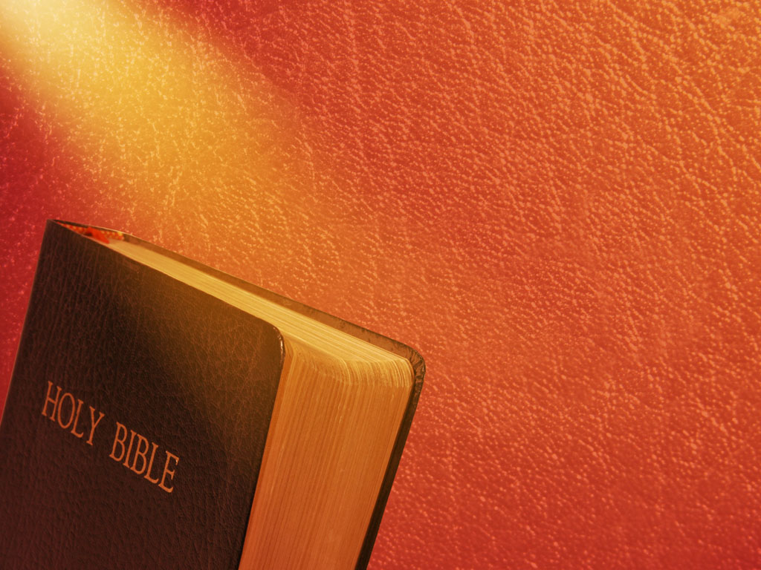
That is why (only) the King James Bible admonishes us to…
“Study to shew thyself approved unto God…”
2 Tim. 2:15a

Slide 14
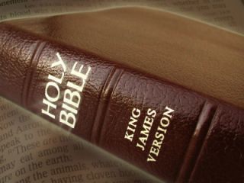
So, sit back, relax and open your heart to what God has to say to YOU today in His matchless and Holy Word.

