Slide 1

“LORD, DO IT AGAIN!”

Slide 2
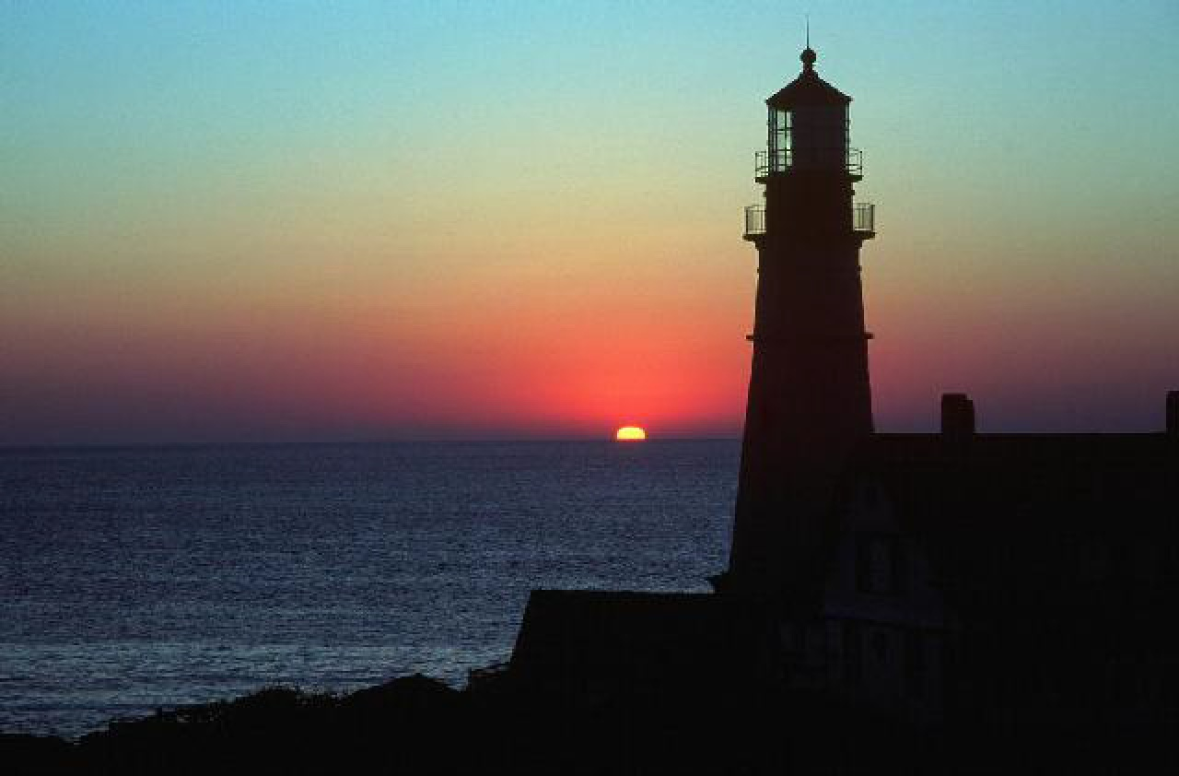
Pastor & Mrs. Guarneri…
Welcome YOU to Straightway Baptist Church
A Lighthouse in this community

Slide 3
SIT BACK AND ENJOY THE CONGREGATIONAL SINGING, THE SPECIAL MUSIC and OF COURSE – THE MESSAGES FROM GOD’S WORD

Slide 4

God’s Holy Word has the answers for life’s difficult storms. Pay close attention to the preaching!

Slide 5
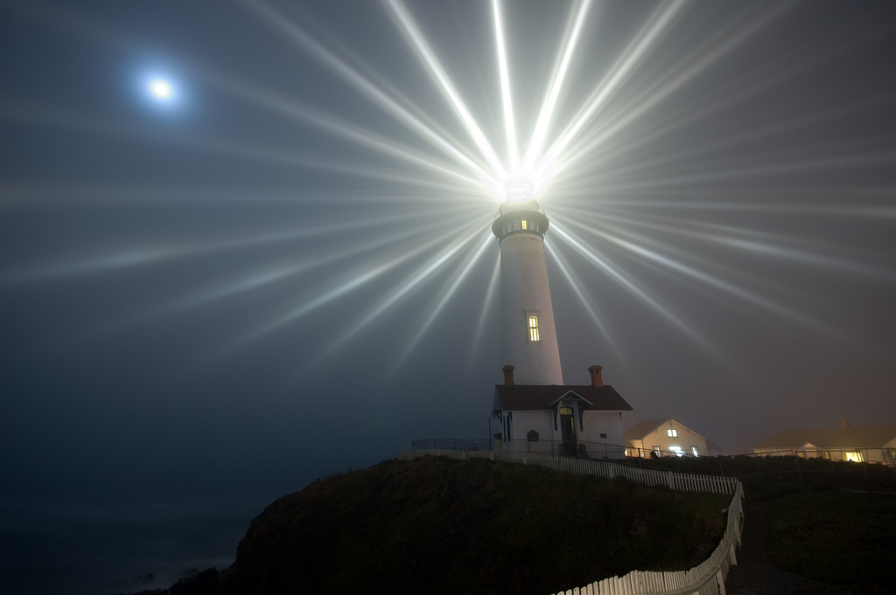
Thank you for attending today. We trust you will be glad you did.
God’s Word is a “lamp unto (our) feet and a light unto (our) path.” HEAR it today!

Slide 6
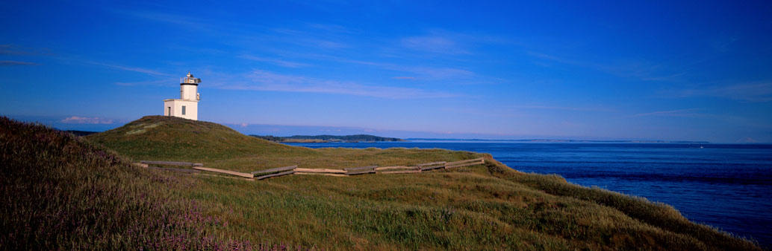
This is a fundamental
Bible-believing church
We use only God’s Word –the King James Bible

Slide 7
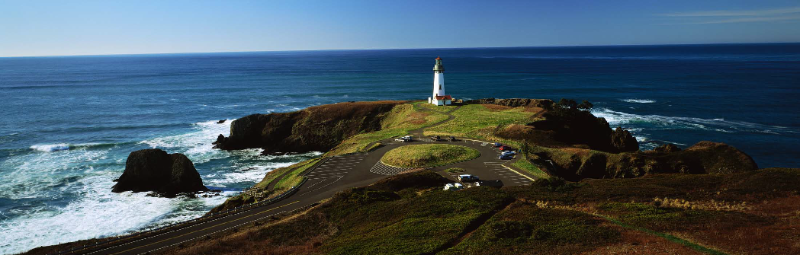
God’s Word contains the only provision God has made for salvation and Christian growth.
We are commanded to “study” God’s Word.
Notes:
nm

Slide 8
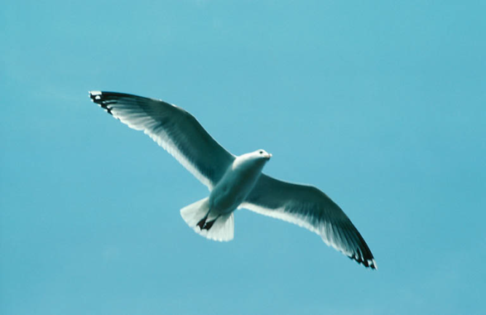
To day is YOUR opportunity to allow God to speak to YOU!
Do you know how to use the Bible to help people in need?
Are you growing, going and glowing for the Savior?!
Can you lead someone to Christ?

Slide 9
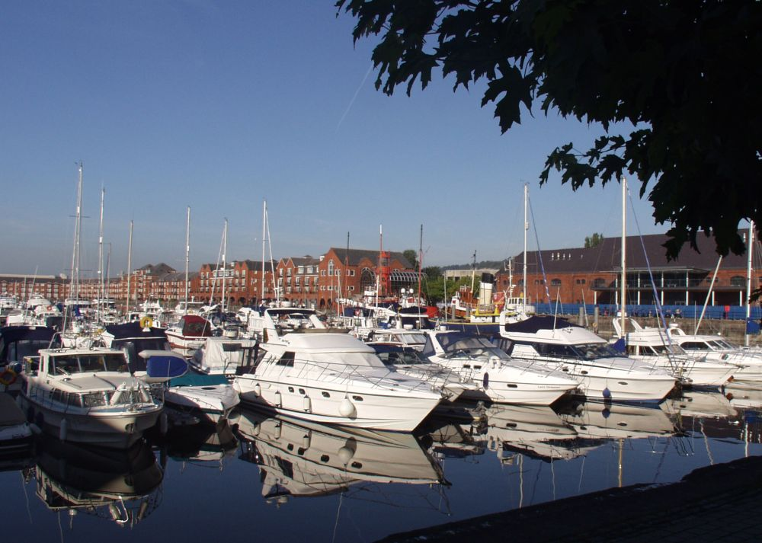
Why not make Straightway Baptist your “home port”?!

Slide 10
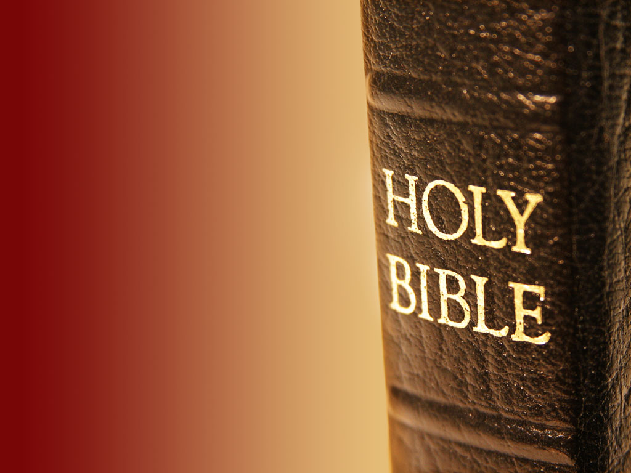
Now, get ready to listen intently to God’s voice through His holy Word

