Slide 1
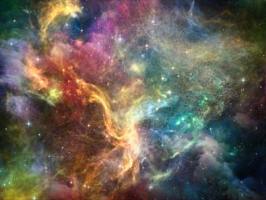
Romans 11:33 O the depth of the riches both of the wisdom and knowledge of God! how unsearchable are his judgments, and his ways past finding out!
TOTALLY AWESOME!

Slide 2
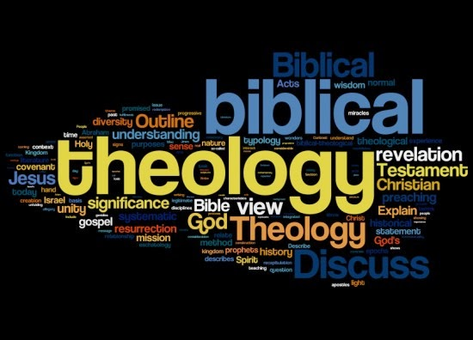

Slide 3
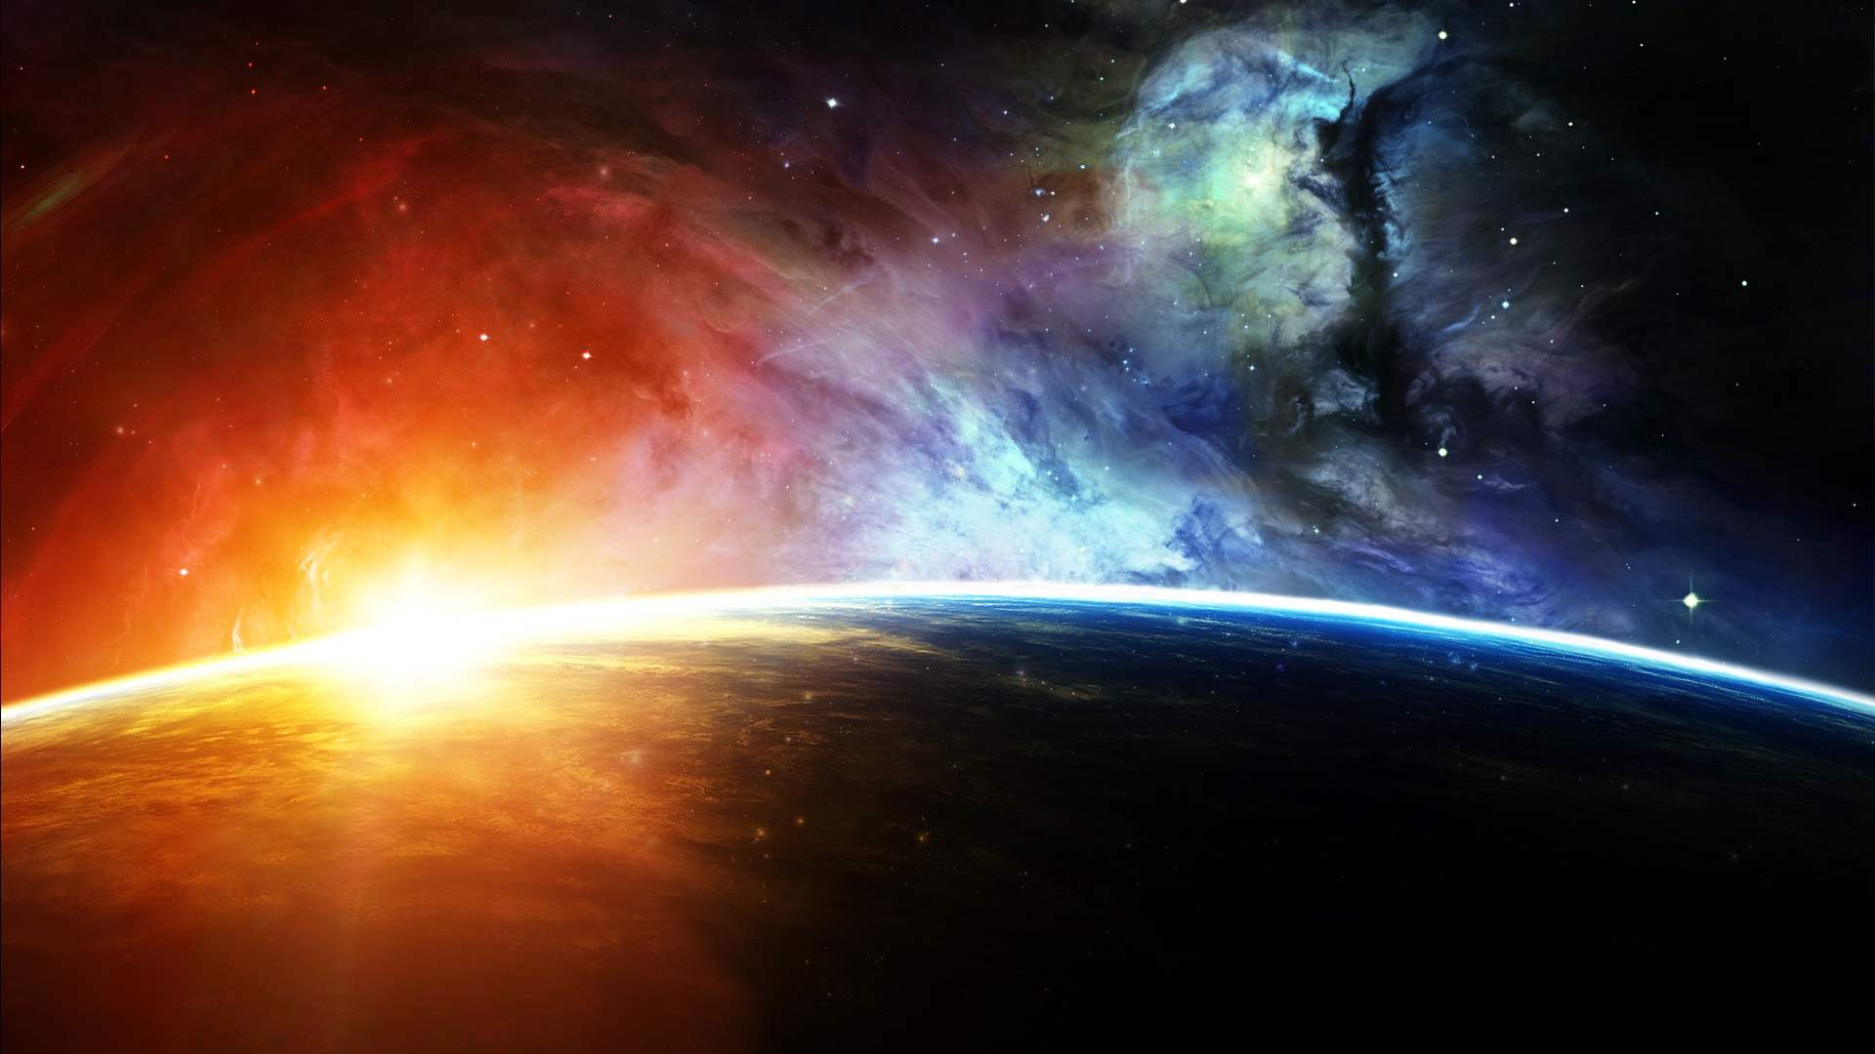
“In the beginning (TIME)
God created (ENERGY)
the heaven (SPACE)
and the earth.” (MATTER)
Gen. 1:1

Slide 4
THEOLOGY
“THEOS = “GOD”
LOGOS = “SPEECH”
(A speech or discourse about God)

Slide 5
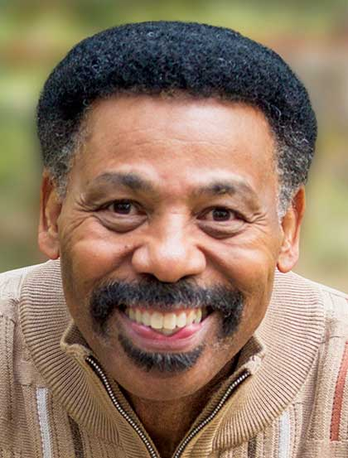
Dr. Tony Evans
No study of God can be said to be comprehensive for 3 reasons…
Limitation of the human mind.
The moral problem (sin)
A resource problem

Slide 6
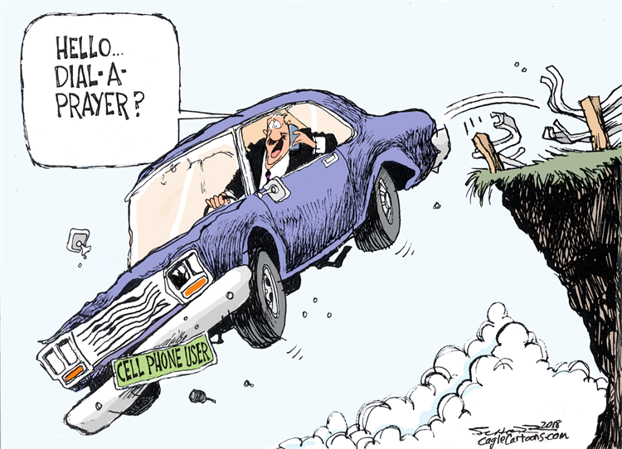
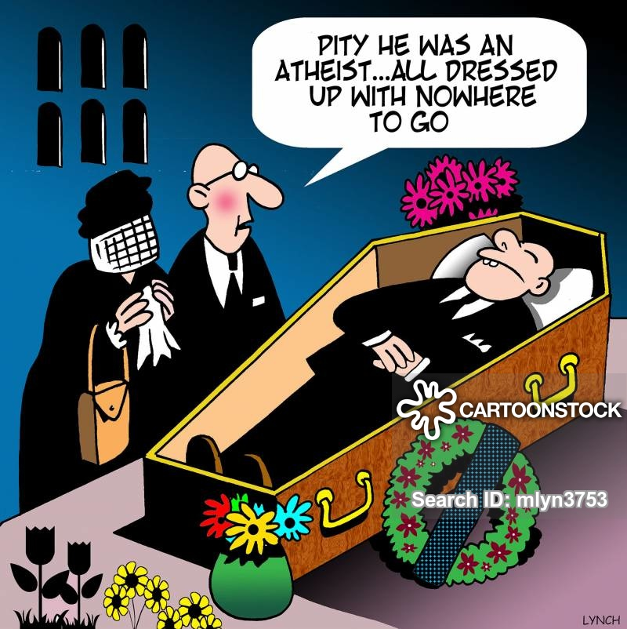

Slide 7
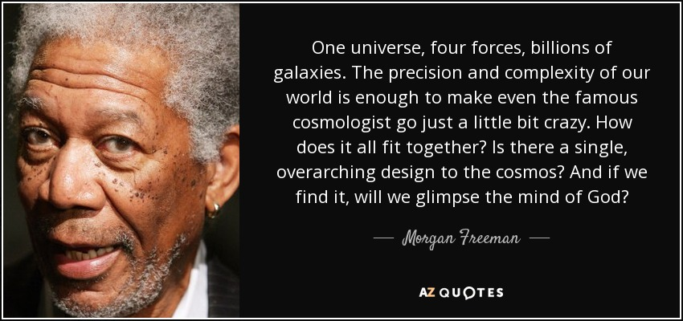
AGNOSTIC OR ATHEIST -
Movie star, actor: Mr. Morgan Freeman

Slide 8
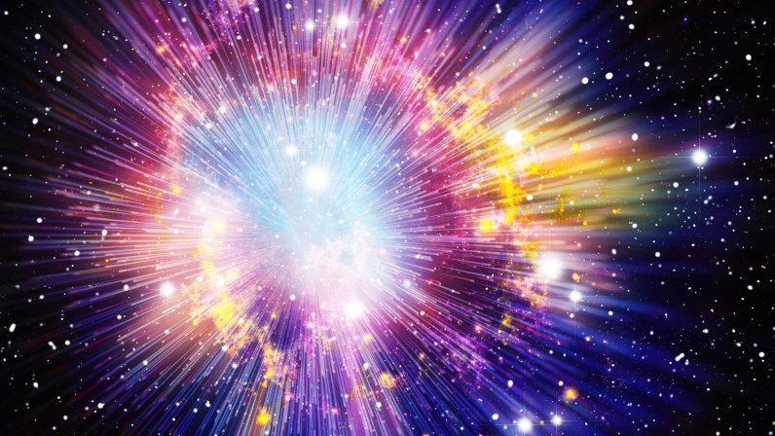
.
.
THE BIG BANG THEORY

Slide 9
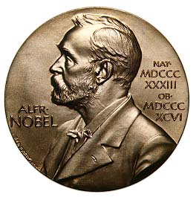
Nobel Peace Prize Winner in Science, George Wald
“When it comes to the origin of life, there are only 2 possibilities: creation and spontaneous generation (evolution).
There is no third way, spontaneous generation was disproved 100 yrs. ago, but that leads us to only one other conclusion: that of supernatural creation. We cannot accept that on philosophical grounds, therefore, we choose to believe the impossible: that life arose spontaneously by chance.”

Slide 10
GOD – A PROVABLE BEING
2 Tim. 3:16,17 MEMORIZE
Proof from Scripture
Proof from Personal Experience

Slide 11
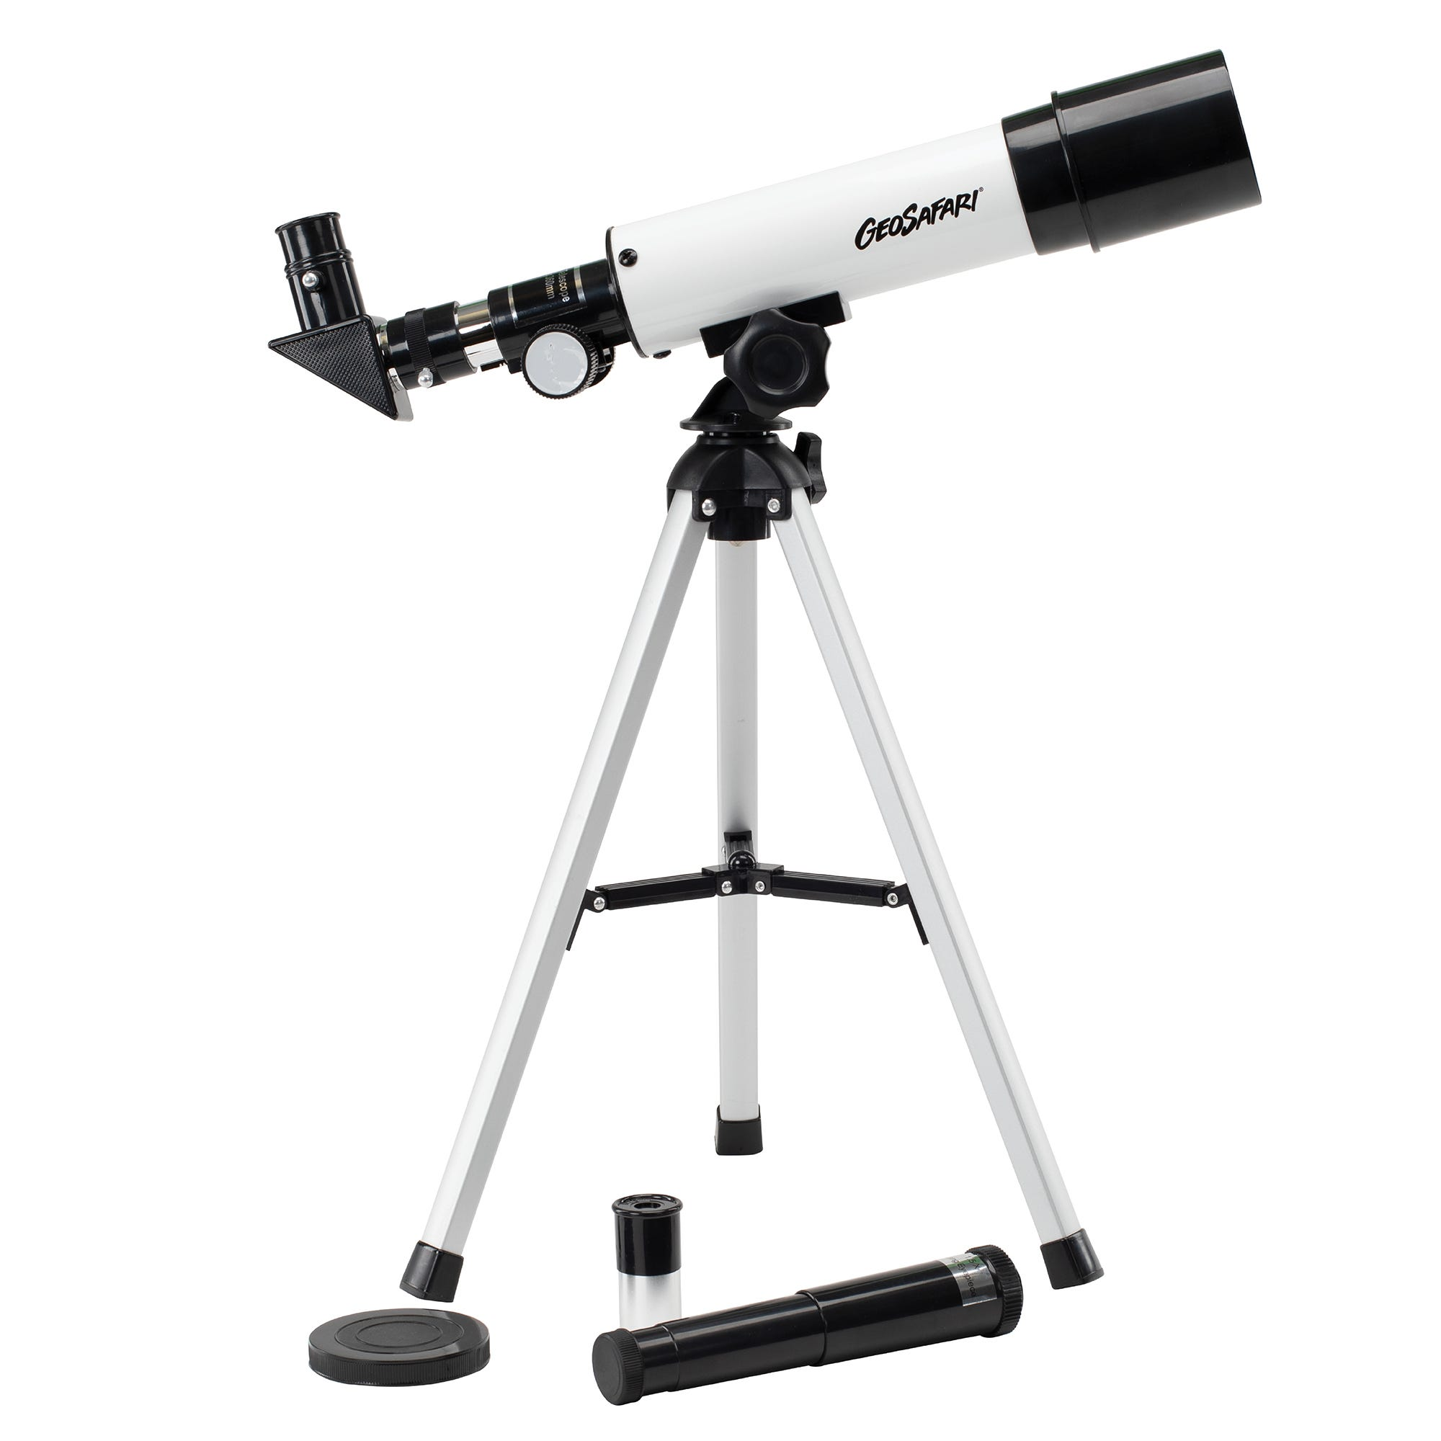
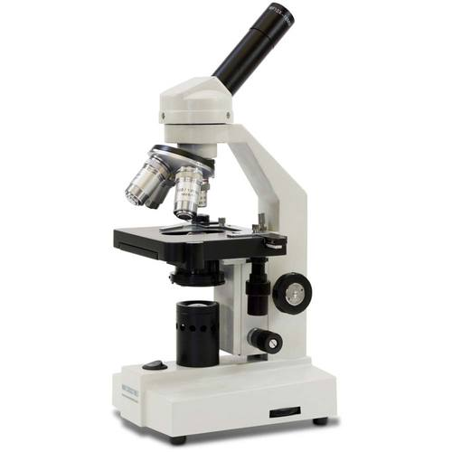
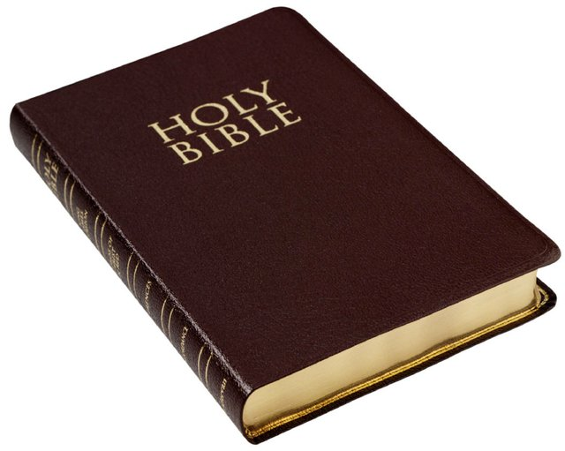
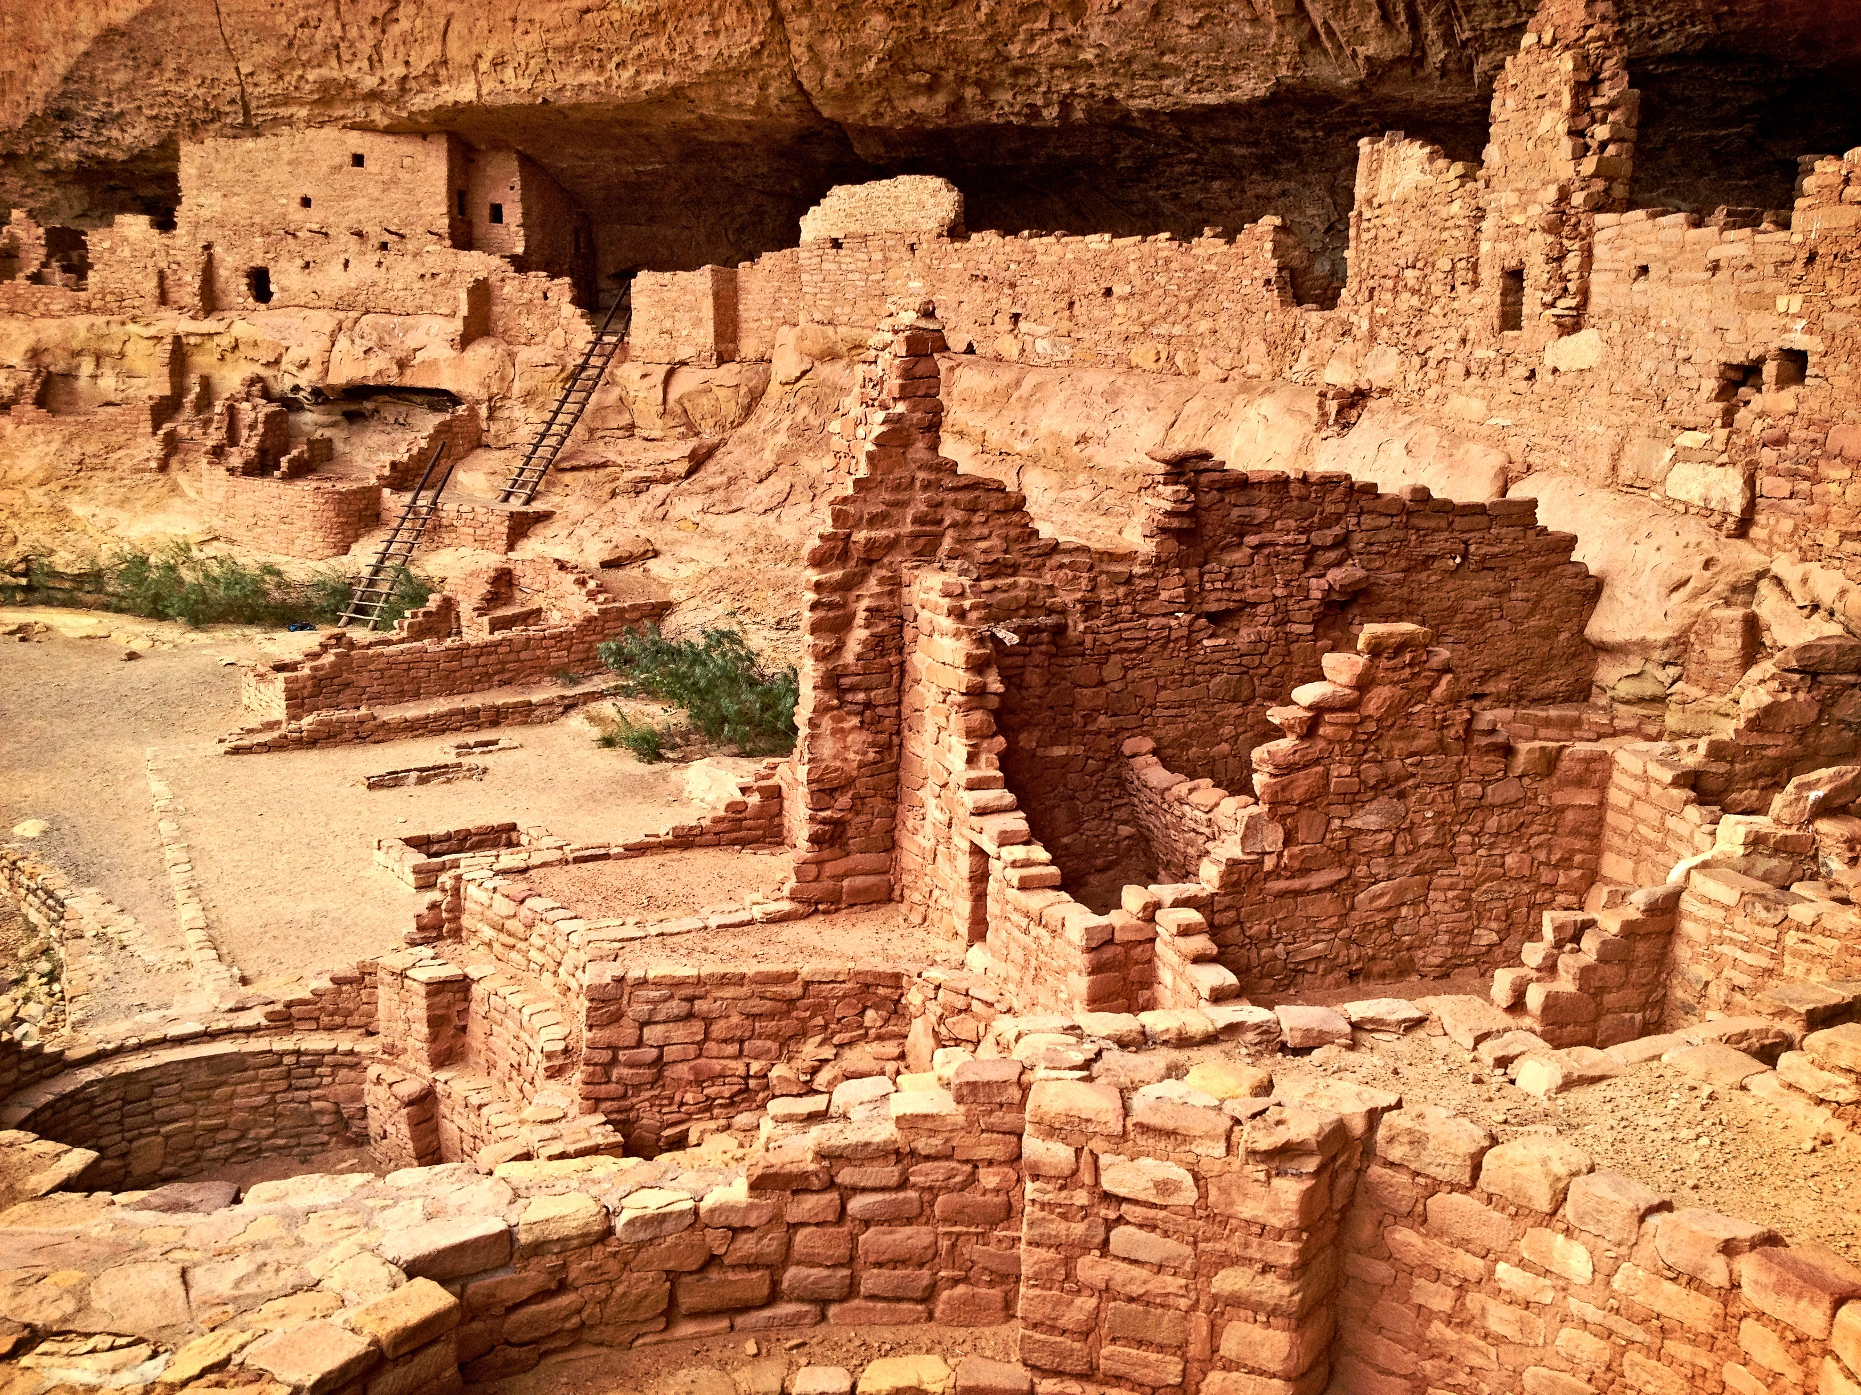
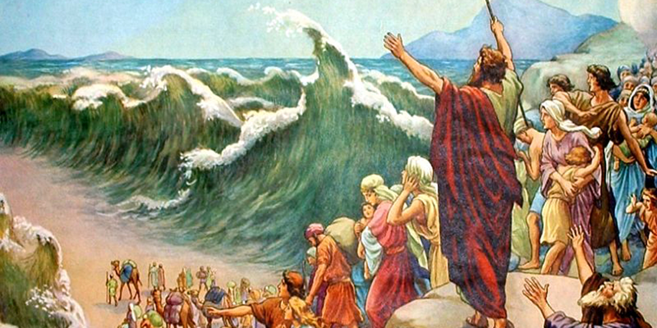
GOD – A PROVABLE BEING
Proof from Scripture

Slide 12
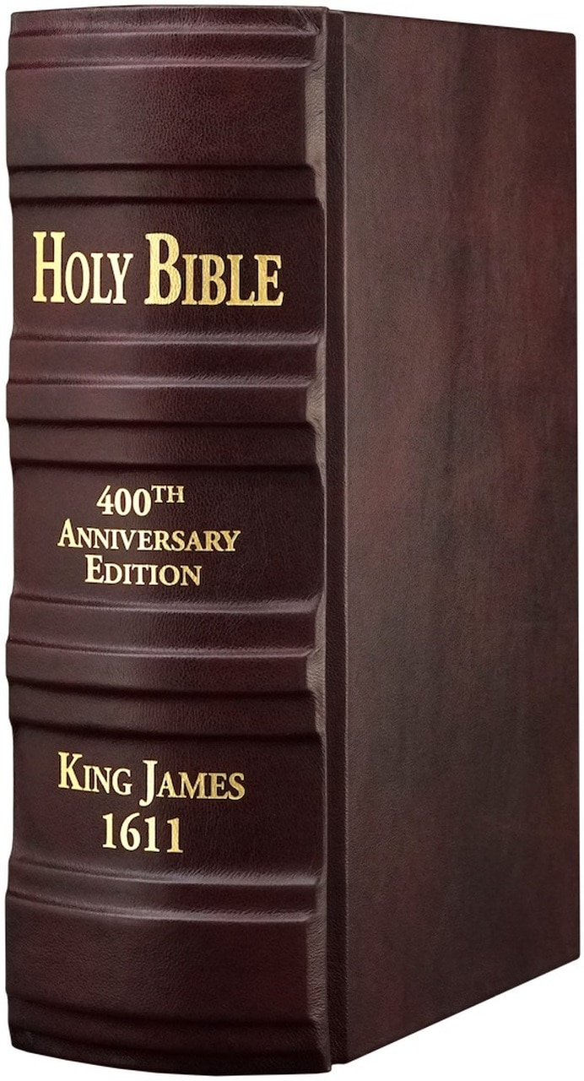
GOD – A PROVABLE BEING
Proof from Scripture
Proof from Personal Experience
Proof from Nature

Slide 13
LAWS OF THERMODYNAMICS:
The Conservation of Energy: No new energy is being created or destroyed. (Creation is an event of the past)
The Law of Entropy (decline or disorder): everything is winding down, decaying, wearing out, dying, etc.

Slide 14
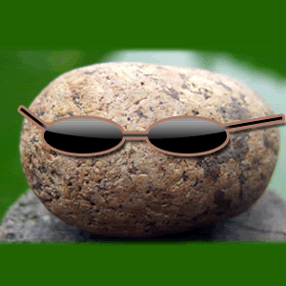
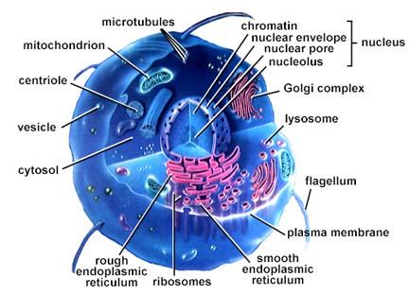

Slide 15
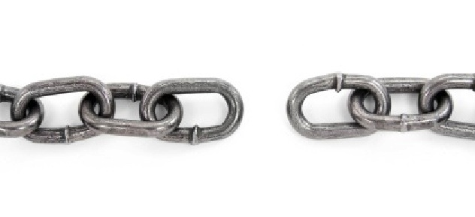
THE FIRST MISSING LINK
SPONTANEOUS GENERATION
NON-LIVING TO LIVING MATTER

Slide 16
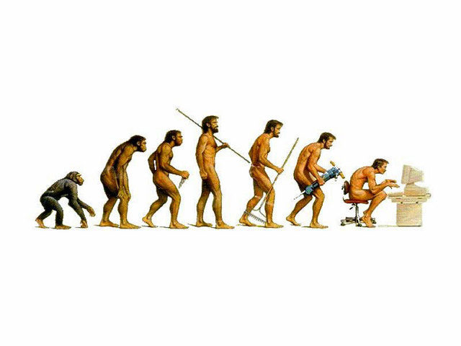
George Wald: “One has only to contemplate the magnitude of the task to concede that the spontaneous generation of a living organism is impossible. Yet here we are, as a result, I believe, of spontaneous generation…

Slide 17
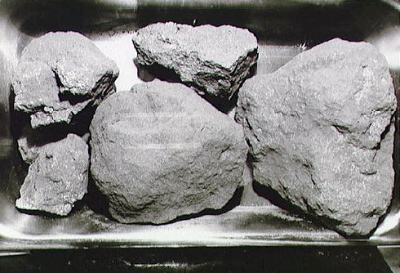
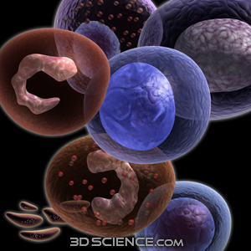
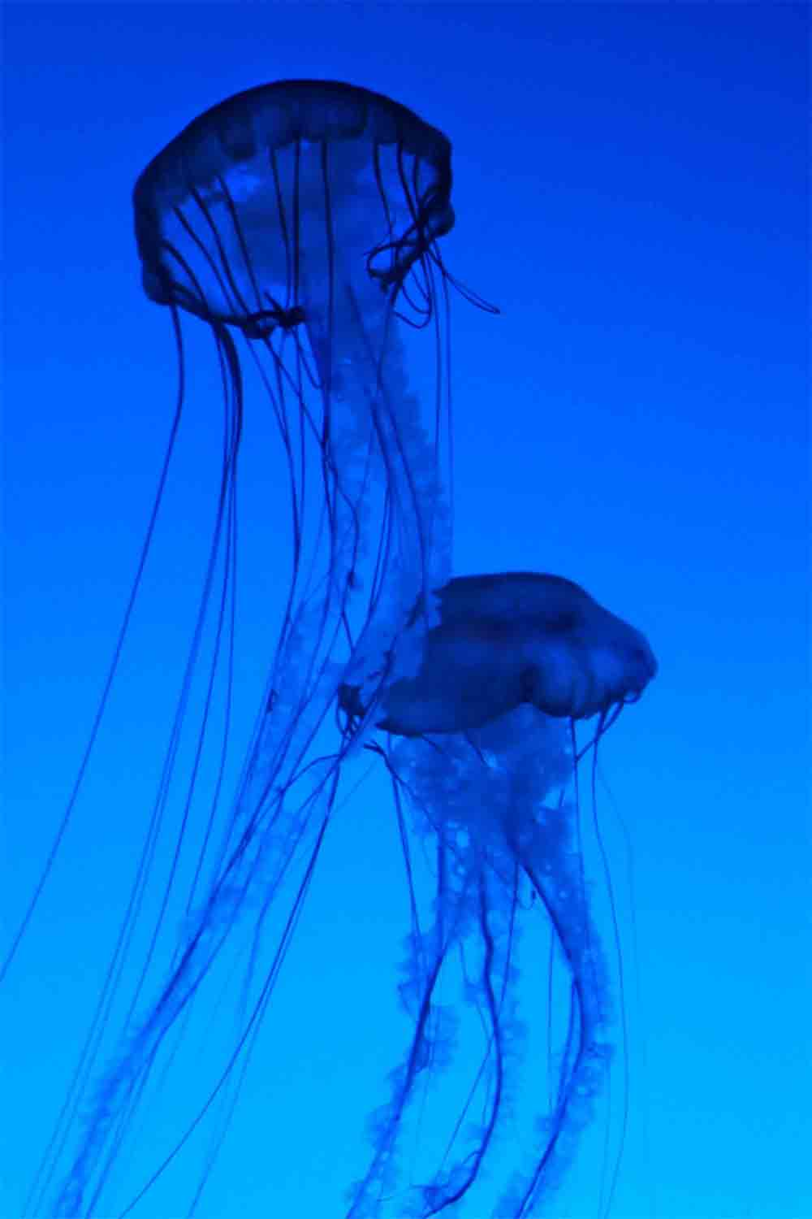
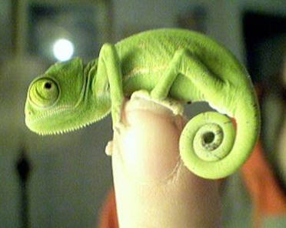
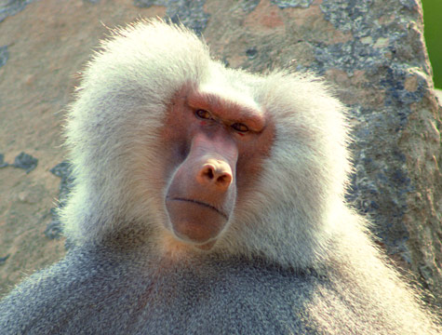
The “missing links are still missing!
Non-living to living
One-celled to multi-celled organisms
Invertebrates to vertebrates
Reptiles to birds
Primates to man

Slide 18
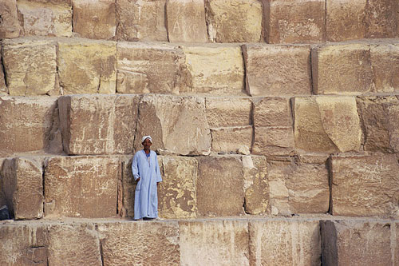
FOUNDATIONAL BELIEFS DETERMINE BASIC MORALITY:
Evolution is Degrading to Humanity
Evolution is Hostile to Reason
Evolution is Against Scripture

Slide 19
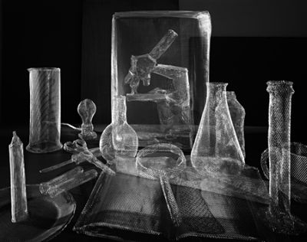
“The case for Darwinian evolution is bankrupt. The evidence for Darwinism is not only grossly inadequate, it is systematically distorted.

Slide 20
“I’m convinced that sometime in the not-to-distant future – I don’t know, maybe twenty or thirty years from now – people will look back in amazement and say:

Slide 21
‘How could anyone have believed this?’ Darwinism is merely materialistic philosophy masquerading as science, and people are recognizing it for what it is.” - IBID. pp. 65,66

Slide 22
GOD – A PROVABLE BEING
Proof from Scripture
Proof from Personal Experience
Proof from Nature
Proof from Conscience

Slide 23
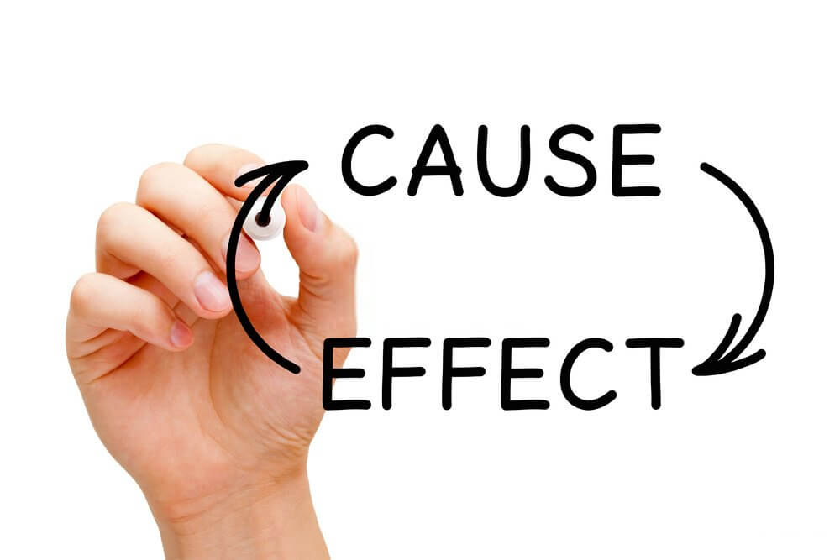
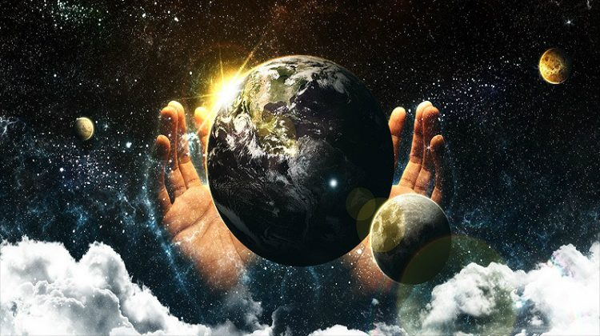
GOD – A PROVABLE BEING
Proof from Cause & Effect
(Cosmological Argument)
Proof from Life

Slide 24
John 1:18 No man hath seen God at any time; the only begotten Son, which is in the bosom of the Father, he hath declared him.
MEMORIZE
“God is not subject to the microscopic scrutiny of man, God is the subject of revelation.” - Ruckman

Slide 25
Doctrinal Statement (memorize)
In every Divine act all three members of the Godhead have a part, though not always an equal part.

Slide 26
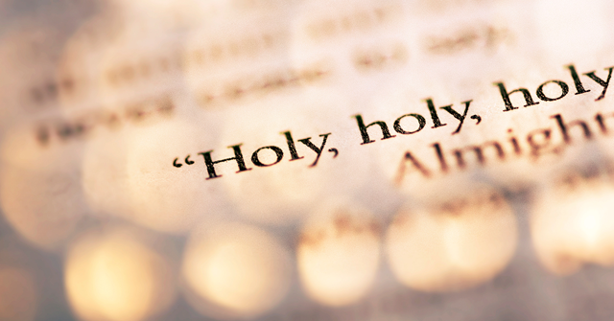
GOD – A BALANCED BEING
His Holiness
(Separates Him from His creation)

Slide 28
Isaiah 6:3 And one (saraphim) cried unto another, and said, Holy, holy, holy, is the LORD of hosts: the whole earth is full of his glory.
MEMORIZE

Slide 29
GOD – A BALANCED BEING
His Holiness
(Separates Him from His creation)
(Demands Punishment for Sin)

Slide 30
GOD – A BALANCED BEING
His Faithfulness:
(Trusted, reliable, dependable, trustworthy)
(Delivers on His promises)
[exceeding great & precious]

Slide 31
1Thes. 5:24 Faithful is he that calleth you, who also will do it.
MEMORIZE

Slide 32
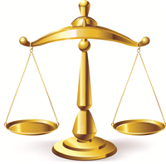
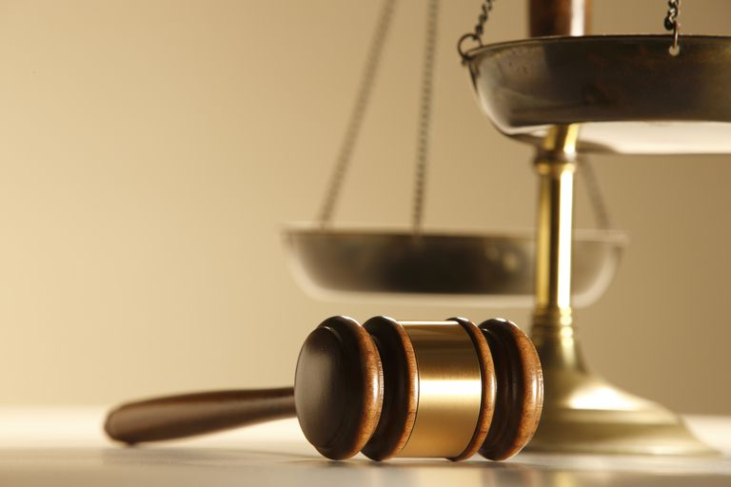
GOD – A BALANCED BEING
His Mercy:

Slide 33
Ps. 118:29 O give thanks unto the LORD; for he is good: for his mercy endureth for ever.
MEMORIZE

Slide 34
GOD – A BALANCED BEING
His Mercy:
(Contingent upon repentance)
(No mercy in Hell)
(Mercy here on just & unjust)

Slide 35
GOD – A BALANCED BEING
His Justice:
(good works for salvation is blasphemy)
(God’s Justice balances truth and
the love of God )

Slide 36
Is. 45:21b …there is no God else beside me; a just God and a Saviour; there is none beside me.
MEMORIZE

Slide 37
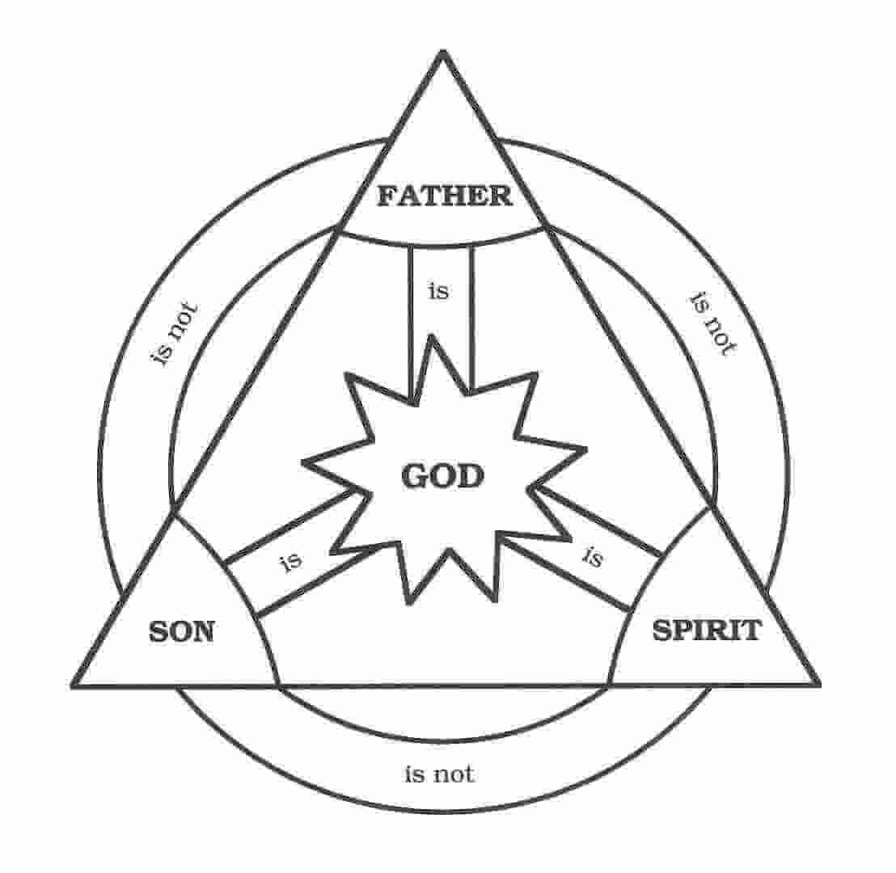
The Holy Trinity
No confusion
Absolute Balance

Slide 38
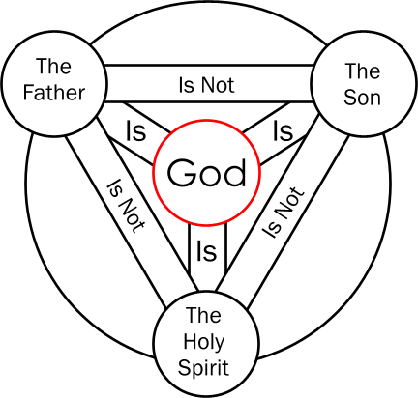
GOD – A TRIUNE BEING
The Unity and Trinity of God
UNITY – ONE GOD
TRINITY – THREE PERSONS
“Elohim” = plural noun translated “God” in KJB

Slide 39
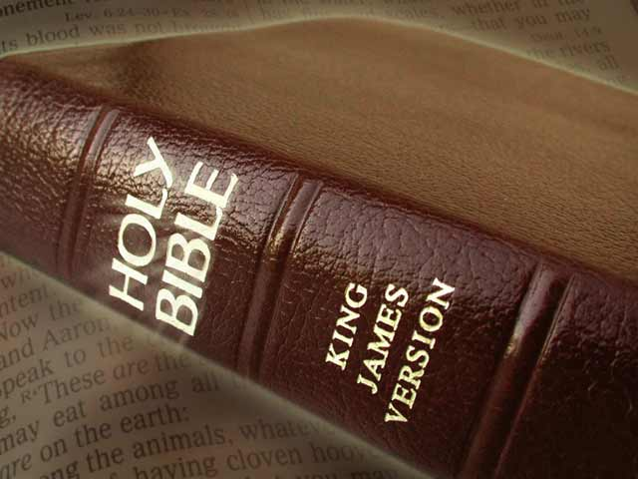
HEBREWS 4:12
MEMORIZE

Slide 40
GOD – A TRIUNE BEING
Scripture Proofs
(1 God – 3 distinct Persons)
(Many scriptural proofs)
Memorize: Mt. 28:19,
Mt. 3:16,17

Slide 41
GOD – A TRIUNE BEING
Doctrinal Statement:
By the Trinity of God is meant that He is one in being and substance, possessed of three personal distinctions, revealed to us as Father, Son and Holy Spirit.
MEMORIZE

Slide 42
GOD – A TRIUNE BEING
Scripture Proofs in N.T.:
Great Commission – Mt. 28:19
Apostolic Benediction – 2 Cor. 13:14
Jesus’ Baptism – Mt. 3:16,17
Teachings of Christ – John 14:16

Slide 43
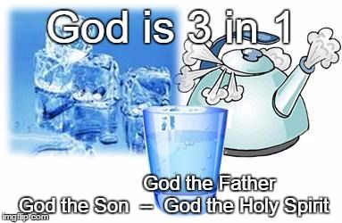

Slide 44
GOD – A TRIUNE BEING
Scripture Proofs in N.T.:
Great Commission – Mt. 28:19
Apostolic Benediction – 2 Cor. 13:14
Jesus’ Baptism – Mt. 3:16,17
Teachings of Christ – John 14:16
Paul’s Teachings – 1 Cor. 12:4-6

Slide 45
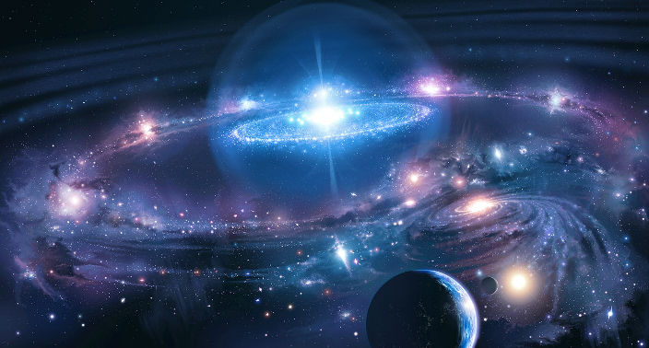
HIS CREATION: Gen. 1:1
TOTALLY AWESOME!
The Universe:
“In the beginning (time)
God created (energy)
the heaven (space)
and the earth.” (matter)
MEMORIZE

Slide 46
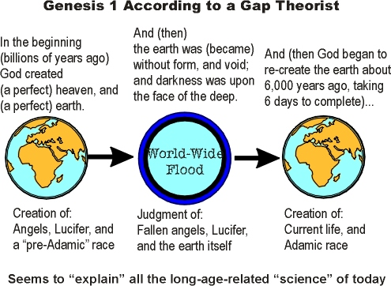

Slide 47
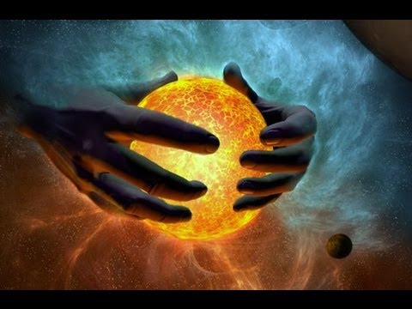
RECENT CREATION: The Bible View
Considers Genesis 1 an outline of creation:
Gen. 1:1 Introductory Sentence
Gen. 1:2 “was” not “became”
Gen. 1:3ff Details of creation
(Day 1, 2, 3 etc.)

Slide 49
The Dispensational Approach to God’s Word:
“AS” – “LIKE”
SCRIPTURE MUST BE ACCEPTED AS GOD’S WORD
SCRIPTURE MUST BE INTERPRETED LITERALLY
SCRIPTURE MUST NOT BE SPIRITUALIZED

Slide 50
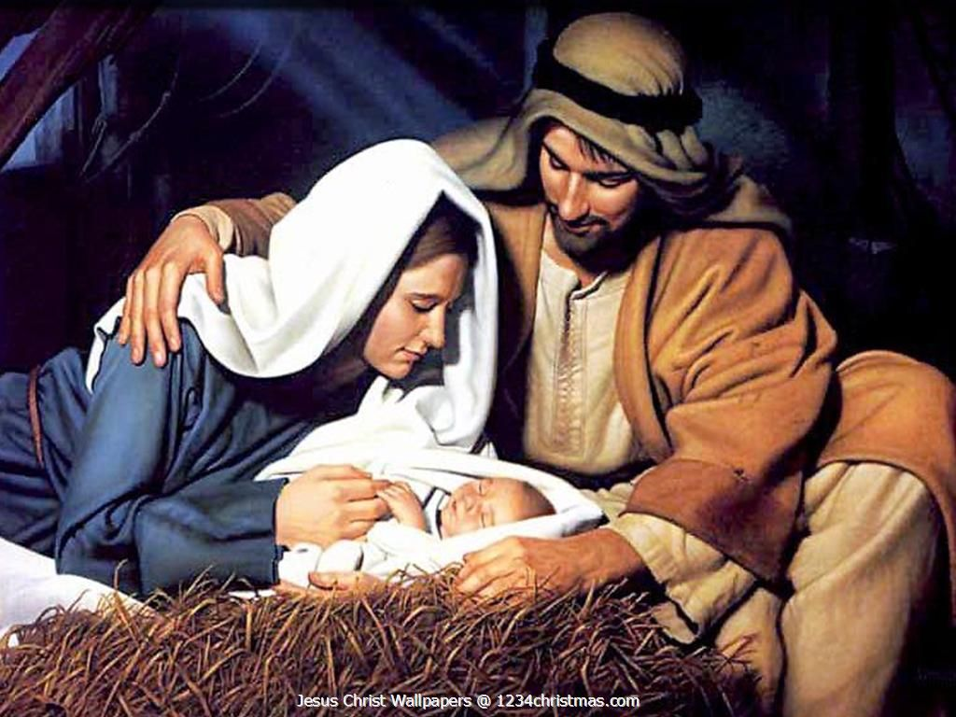
INCARNATION!
MEMORIZE: Philippians 2:5-7

Slide 51
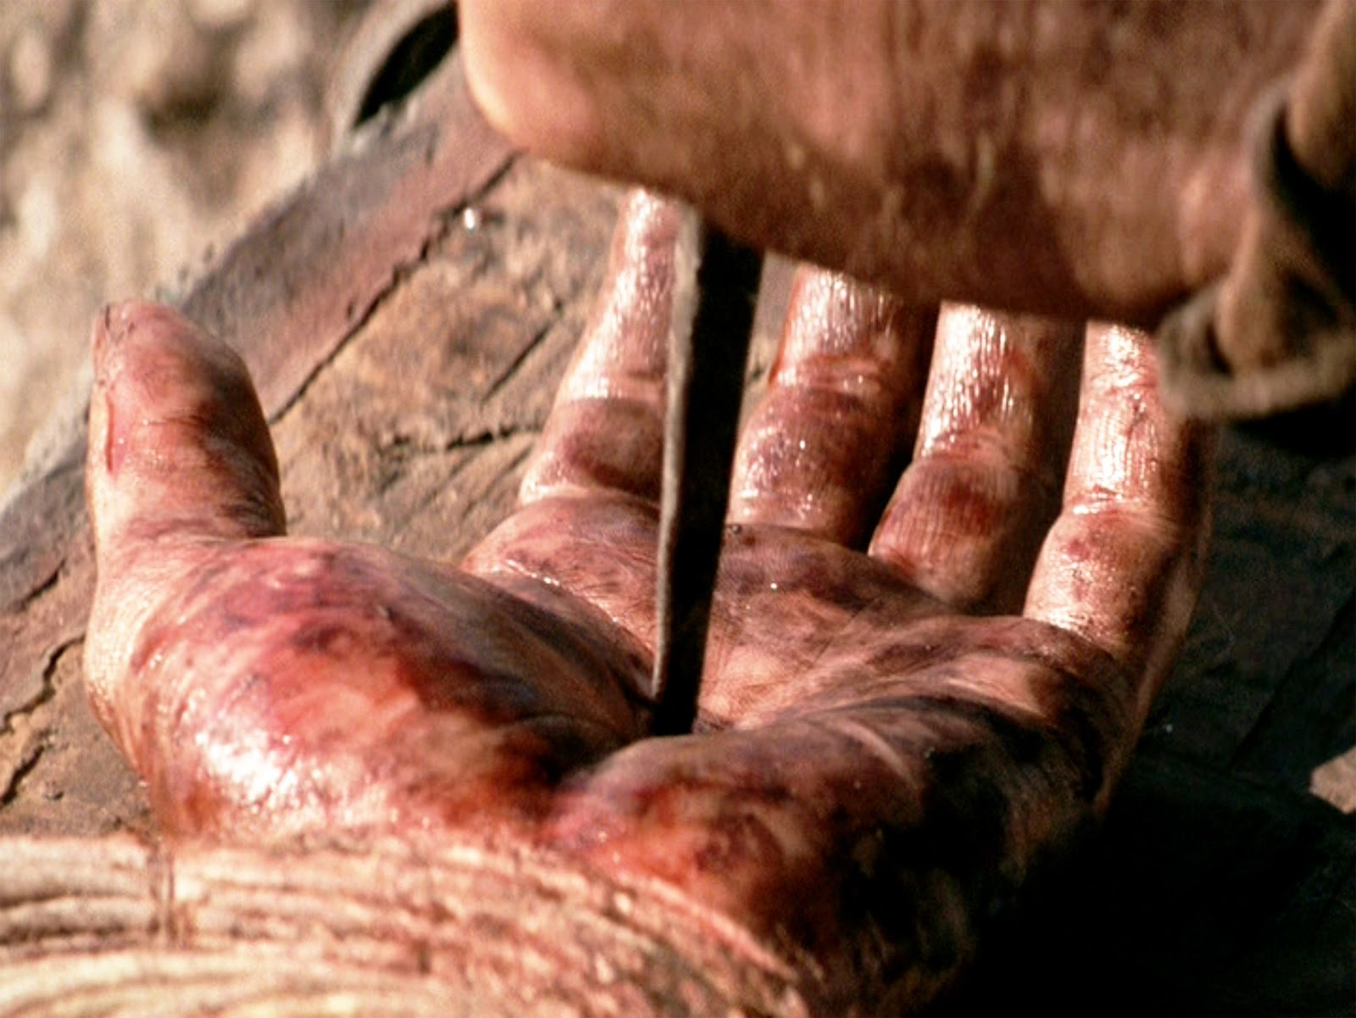
REDEMPTION
MEMORIZE: 2 Cor. 5:21

Slide 52
THE SCHOOLS OF THEOLOGY
CATHOLICISM
CONSERVATIVE PROTESTANT
REFORMED CALVINISTIC PROTESTANT (study)
ARMINIAN PROTESTANT

Slide 53
THE SCHOOLS OF THEOLOGY
LIBERAL PROTESTANT
NEO-ORTHODOX
FUNDAMENTALISM
NEO-EVANGELICALISM
BIBLE BELIEVING THEOLOGY

Slide 54
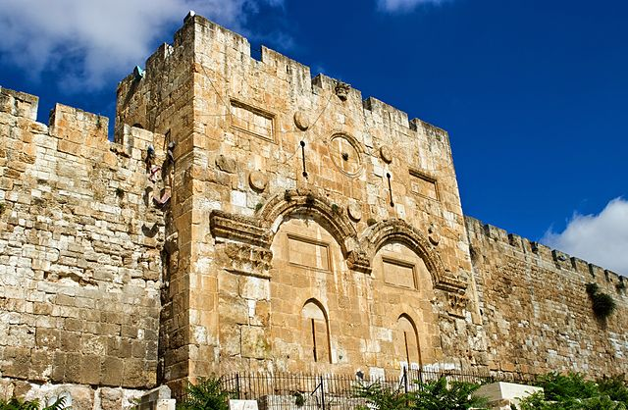
EAST GATE BAPTIST COLLEGE
Baptist Doctrine
Systematic Theology
Theology Proper
Dr. Paul C. Fedena

Slide 55
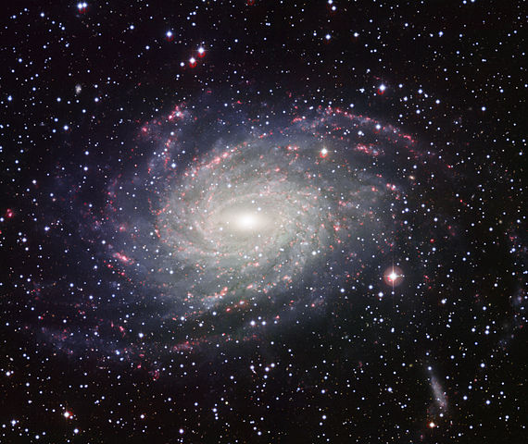
GOD – AN INFINITE BEING
His Eternality
(Unending Existence)
Memorize Rev.1:8

Slide 56
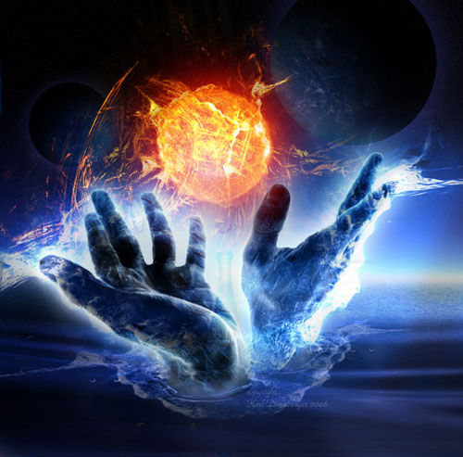
GOD – AN INFINITE BEING
His Omnipotence
(Almighty Power)
Memorize Rev. 4:11

Slide 57
GOD – AN INFINITE BEING
His Omniscience
(Absolute Knowledge)
Proverbs 15:3

Slide 58
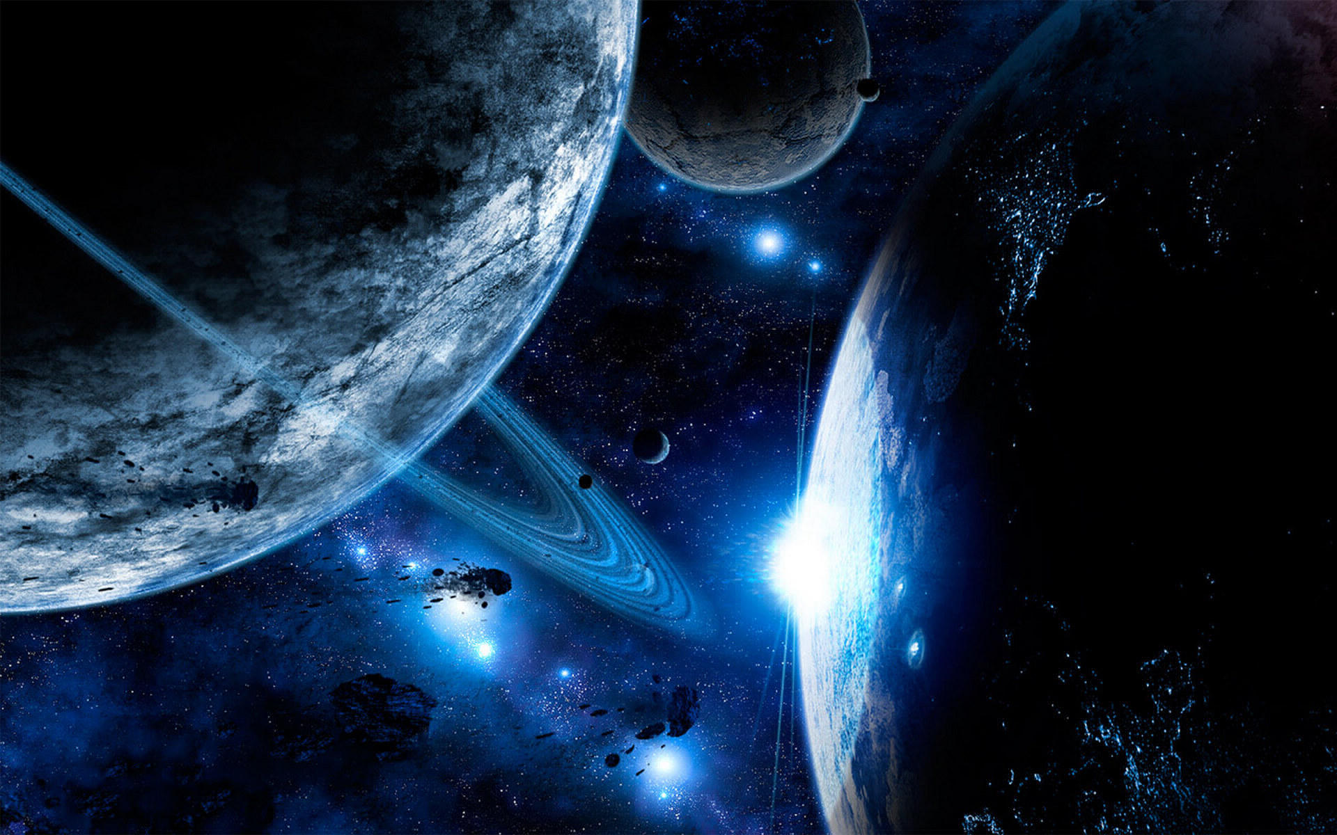
GOD – AN INFINITE BEING
His Omnipresence)
(Universal Presence)
Jeremiah 23:24

Slide 59
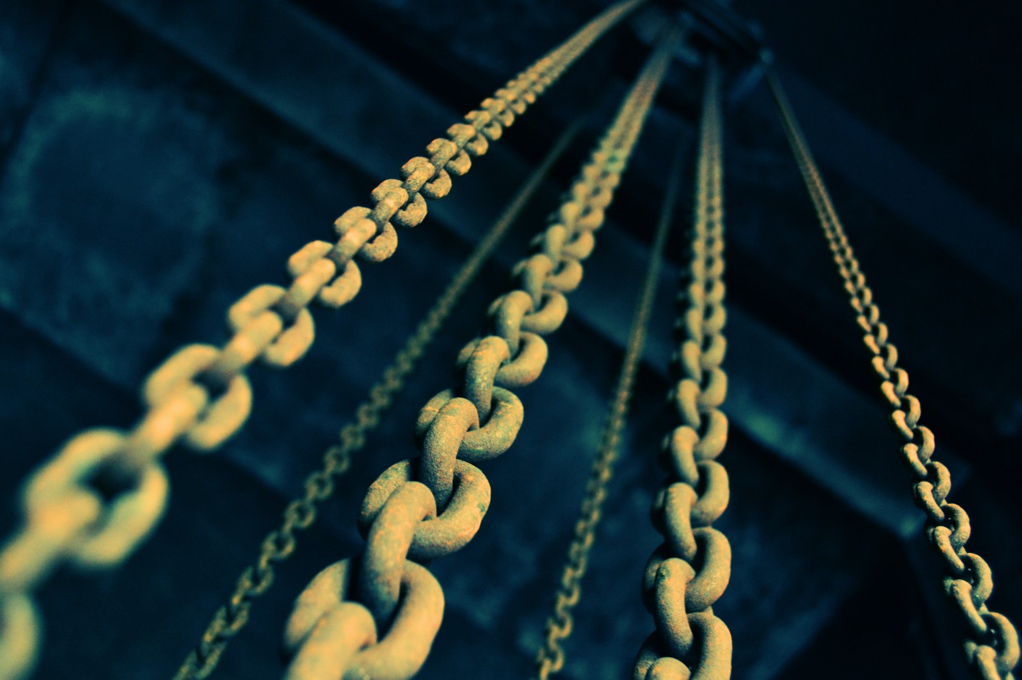
GOD – AN INFINITE BEING
His Immutability)
(Unchangeableness)
Malachi 3:6a

Slide 60
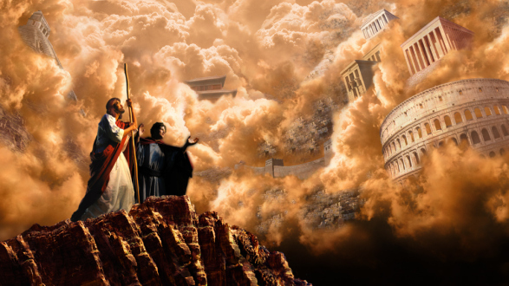
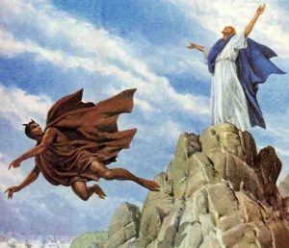
GOD – AN INFINITE BEING
His Impeccability
(Flawlessness)
James 1:13

Slide 61
GOD – AN INFINITE BEING
His Truthfulness)
(Absolute Truth)
John 14:6

Slide 62
GOD – AN INFINITE BEING
His Unity)
(Total Oneness)
Deut. 6:4

Slide 63
GOD – AN INFINITE BEING
His Glory
(Total Majesty)
2 Peter 1:16

Slide 64
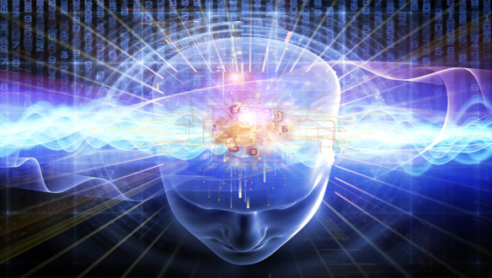
GOD – AN INFINITE BEING
His Transcendence:
(Distinct from His Creation)
Romans 11:33

Slide 65
Romans 11:33 O the depth of the riches both of the wisdom and knowledge of God! how unsearchable are his judgments, and his ways past finding out!
TOTALLY AWESOME!

Slide 66
Dr. Tony Evans
GOD IS!
“There is only one true God, not the god of this or that religion. You are either related to the one true God, Who is transcendent, spirit, eternal and immutable, or to no god.”

Slide 67
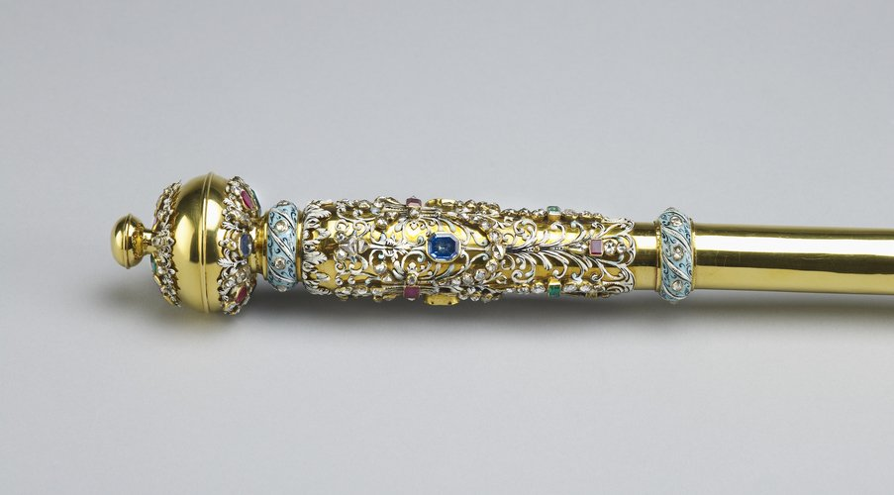
GOD – AN INFINITE BEING
His Sovereignty)
(Absolute Authority)
Memorize Deut. 55:8,9

Slide 68
God’s sovereignty means that though He allows and permits alternate choices among men, He will ultimately achieve His intended purpose; His will cannot ultimately be thwarted because He is God.

Slide 69
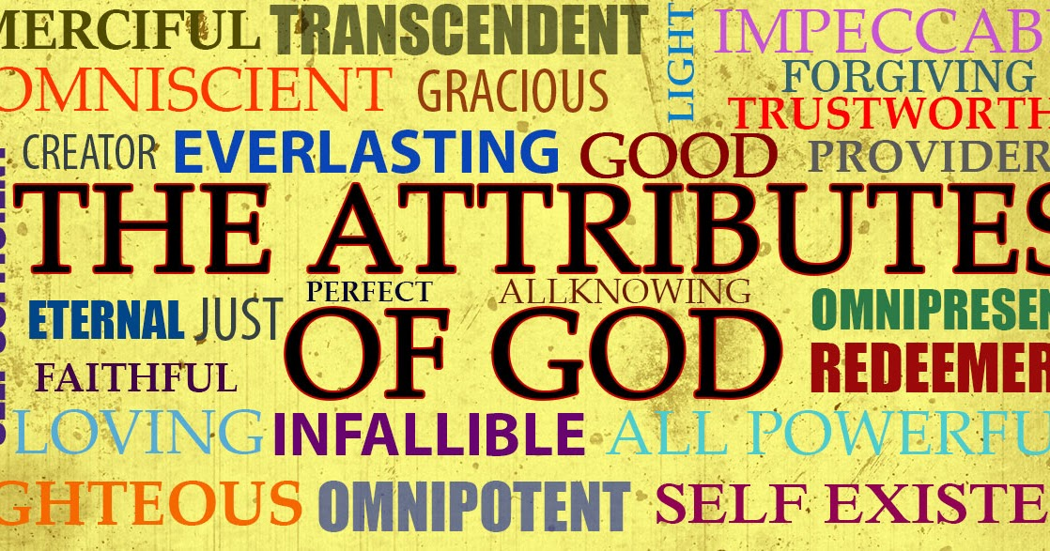

Slide 70
His Non-Communicable Attributes or Characteristics
NEXT…
His Communicable Attributes
(We can be like Him!)

Slide 71
HOW CAN WE BE LIKE GOD?

Slide 72
GOD’S COMMUNICABLE ATTRIBUTES:
His Holiness
(Absolute Purity)
1 Peter 1:16

Slide 73
GOD’S COMMUNICABLE ATTRIBUTES:
His Righteousness
(Absolute or Positive Goodness)
2 Cor. 5:21

Slide 74
GOD’S COMMUNICABLE ATTRIBUTES:
His Mercy
(Ultimate Compassion)
Luke 6:36

Slide 75
GOD’S COMMUNICABLE ATTRIBUTES:
His Jealousy
(Intolerance of Idolatry)

Slide 76
Num. 5:29 This is the law of jealousies, when a wife goeth aside to another instead of her husband, and is defiled; 30 Or when the spirit of jealousy cometh upon him, and he be jealous over his wife, and shall set the woman before the LORD, and the priest shall execute upon her all this law.

Slide 77
GOD’S COMMUNICABLE ATTRIBUTES:
His Love
(Boundless Affection)
John 3:16

