Slide 1
…and more!

Slide 2
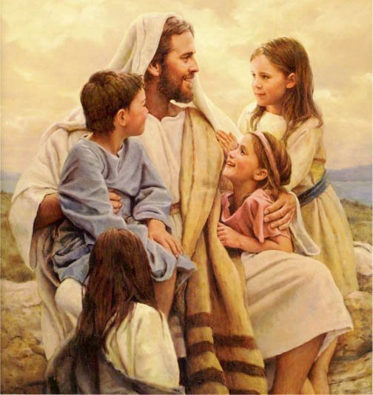
“And they brought young children to Him, that He should touch them…” Mark 10:13

Slide 3
TELL ME AND I’LL FORGET,
SHOW ME AND I MIGHT REMEMBER,
INVOLVE ME AND I’LL UNDERSTAND!

Slide 4
SIGHT:
The Meeting Place
The Medium

Slide 5
SOUND:
The Message
(thesis/subject)
The Mastery
(master the medium)

Slide 6
“In the beginning…”

Slide 7
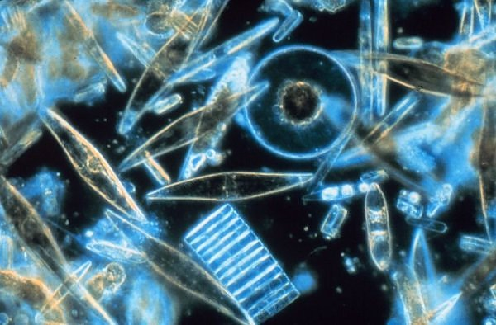

Slide 8
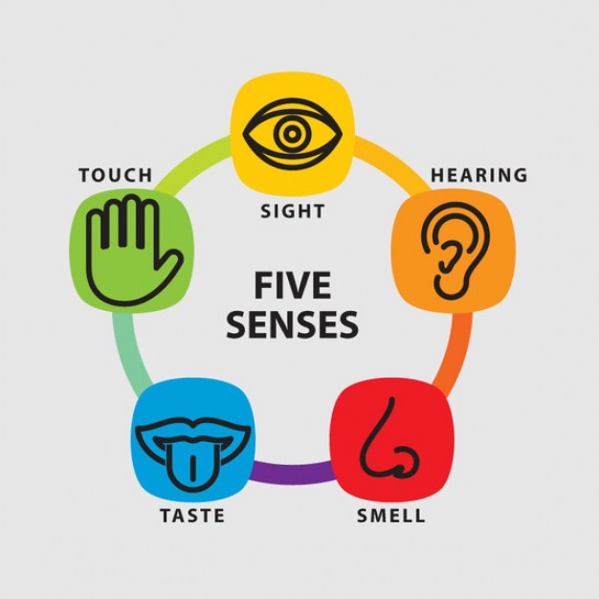

Slide 9
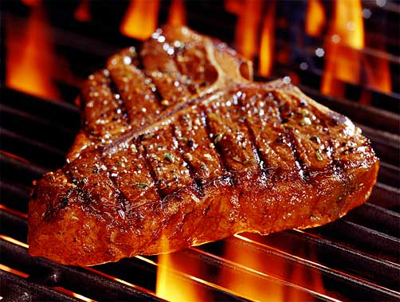
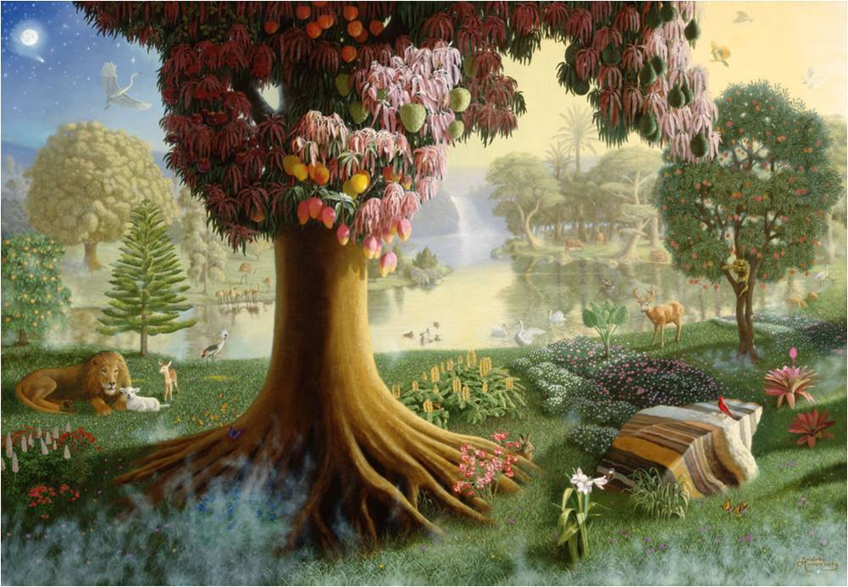

Slide 10
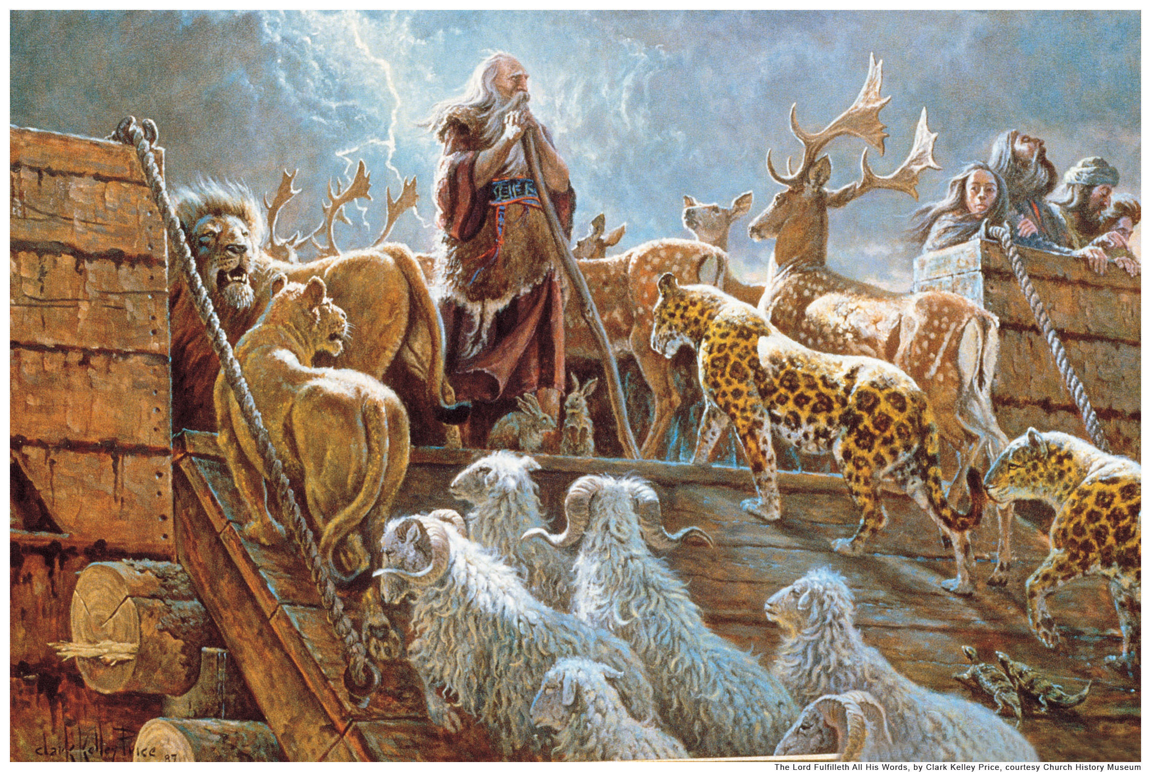

Slide 11
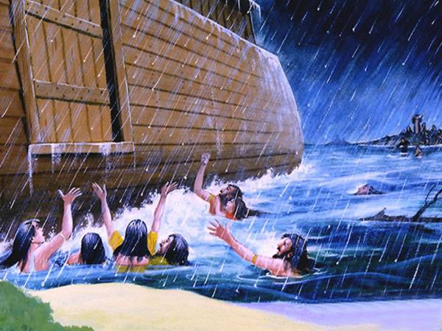
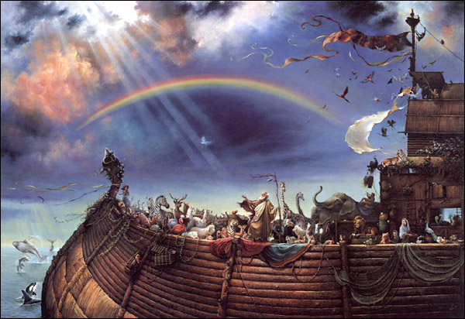
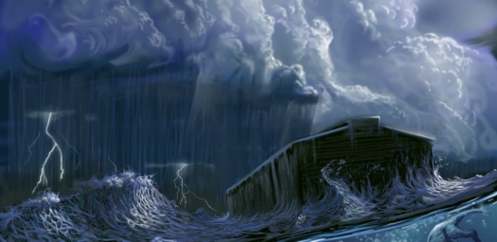

Slide 12
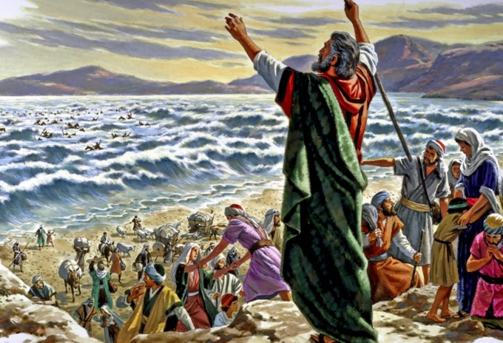
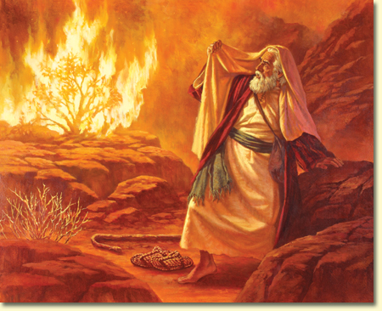
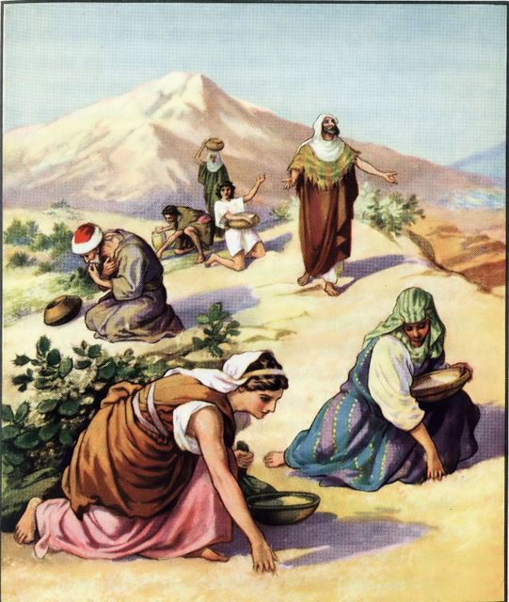
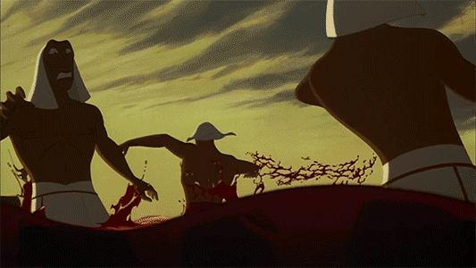

Slide 13
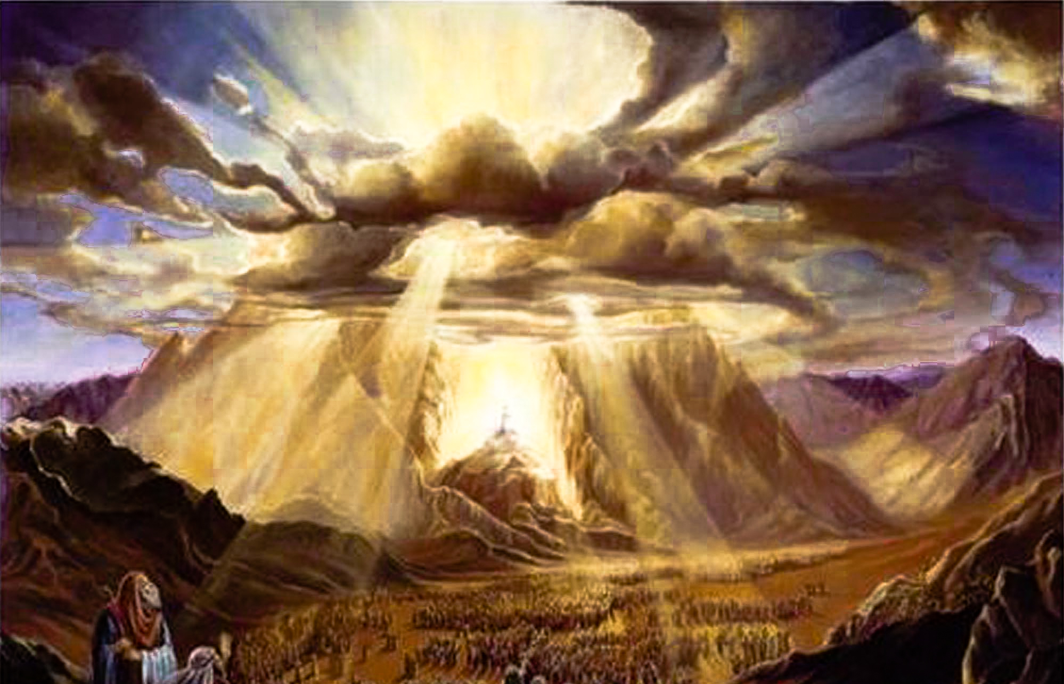
“…THUNDERS AND LIGHTNINGS, AND A THICK CLOUD…AND THE VOICE OF A TRUMPET EXCEEDING LOUD…SMOKE…FIRE…THE WHOLE MOUNT QUAKED GREATLY…” Ex.19:16,17

Slide 14
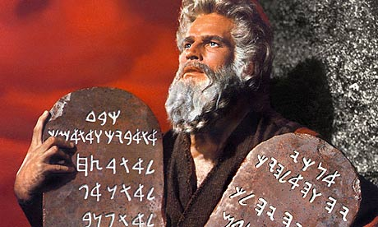

Slide 15
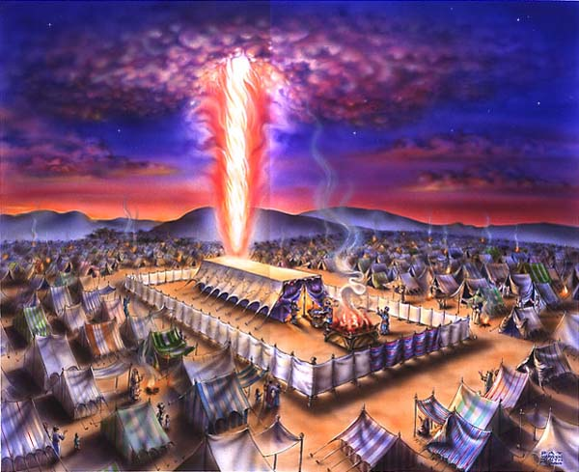
50 chapters

Slide 16
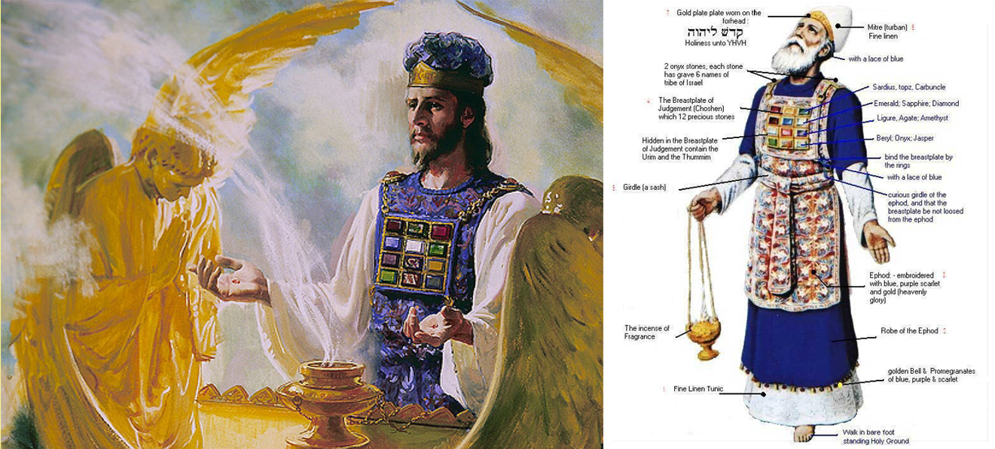

Slide 17
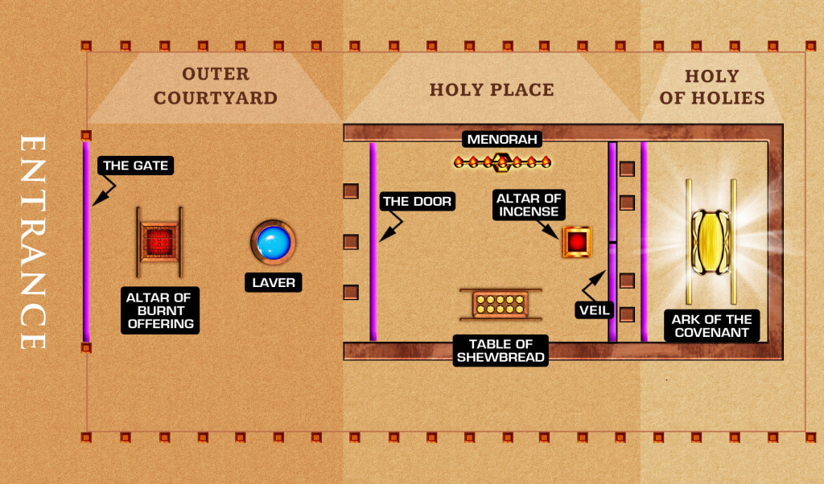

Slide 18
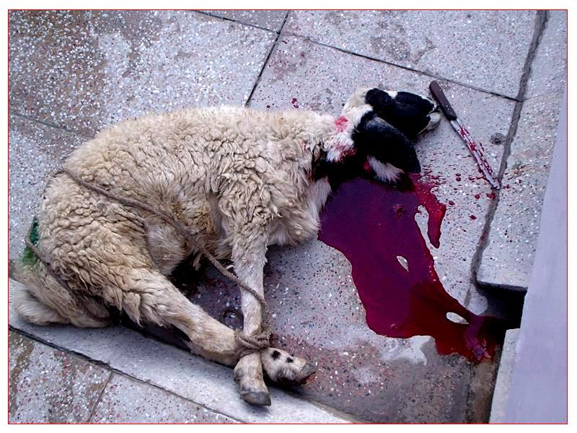

Slide 19
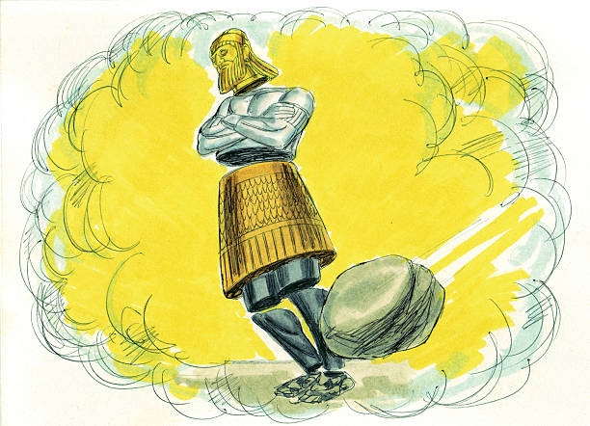
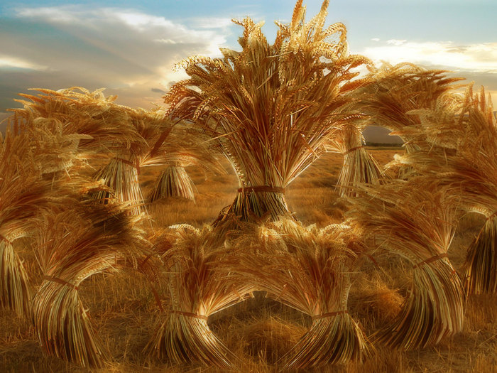
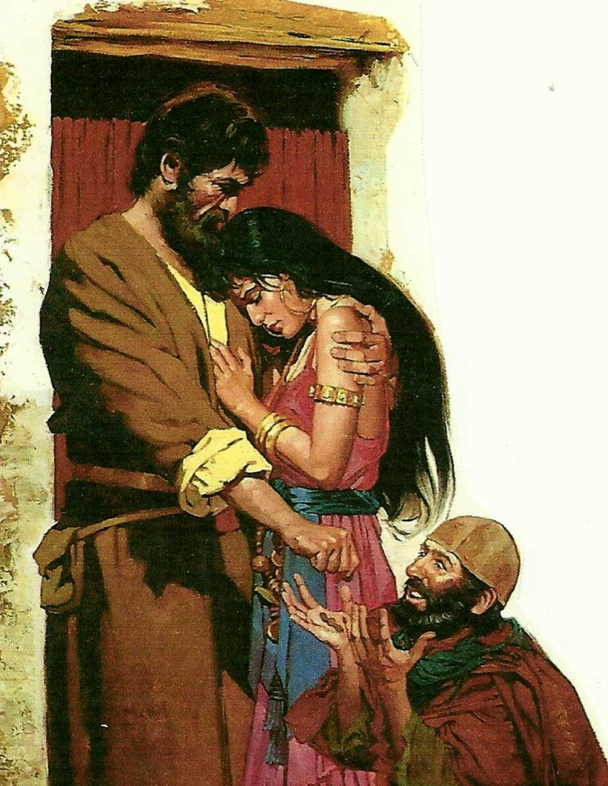
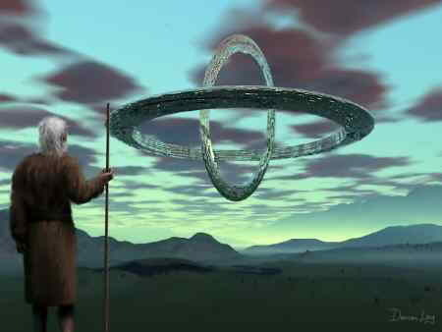

Slide 20
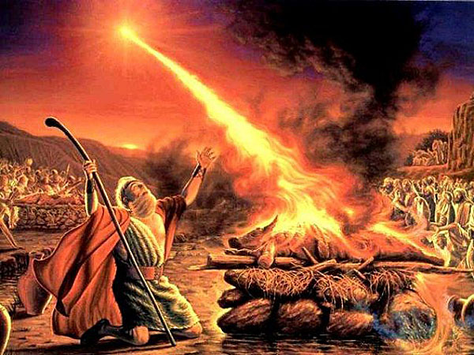

Slide 21
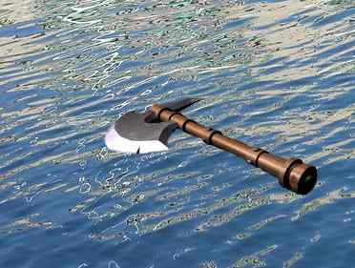

Slide 22
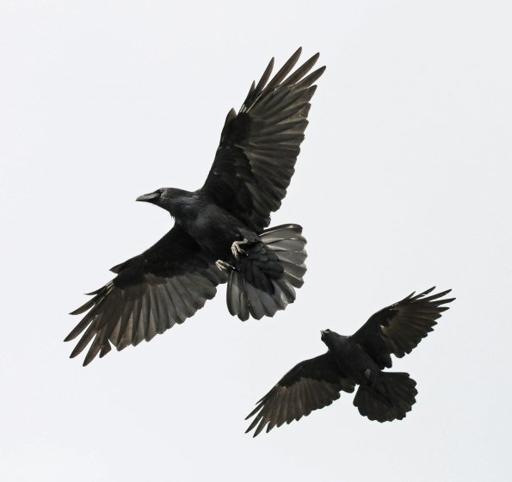
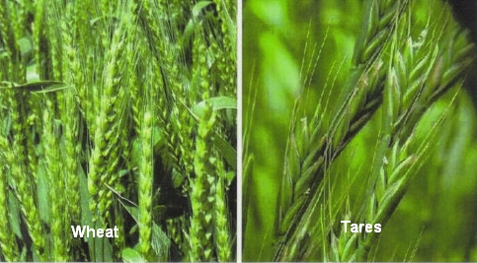
(46)

Slide 23
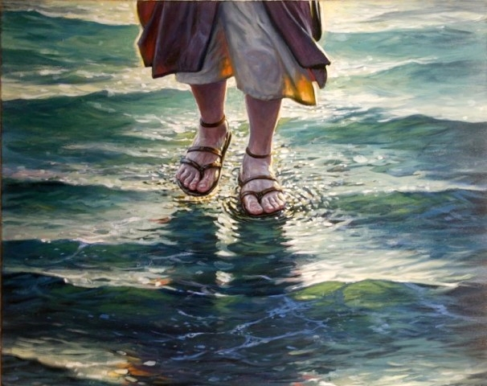
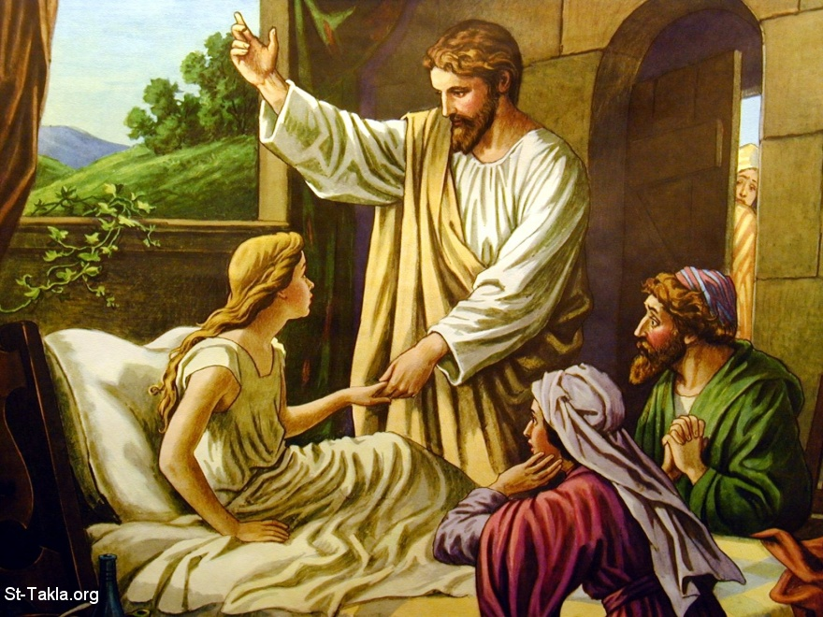
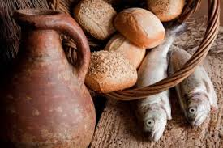
34+

Slide 24
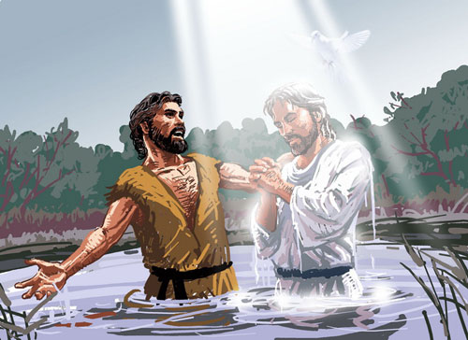
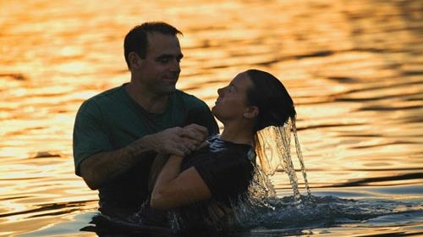

Slide 26
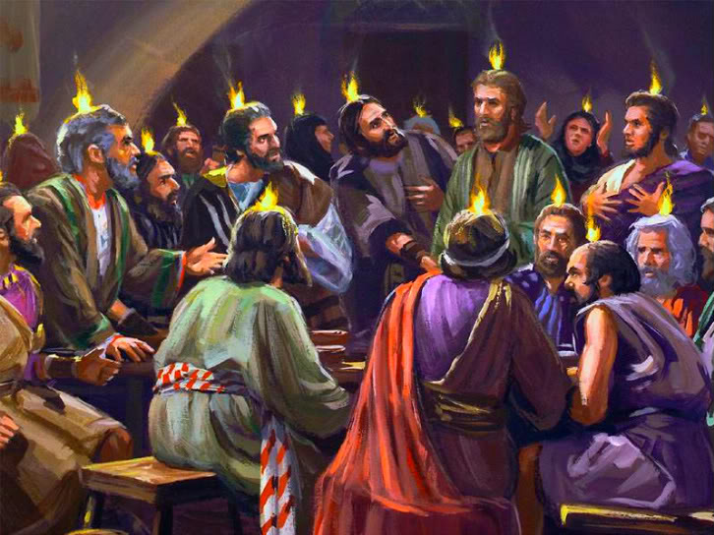

Slide 27
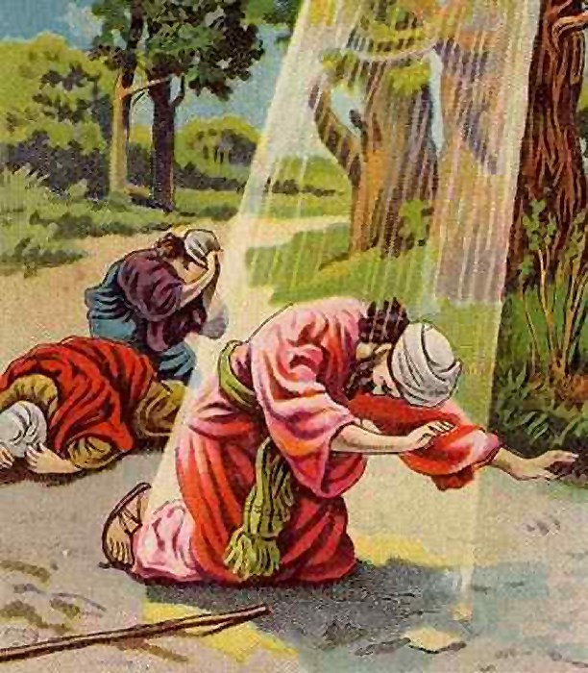
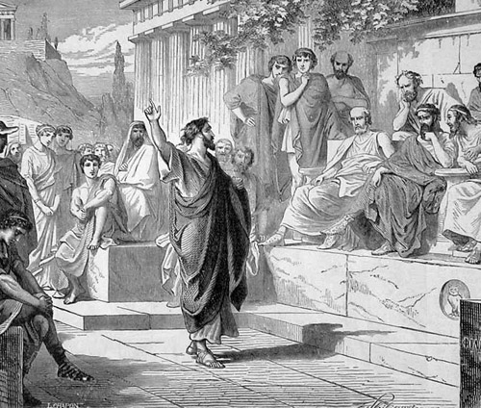
“to the unknown god…”

Slide 28
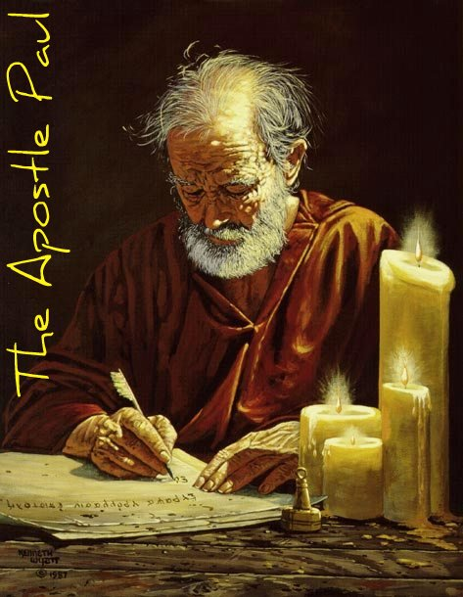
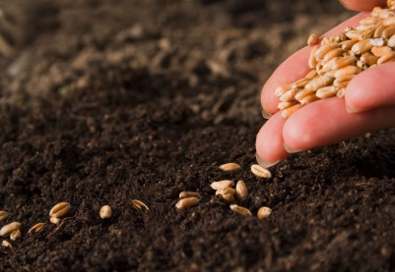
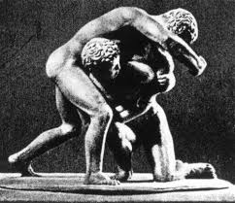
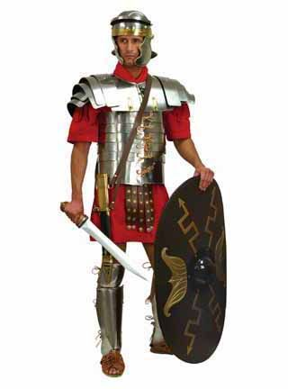
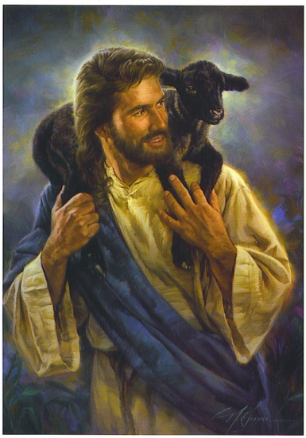
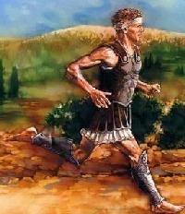

Slide 29
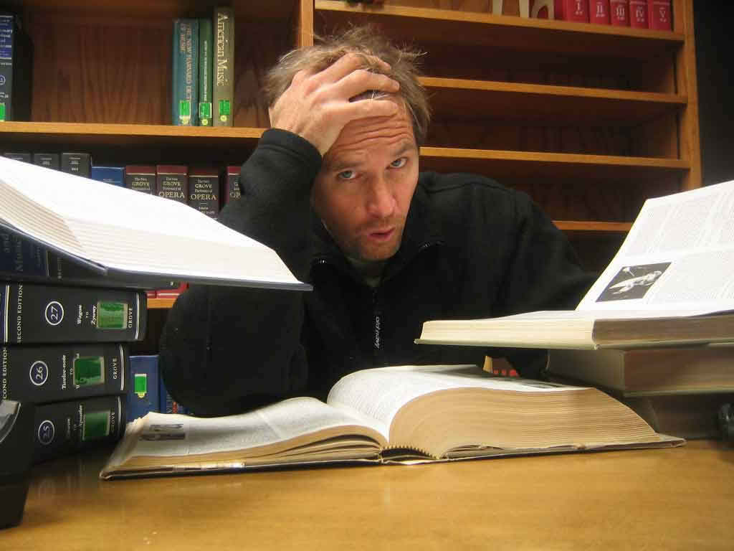
PREPARATION
TIME

Slide 30
TECHNOLOGY- GOOD OR BAD?

Slide 31
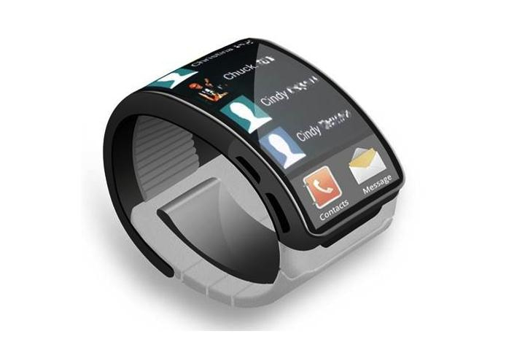
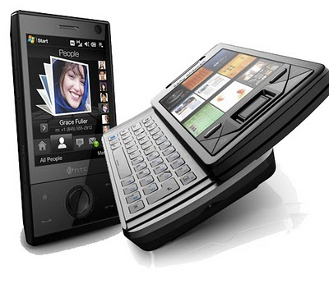
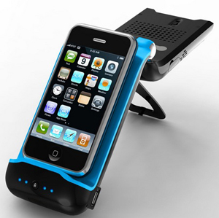
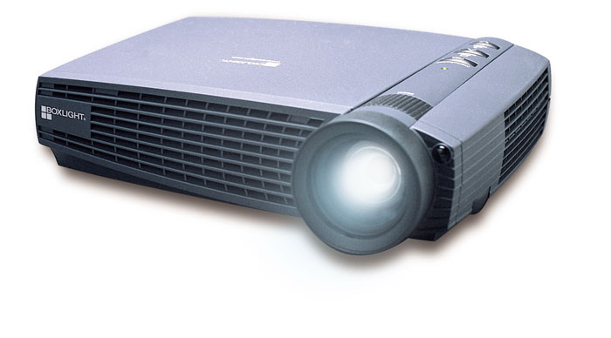

Slide 32
TO BE THE BEST TEACHER/ PREACHER POSSIBLE
YOUR (OUR)
JOB IS TO:
EVANGELIZE,ENGAGE,
ENLIST,
EXCITE, AND
ENCOURAGE!

Slide 33
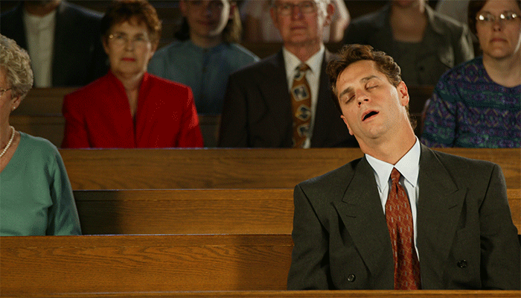
CHANGE THIS…

Slide 34
…INTO THIS!

Slide 36
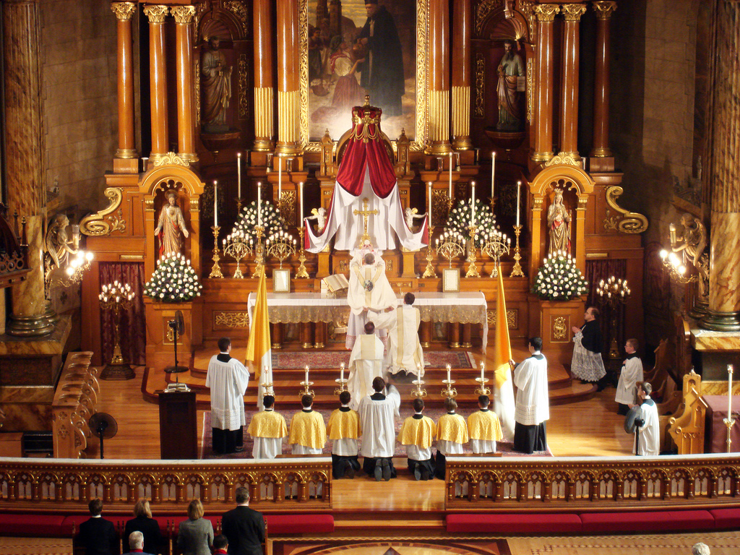
Liturgical churches use as many visual, audio, and tactile stimuli as possible…

Slide 37
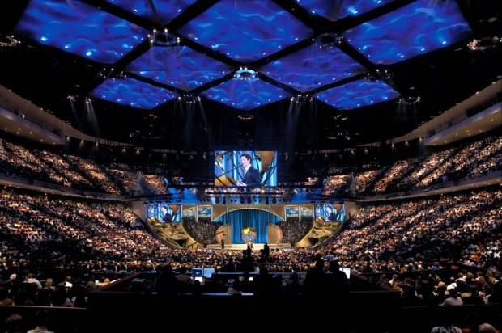
THE MEGA-CHURCHES USE AS MANY OF THE SENSES AS POSSIBLE TO ENGAGE EXCITE AND CHALLENGE PEOPLE.
WE MUST NOT CHANGE OUR THEOLOGY, BUT WE MAY NEED TO CHANGE OUR METHODOLOGY!

Slide 38
…and more!

