Slide 1
MARRIAGE SEMINAR
“till death do us part”

Slide 2
MARRIAGE SEMINAR
“till death do us part”

Slide 3
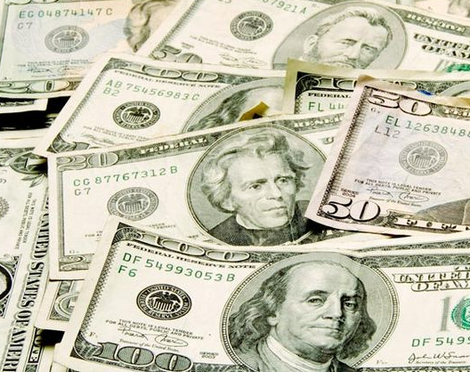
$HEKEL$
“Ye cannot serve God and mammon*”
(*money or riches)

Slide 4
Mt. 6:19 Lay not up for yourselves treasures upon earth, where moth and rust doth corrupt, and where thieves break through and steal: 20 But lay up for yourselves treasures in heaven, where neither moth nor rust doth corrupt, and where thieves do not break through nor steal: 24 No man can serve two masters: for either he will hate the one, and love the other; or else he will hold to the one, and despise the other. Ye cannot serve God and mammon. 25 Therefore I say unto you, Take no thought for your life, what ye shall eat, or what ye shall drink; nor yet for your body, what ye shall put on. Is not the life more than meat, and the body than raiment

Slide 5
26 Behold the fowls of the air: for they sow not, neither do they reap, nor gather into barns; yet your heavenly Father feedeth them. Are ye not much better than they? 27 Which of you by taking thought can add one cubit unto his stature for your heavenly Father knoweth that ye have need of all these things . 33 But seek ye first the kingdom of God, and his righteousness; and all these things shall be added unto you. 34 Take therefore no thought for the morrow: for the morrow shall take thought for the things of itself. Sufficient unto the day is the evil thereof.

Slide 6
The husband controls the money (budget)
This doesn’t mean that he has to spend the money…

Slide 7
The husband controls the money (budget)
It does mean that he must be aware of every expenditure…

Slide 8
May the wife work outside the home?
What is the “ideal” wife & mother?

Slide 9
Prov. 31:13 She seeketh wool, and flax, and worketh willingly with her hands.14 She is like the merchants' ships; she bringeth her food from afar. 15 She riseth also while it is yet night, and giveth meat to her household, and a portion to her maidens. 16 She considereth a field, and buyeth it: with the fruit of her hands she planteth a vineyard. 17 She girdeth her loins with strength, and strengtheneth her arms. 18 She perceiveth that her merchandise is good: her candle goeth not out by night. 19 She layeth her hands to the spindle, and her hands hold the distaff. 20 She stretcheth out her hand to the poor; yea, she reacheth forth her hands to the needy.

Slide 10
Prov. 31:21 She is not afraid of the snow for her household: for all her household are clothed with scarlet. 22 She maketh herself coverings of tapestry; her clothing is silk and purple. 23 Her husband is known in the gates, when he sitteth among the elders of the land. 24 She maketh fine linen, and selleth it; and delivereth girdles unto the merchant. 25 Strength and honour are her clothing; and she shall rejoice in time to come. 26 She openeth her mouth with wisdom; and in her tongue is the law of kindness. 27 She looketh well to the ways of her household, and eateth not the bread of idleness.

Slide 11
Here are some “ifs”…
IF…
…SHE CAN SUBMIT HER PAYCHECK
…SHE CAN REMAIN IN WILLING SUBJECTION TO HER HUSBAND
…SHE CAN BE AT HOME WHEN THE CHILDREN ARE THERE
…SHE CAN BE A GOOD WIFE & MOTHER

Slide 12
THE WIFE AND FINANCIAL PLANNING…

Slide 13
MARRIAGE SEMINAR
Part 1 - SUBMISSION
Part 2 - SWEETNESS
Part 3 – SHEKELS
Part 4 – SWITCHES
Part 5 - SPIRITUALITY
“till death do us part”

