Slide 1
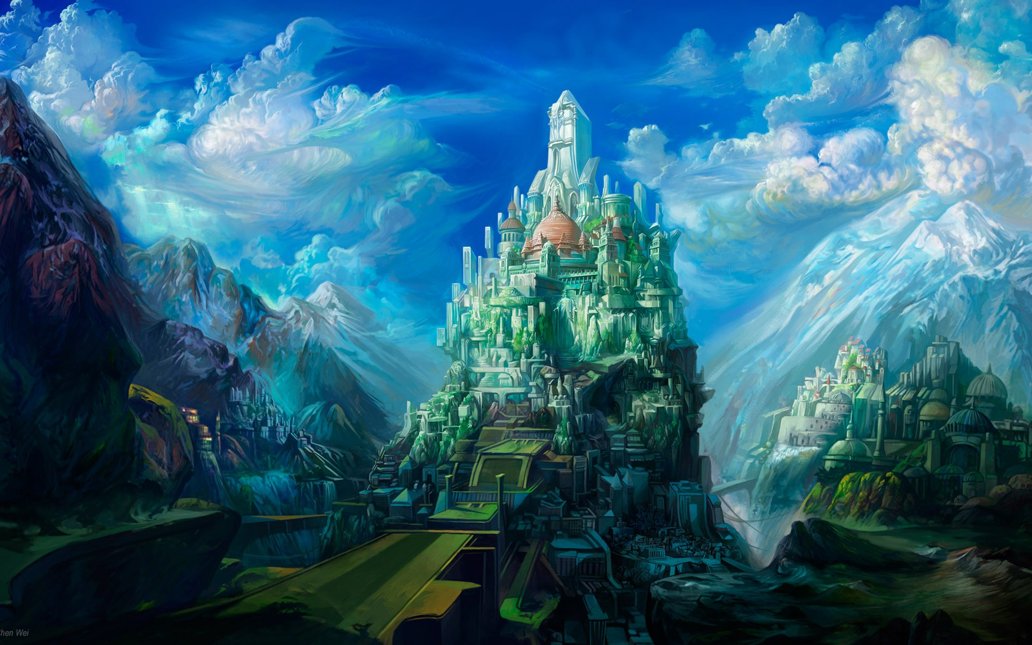
HEAVEN ON EARTH SUNDAY

Slide 2
HEAVEN – GOD’S HOME AND THE BELIEVER’S HOPE
“…for the hope which is laid up for you in heaven” Col. 1:5

Slide 3
HEAVEN – GOD’S HOME AND THE BELIEVER’S HOPE
Where is heaven?
Who will be there?
What will our neighbors be like?
What will heaven be like?

Slide 4
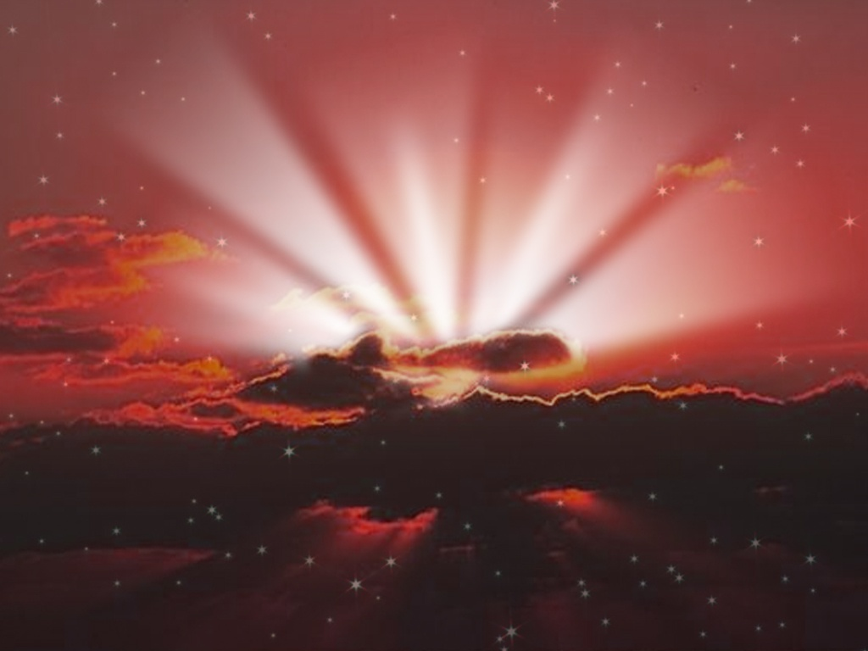
1. HEAVEN IS JESUS’ CURE FOR HEART TROUBLE:
HEAVEN – GOD’S HOME AND THE BELIEVER’S HOPE
“Let not your heart be troubled…” John 14:1
They have “heart trouble”
SAD
ASHAMED
PERPLEXED
DISTURBED

Slide 5
1. HEAVEN IS JESUS’ CURE FOR HEART TROUBLE:
HEAVEN – GOD’S HOME AND THE BELIEVER’S HOPE
“Let not your heart be troubled…”John 14:1
Faith in His Person
Faith in His Pronouncement
The promise of a place:
“HOME”
“ COUNTRY”
“CITY”
“KINGDOM”
“PARADISE”

Slide 6
1. HEAVEN IS JESUS’ CURE FOR HEART TROUBLE:
HEAVEN – GOD’S HOME AND THE BELIEVER’S HOPE
“Let not your heart be troubled…” John 14:1
Faith in His Person
Faith in His Pronouncement
The promise of a place
The promise of His preparation
Our “honeymoon suite”!

Slide 7
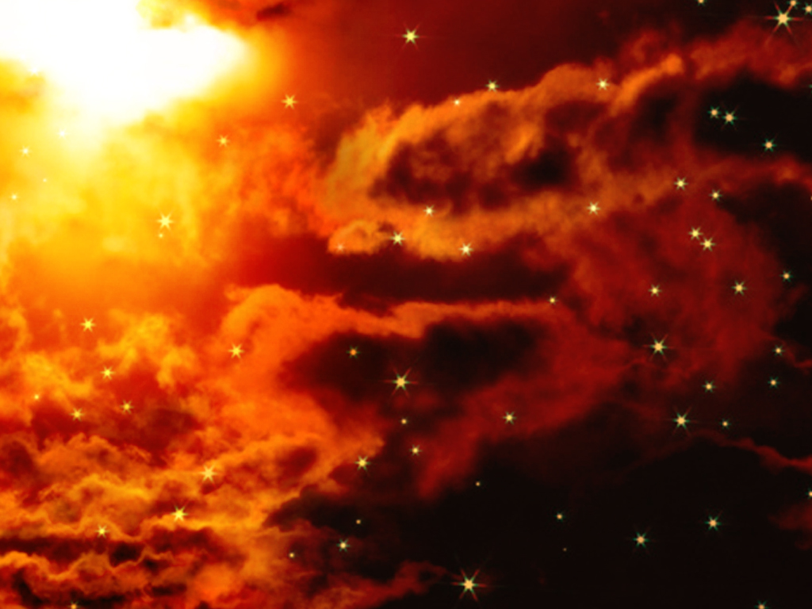
2. HEAVEN IS JESUS’ CURE FOR INSECURITY:
HEAVEN – GOD’S HOME AND THE BELIEVER’S HOPE
“I go to prepare a place for you…” John 14:3
His Father’s House Becomes Our House

Slide 8
2. HEAVEN IS JESUS’ CURE FOR INSECURITY:
HEAVEN – GOD’S HOME AND THE BELIEVER’S HOPE
His Father’s House Becomes Our House:
Its size

Slide 9
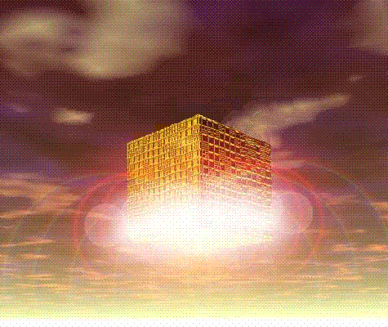
NEW JERUSALEM
1500 MILES EVERY DIRECTION
2,250,000 SQ. MILES
30 TIMES PRESENT POPULATION OF EARTH

Slide 10
2. HEAVEN IS JESUS’ CURE FOR INSECURITY:
HEAVEN – GOD’S HOME AND THE BELIEVER’S HOPE
His Father’s House Becomes Our House:
Its size
Its location
Its accessibility
Its wonders

Slide 11
“…and there shall in no wise enter into it anything that defileth, neither whatsoever worketh abomination, or maketh a lie: but they which are written in the Lamb’s book of life.” Rev. 21:27

Slide 12
“…the fearful, and the unbelieving and the abominable, and murderers and whoremongers and sorcerers, and idolaters, and all liars,

Slide 13
shall have their part in the lake which burneth with fire and brimstone: which is the second death.”
Rev. 21:8

Slide 14
“Know ye not that the unrighteous shall not inherit the kingdom of God. Be not deceived: neither fornicators, nor idolaters, nor adulterers, nor effeminate, nor abusers

Slide 15
…of themselves with mankind, nor thieves, nor drunkards, nor evil doers, nor extortioners, shall inherit the kingdom of God.” 1 Cor. 6:9

Slide 17
IS HEAVEN YOUR FINAL DESTINATION?
Where will YOU spend forever?!!
What about your friends & loved ones?!

