Slide 1
IT’S ALL ABOUT HEAVEN – AND YOU!
HEAVEN ON EARTH?

Slide 2
“But as it is written, Eye hath not seen, nor ear heard, neither have entered into the heart of man, the things which God hath prepared for them that love Him.”

Slide 3
“But God hath revealed them unto us by His Spirit: for the Spirit seartheth all things, yea, the deep things of God.” 1 Cor. 2:9,10

Slide 4
MOVING TO OUR FUTURE HOME!

Slide 5
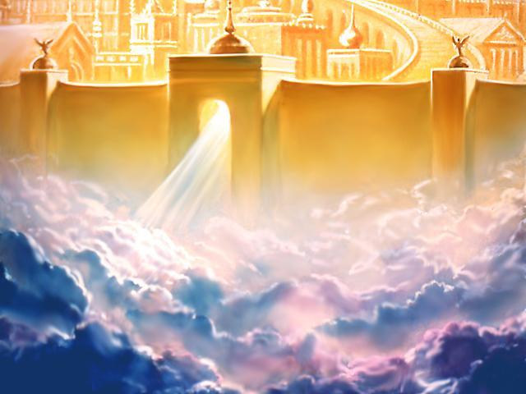
HEAVEN
What is Heaven?
Where is Heaven?
How do we get to Heaven?
What will we do in Heaven?
What will we be like in Heaven?

Slide 6
“Satan need not convince us that Heaven doesn’t exist. He need only convince us that Heaven is a place of boring unearthly existence.” - Alcorn

Slide 7
Spiritual & Physical are not opposites!
The spiritual is real and tangible & able to be experienced with our senses.

Slide 9
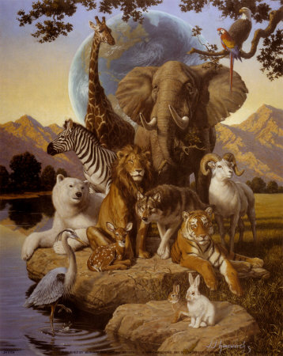
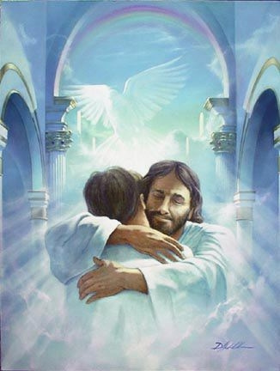

Slide 10
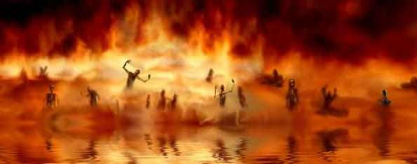
YOUR FIRST STOP AFTER DEATH:
Your Default Destination is Hell
“He that believeth on Him is not condemned: but he that believeth not is condemned already… Jn. 3:18

Slide 11
YOUR FIRST STOP AFTER DEATH:
Your Purchased Destination is Heaven
…whosoever believeth in Him should not perish, but have everlasting life.”
Jn. 3:16b

Slide 12
“For we know that if our earthly house of this tabernacle were dissolved, we have a building of God, an house not made with hands…

Slide 13
…eternal in the heavens. For in this we groan, earnestly desiring to be clothed upon with our house which is from heaven. 2 Cor. 5:1,2

Slide 14
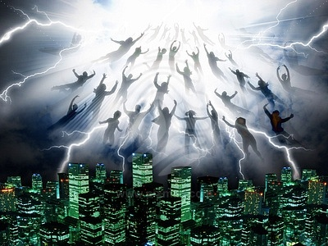
THE RAPTURE:

Slide 15
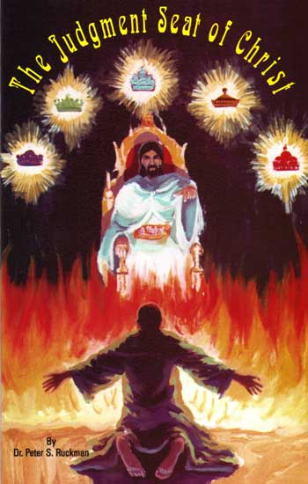
YOUR FINAL DESTINATION AFTER THE RAPTURE:
The First Seven Years
The Judgment Seat
The Marriage Supper
(What will you wear to your Wedding?!)
Rev. 19:7,8

Slide 16
The marriage of the Lamb is come, and His wife hath made herself ready. And to her was granted that she would be arrayed in fine linen clean & white: for the fine linen is the righteousness of the saints. Rev. 19:7b,8

Slide 17
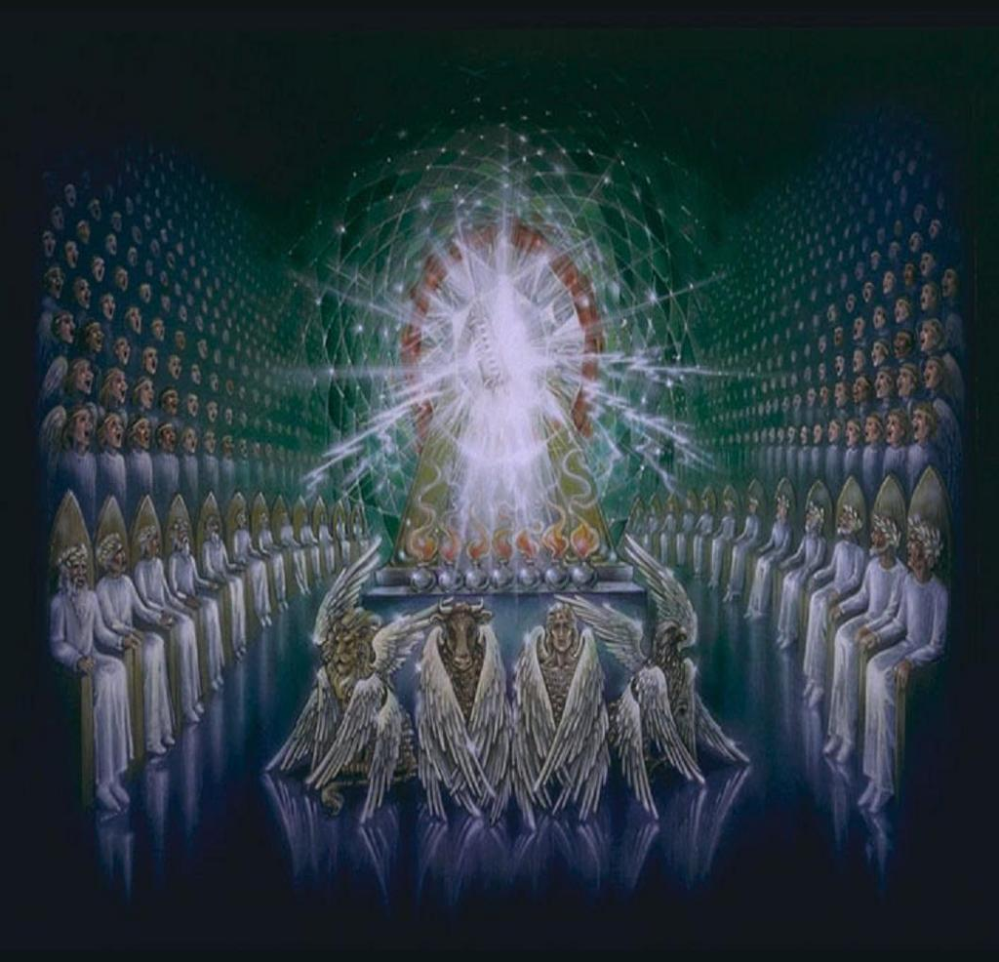
YOUR FINAL DESTINATION AFTER THE RAPTURE:
The First Seven Years
The Next Thousand Years
The Millennial Reign of Christ on Earth

Slide 18
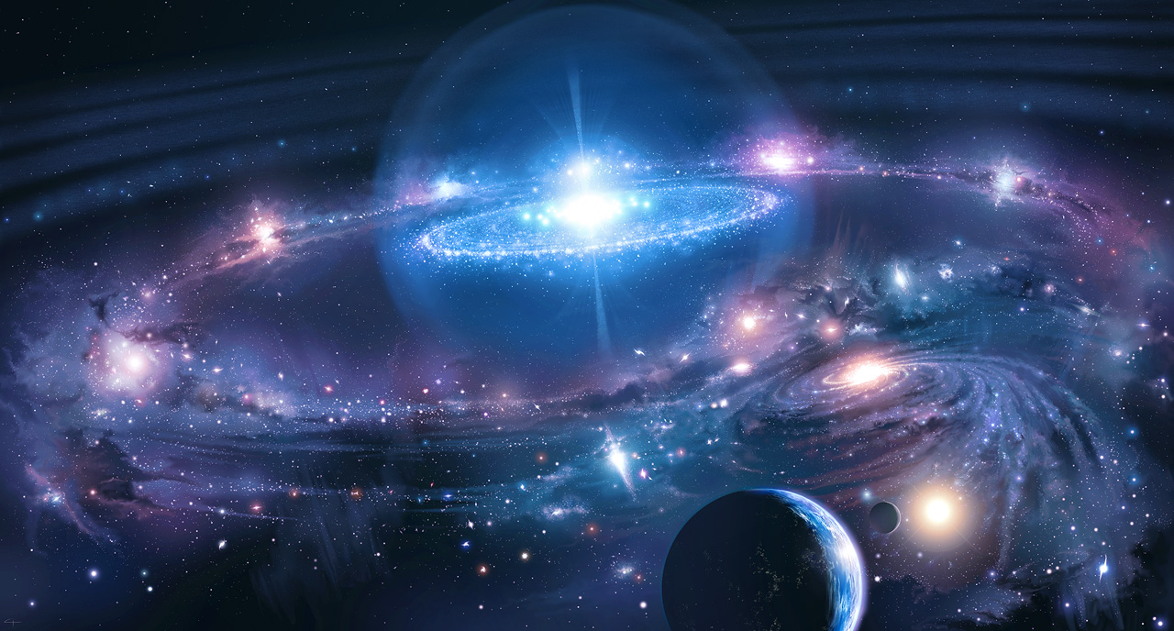
YOUR FINAL DESTINATION AFTER THE RAPTURE:
The First Seven Years
The Next Thousand Years
The Eternal State

Slide 19
For, behold, I create a new heavens and a new earth: and the former shall not be remembered, nor come into mind. Isaiah 65:17

Slide 20
Wherever God dwells that is Heaven!
He will dwell with men on the new earth!

Slide 21
“For I know that my Redeemer liveth, and that He shall stand at the latter day upon the earth…in my flesh shall I see God…” Job. 19:25,26

Slide 22
“For our conversation is in heaven; from whence also we look for the Saviour, the Lord Jesus Christ…

Slide 23
…Who shall change our vile body, that it may be fashioned like unto His glorious body…” Phil. 3:20,21

Slide 24
YOUR FINAL DESTINATION AFTER THE RAPTURE:
The Eternal State
Tears will be gone
Death & hell will be consigned to the lake of fire
All the abominable will be banished

Slide 25
YOUR FINAL DESTINATION AFTER THE RAPTURE:
The Eternal State
Animals, a Temple, books, people, angels, musical instruments , the Tree of Life, streets, rivers, gold, crowns, clothing, chariots, O.T. & Tribulation saints, New Jerusalem, the Church, our mansions, the Savior…

Slide 26
YOUR FINAL DESTINATION AFTER THE RAPTURE:
The Eternal State
Animals, a Temple, books, people, angels, musical instruments , the Tree of Life, streets, rivers, gold, crowns, clothing, chariots, O.T. & Tribulation saints, New Jerusalem, the Church, our mansions, the Savior…

Slide 27
YOUR FINAL DESTINATION AFTER THE RAPTURE:
The Eternal State

Slide 28
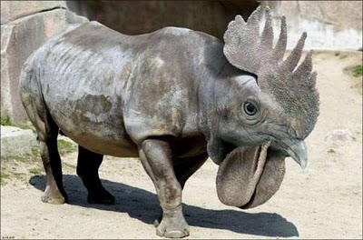
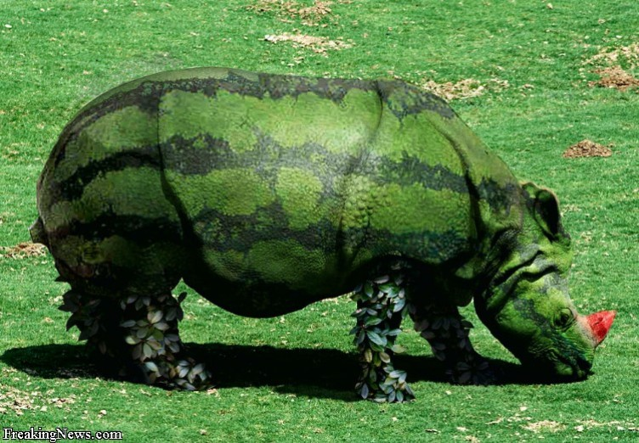

Slide 29
YOUR FINAL DESTINATION AFTER THE RAPTURE:
The Eternal State
Animals, a Temple, books, people, angels, musical instruments , the Tree of Life, streets, rivers, gold, crowns, clothing, chariots, O.T. & Tribulation saints, New Jerusalem, the Church, our mansions, the Savior…

Slide 30
YOUR FINAL DESTINATION AFTER THE RAPTURE:
The Eternal State
And of course, best of all,
WE will be there!

Slide 31
Unsaved friend, why not join us in heaven?

Slide 32
MOVING TO OUR FUTURE HOME!
ARE YOU READY?!

