Slide 1
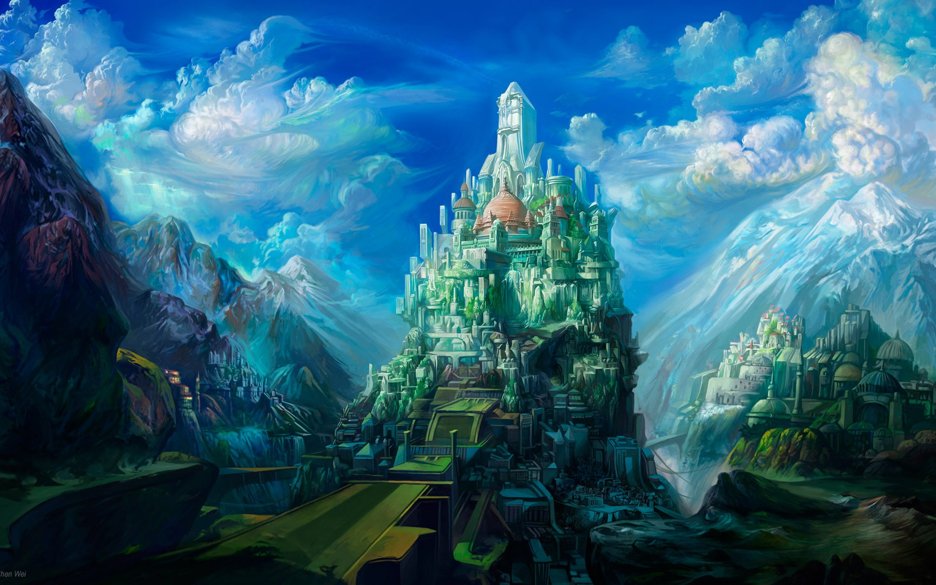
HEAVEN ON EARTH SUNDAY

Slide 2
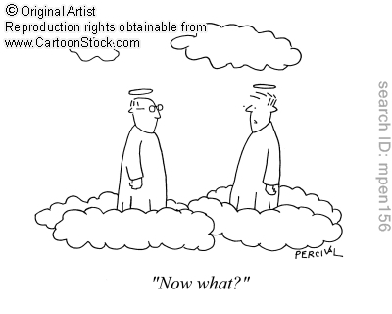
BORED IN GLORY?
Rev. 21:1-8

Slide 3
Satan’s lie: God is boring – sin is fun!
The real question is how could God not be bored with us?!

Slide 5
Satan’s lie: God is boring – sin is fun!
NO! Life under the curse is boring & dangerous!

Slide 6
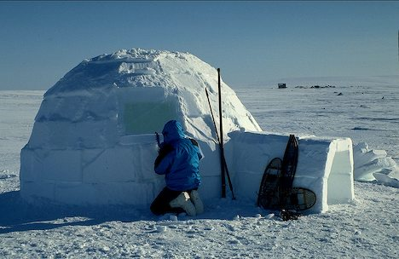

Slide 8
“Christian, meditate much on heaven, it will help thee to press on, and to forget the toll of the way. This vale of tears is but the pathway to a better country:

Slide 9
“…this world of woe is but the stepping-stone to a world of bliss. And after death what cometh? What wonderful world will open upon our astonished sight?”

Slide 10
Wherever God dwells – that is Heaven!

Slide 11
Heaven is FOREVER! What will you possibly DO FOREVER?!
Will you be BORED in GLORY?

Slide 12
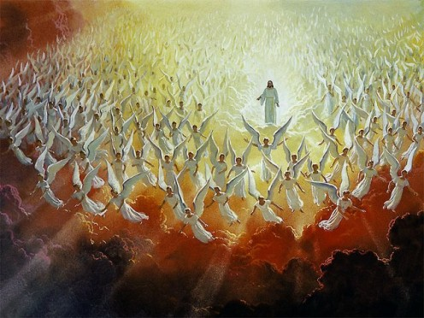
BORED IN GLORY?
SERVICE IN GLORY: Rev. 22:3,4

Slide 13
Revelation 22:3,4 And there shall be no more curse: but the throne of God and of the Lamb shall be in it; and His servants shall serve Him: And they shall see His face: and His name shall be in their foreheads.

Slide 14
BORED IN GLORY?
SERVICE IN GLORY:
Service Requires Obedience
Service May Include Love: Ex. 21:5,6

Slide 15
Exodus 21:5 And if the servant shall plainly say, I love my master, my wife, and my children; I will not go out free: 6 Then his master shall bring him unto the judges; he shall also bring him to the door, or unto the door post; and his master shall bore his ear through with an aul; and he shall serve him for ever.

Slide 16
BORED IN GLORY?
WORSHIP IN GLORY:
Worship Should Not Be Boring: Ps. 148

Slide 17
BORED IN GLORY?
WORSHIP IN GLORY:
Worship Should Not Be Boring: Ps. 148
Worship Includes Music

Slide 18
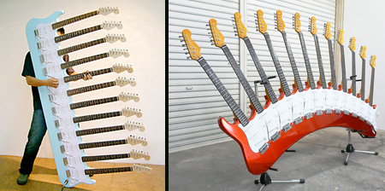
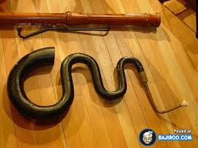
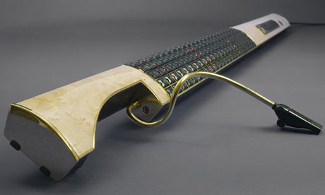

Slide 19
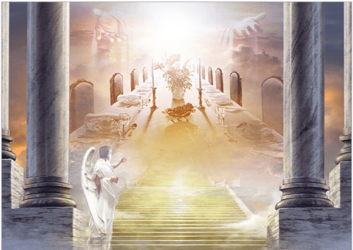
BORED IN GLORY?
SATISFACTION IN GLORY:

Slide 20
“But as it is written, Eye hath not seen, nor ear heard, neither have entered into the heart of man, the things which God hath prepared for them that love Him.” 1 Cor. 2:9

Slide 21
“But God hath revealed them unto us by his Spirit: for the Spirit searcheth all things, yea, the deep things of God.” 1 Cor. 2:10

Slide 22
BORED IN GLORY?
SATISFACTION IN GLORY: 1 Cor. 2:9,10
Eating & Drinking

Slide 23
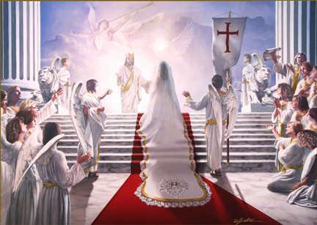
BORED IN GLORY?
SATISFACTION IN GLORY:
Fellowship & Relationships

Slide 24
Jesus & His Friends
Disciples
Peter & James
John the Beloved
The Twelve
The Seventy

Slide 26
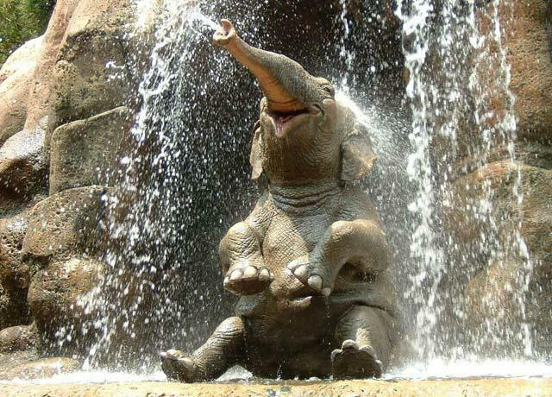
BORED IN GLORY?
SATISFACTION IN GLORY:
Animals & Discoveries

Slide 28
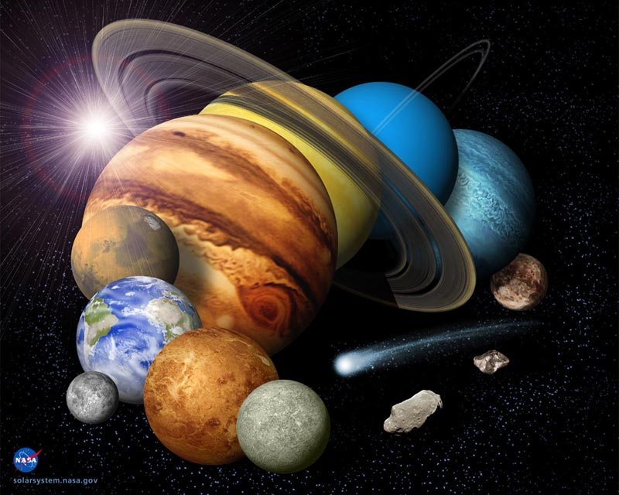
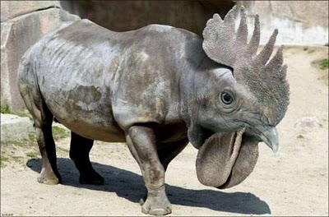
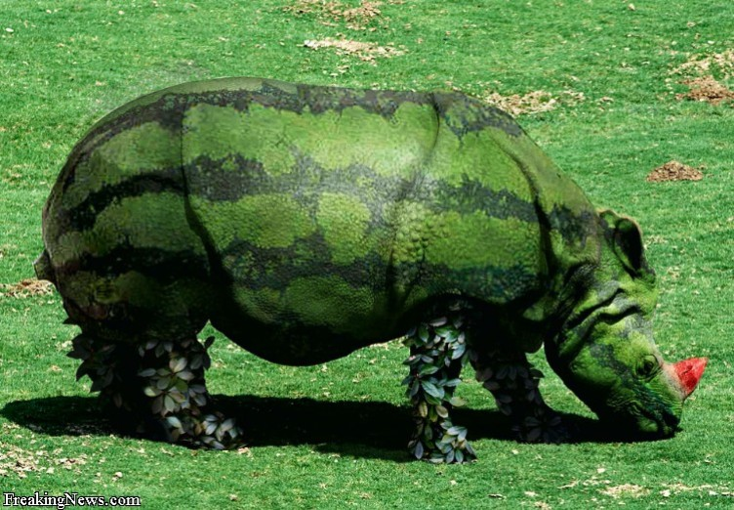

Slide 29
BORED IN GLORY?
SATISFACTION IN GLORY:
Animals & Discoveries

Slide 30
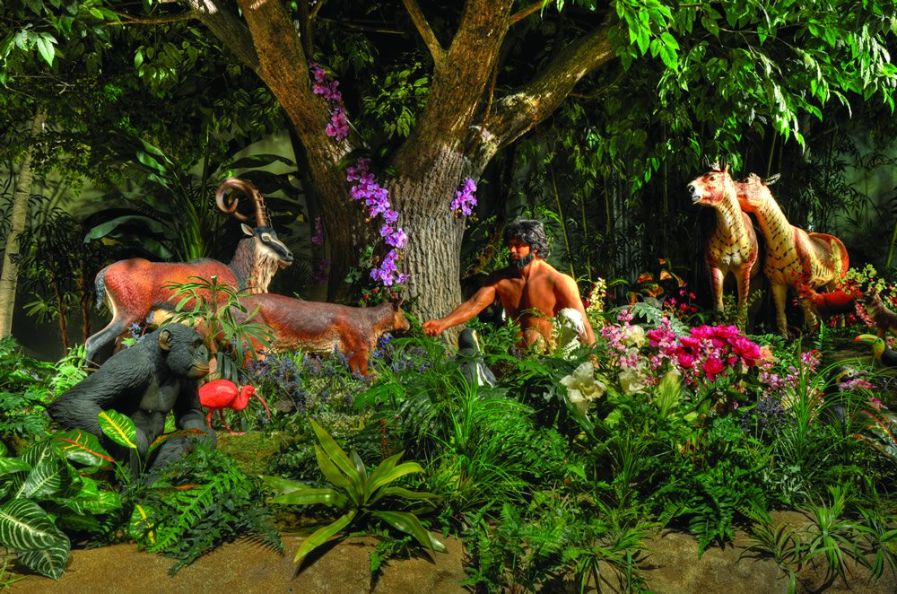
BORED IN GLORY?
SATISFACTION IN GLORY:
Work?

Slide 31
BORED IN GLORY?
SATISFACTION IN GLORY:
Rest & Sleep?

Slide 32
Quote: “Imaginary evil is romantic and varied; real evil is gloomy, monotonous, barren, dangerous and boring.”

Slide 33
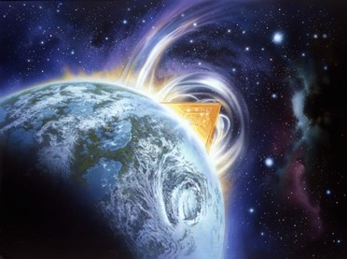
“Imaginary good is boring…real good is always new, marvelous, intoxicating.” - Simone Weil

Slide 34
“Stolen waters are sweet and bread eaten in secret is pleasant. But he knoweth not that the dead are there, and that their guests are in the depths of hell.” Prov. 9:17,18

Slide 35
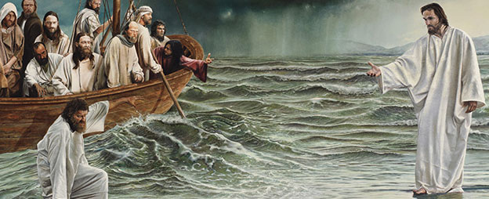
Was Jesus boring on earth? Was life with Jesus on earth boring?

Slide 36
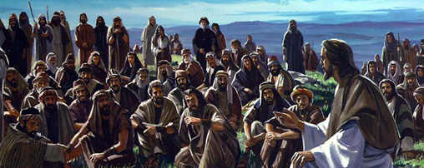
Was Jesus boring on earth? Was life with Jesus on earth boring?

Slide 37
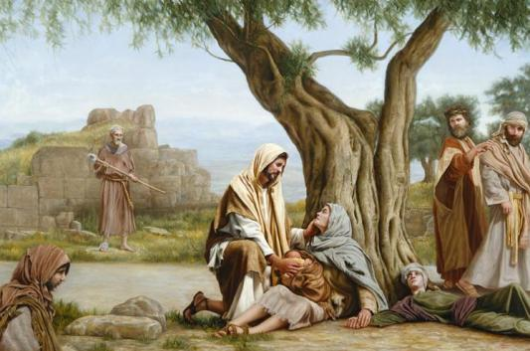
Was Jesus boring on earth? Was life with Jesus on earth boring?

Slide 38
Let’s get excited about HEAVEN!

Slide 39
Of course we all know the alternative and there is nothing there to get excited about!

