Slide 1
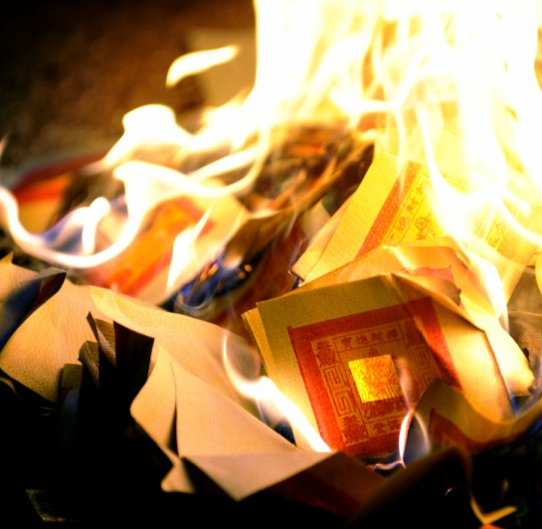
First Baptist Church of Easton
MORTGAGE
BURNING
CELEBRATION
April 10, 2022

Slide 2
Days of Celebration !!!
(PROPHETIC)

Slide 3
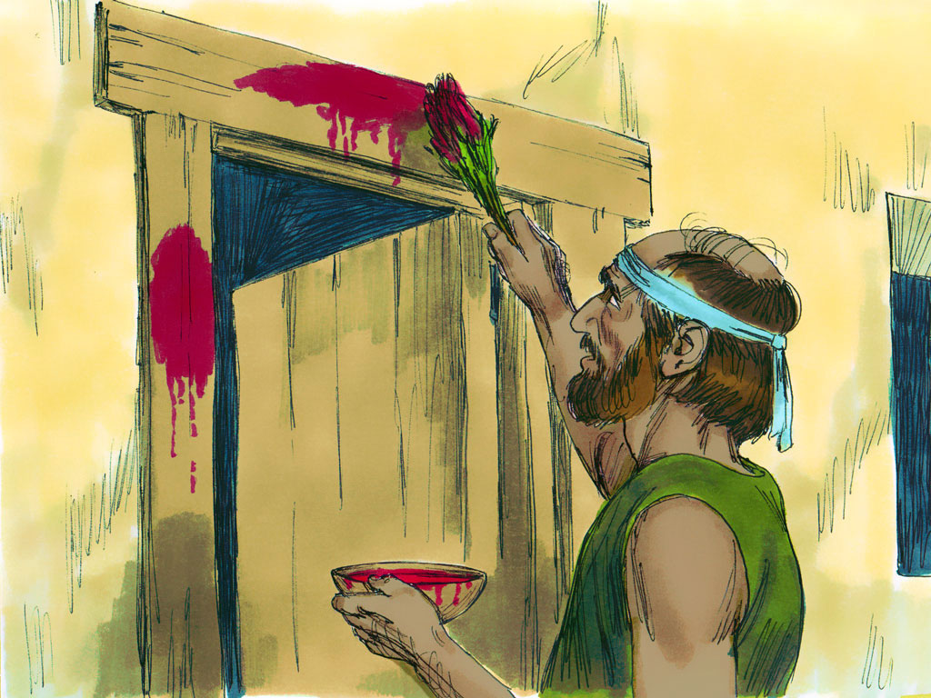
FEAST OF PASSOVER
NUMBERS 9:5
LAMB OF GOD
CRUCIFIXION

Slide 4
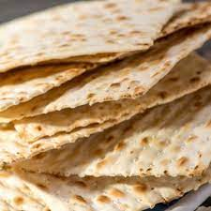
FEAST OF UNLEAVENED BREAD
JESUS, THE BREAD OF LIFE
Exodus 12:17-20

Slide 5
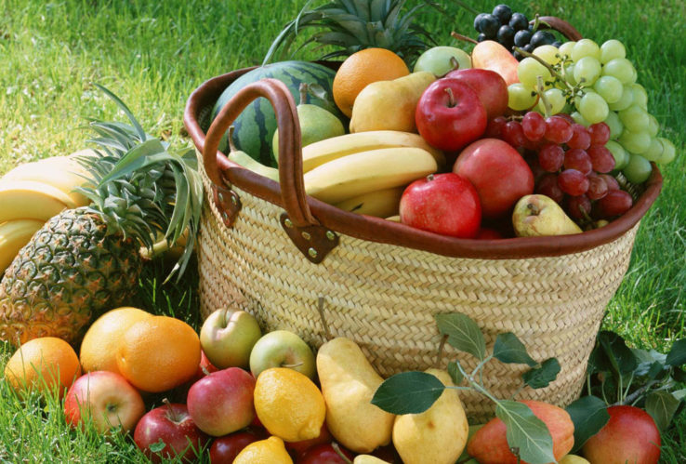
FEAST OF FIRSTFRUITS
RESURRECTION
EXODUS 23:14-16

Slide 6
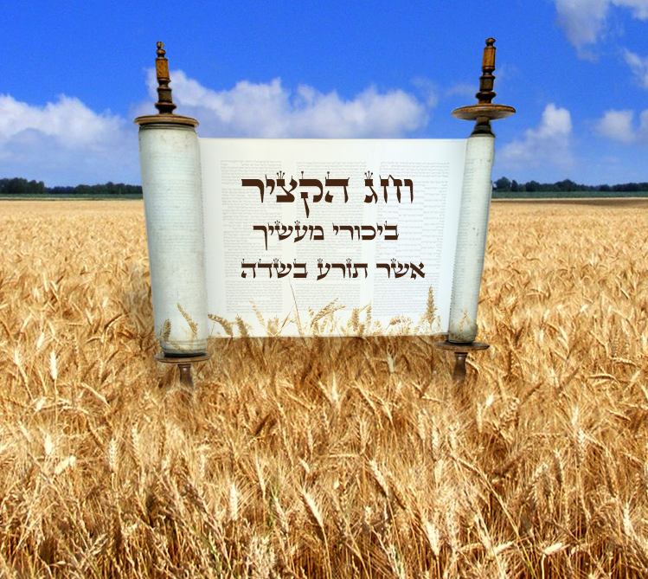
FEAST OF HARVEST (or PENTECOST)
Holy Spirit
Lev. 23:16

Slide 7
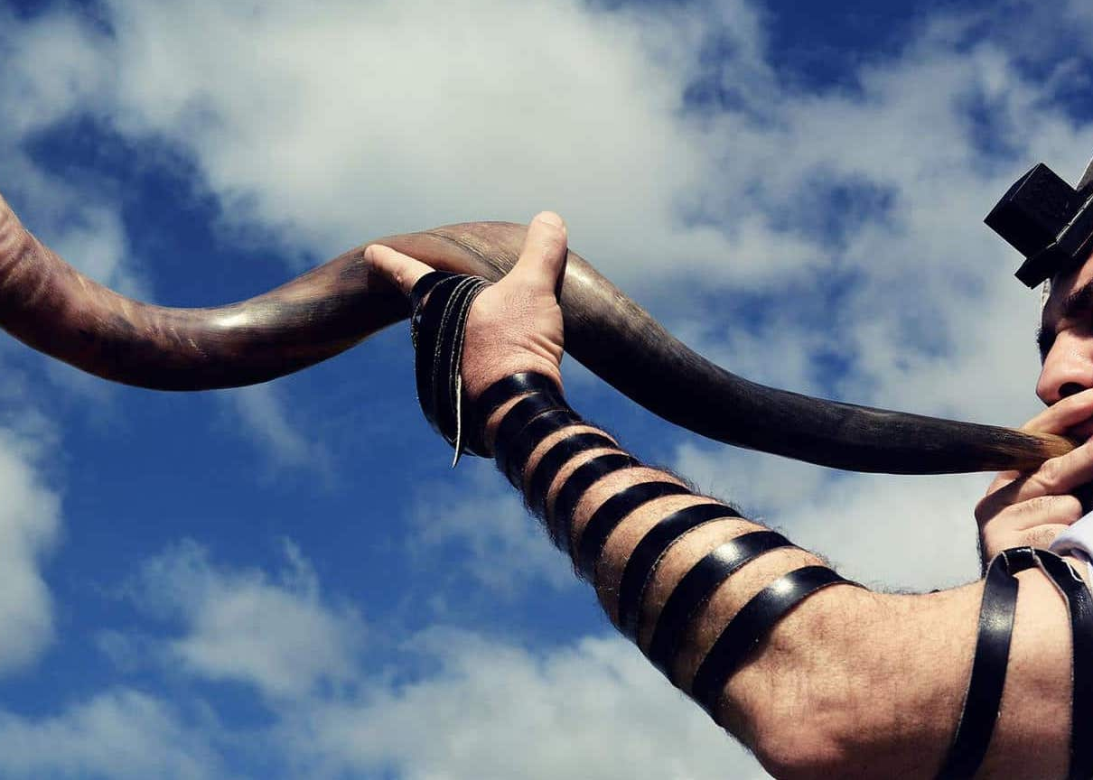
FEAST OF TRUMPETS
RAPTURE
Lev. 23:23-25

Slide 8
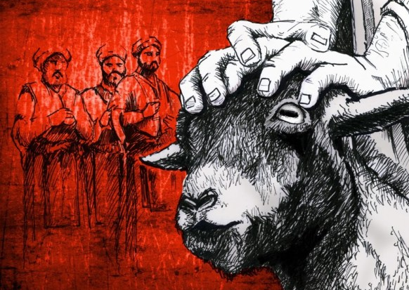
THE FEAST OF THE DAY OF ATONEMENT
ATONEMENT FOR SINS
Lev. 23:27-31

Slide 9
FEAST OF TABERNACLES (or BOOTHS) (SUKKOT)
KINGDOM AGE
Lev. 23:33-36

Slide 10
