Slide 1
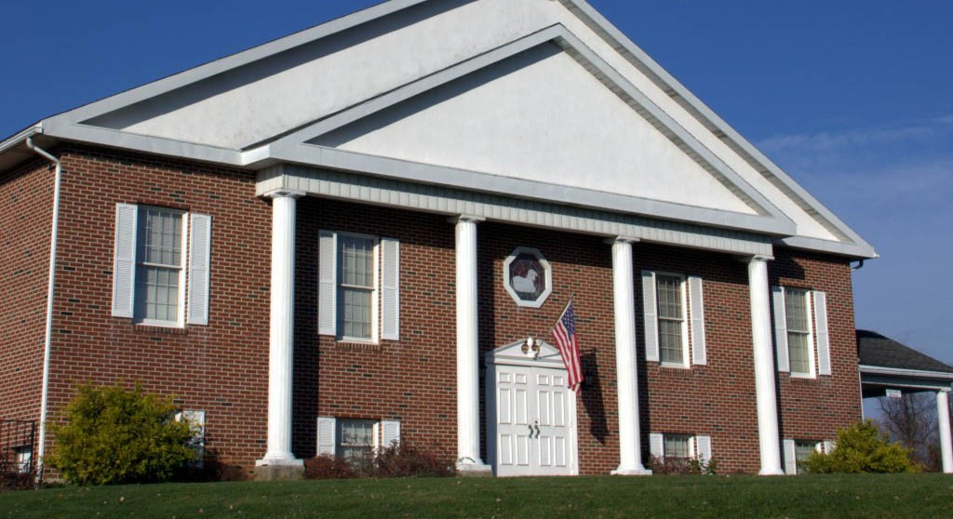
WELCOME TO FIRST BAPTIST!!

Slide 2
Pastor & Mrs. Gilmore

Slide 3
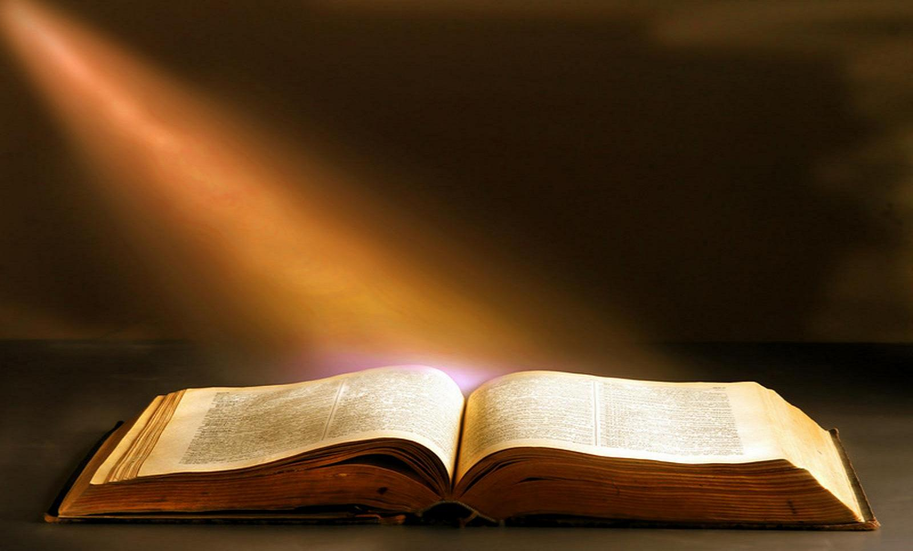
Our Church is an independent, Bible – believing, fundamental Baptist church.

Slide 4
It’s all about GOD’S WORD – THE KING OF THE BOOKS The King James Bible

Slide 5
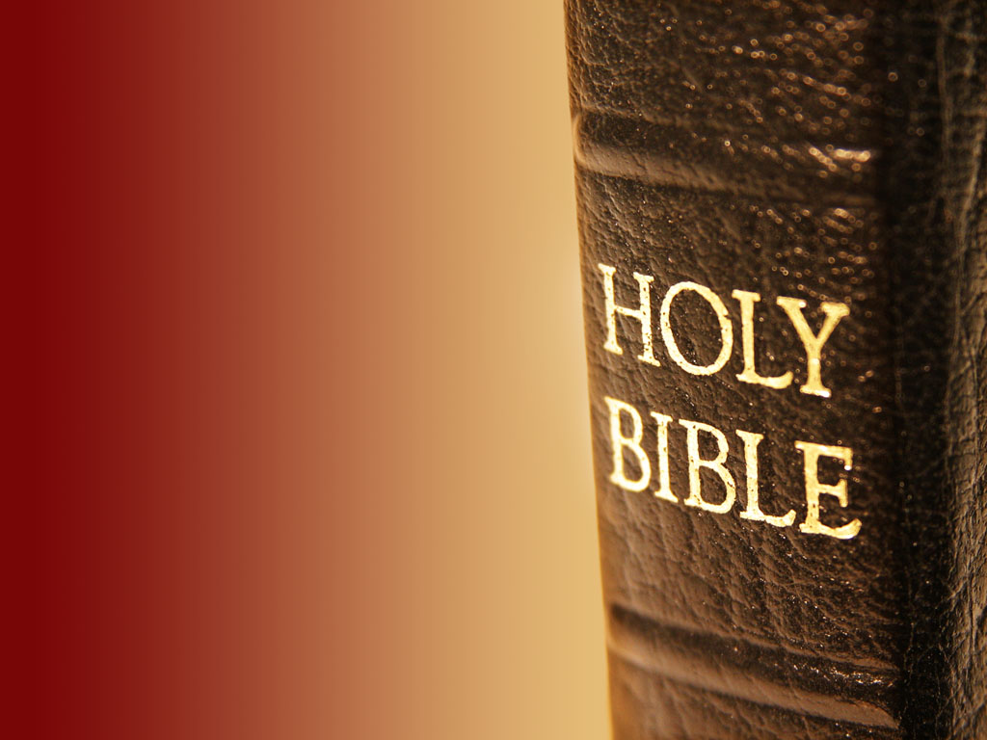
God’s Word - The King James Bible
66 Books,
1189 Chapters,
31,702 Verses,
777,693 Words,
3,566,480 Letters

Slide 6
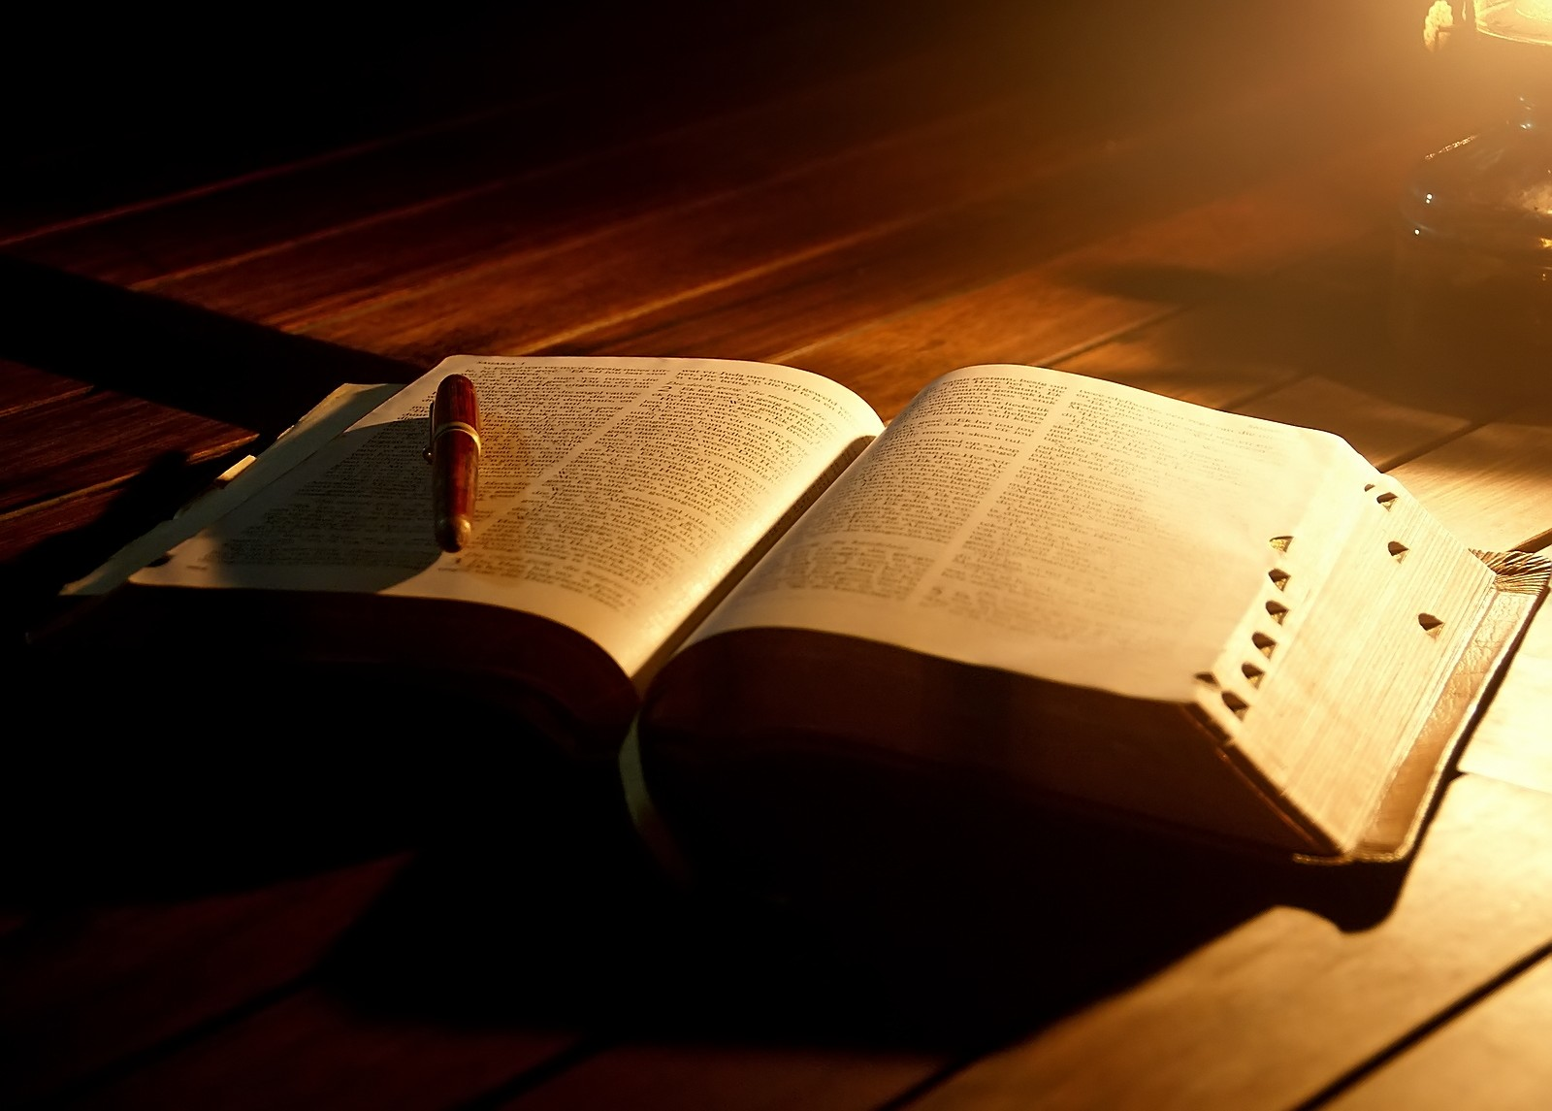
God’s Word - The King James Bible
Longest Chapter =
Psalm 119 with 176 Verses
(176 = 16 X 11) 1611!
Subject? God’s Word

Slide 7
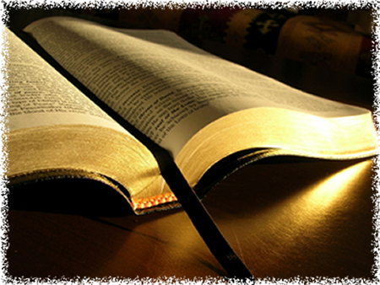
God’s Word - The King James Bible
Shortest Chapter =
Psalm 117
Middle Verse =
Psalm 118:6
Middle Words =
“the LORD”!

Slide 8
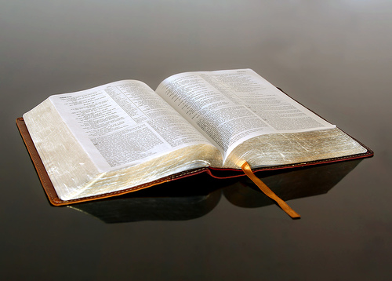
God’s Word - The King James Bible
Longest Verse =
Esther 8:9
Shortest Verse =
John 11:35
“Jesus wept.”

Slide 9
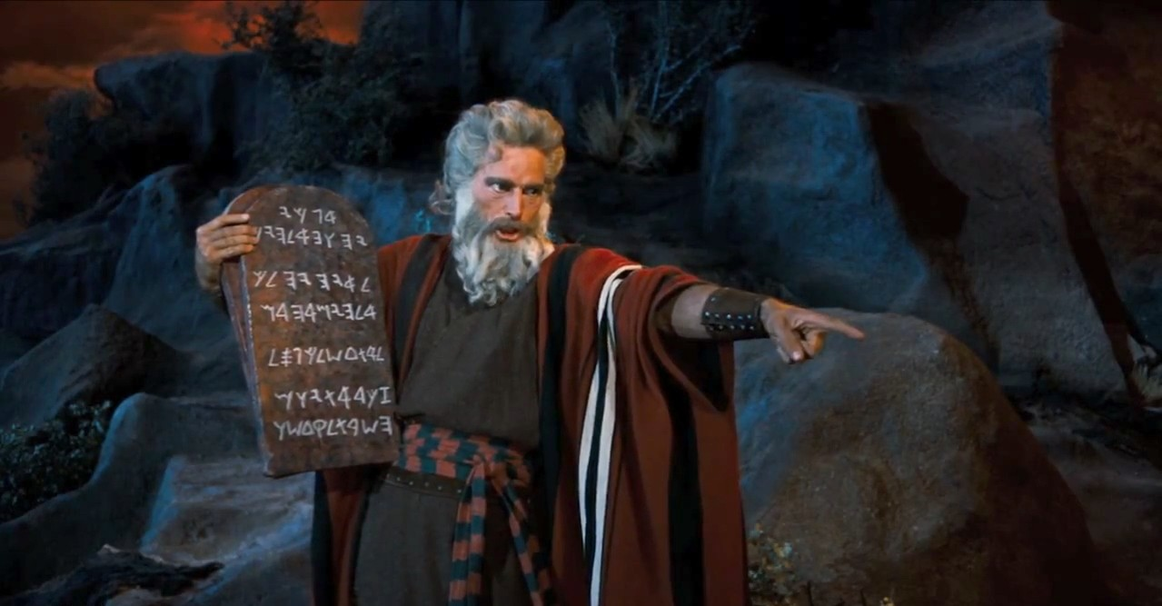
God’s Word - The King James Bible
The First Written Words of God =
The Ten Commandments
Written on Stone Tablets
by God’s own hand

Slide 10
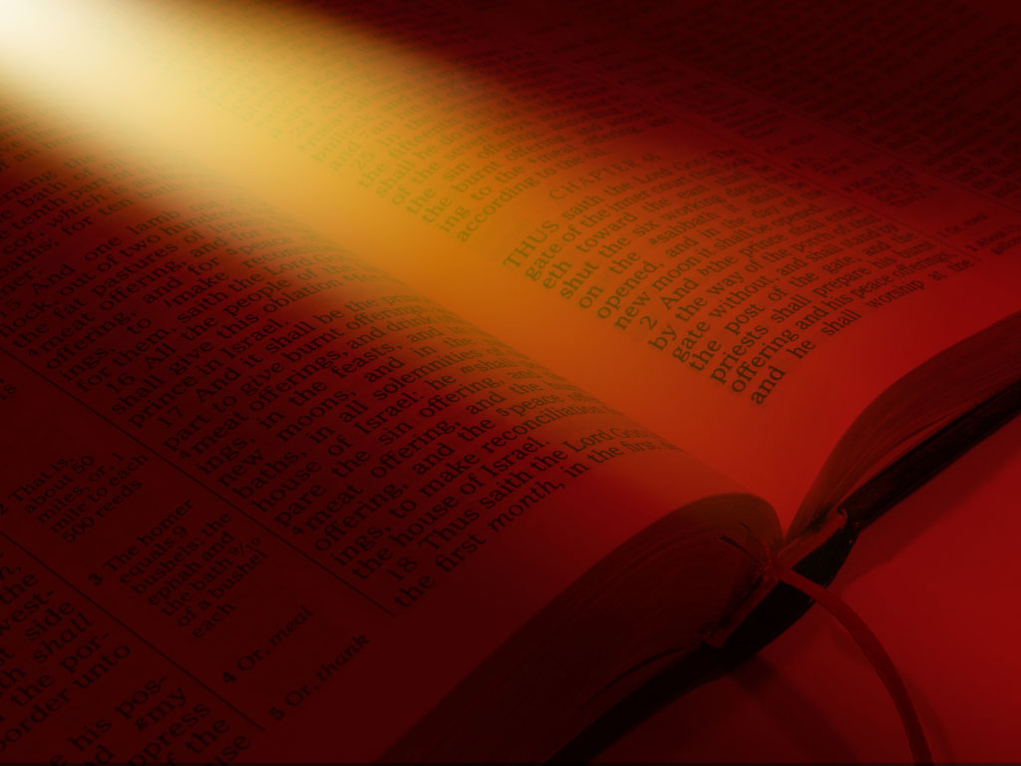
The Bible is the written Word and words of the Living God
Jesus Christ is the Living Word of the Living God

Slide 11
Jesus Christ said: “Man shall not live by bread alone, but by every word that proceedeth out of the mouth of God.” Matthew 4:4

Slide 12
“I believe the King James Bible is the inspired, infallible, inerrant, indestructible & preserved Word and words of the living God.” - Pastor Fedena’s creed

Slide 13
“I pledge allegiance to the Bible, God’s holy Word. I will make it a lamp unto my feet and a light unto my path…

Slide 14
…I will hide it’s words in my heart that I might not sin against God.”

Slide 15
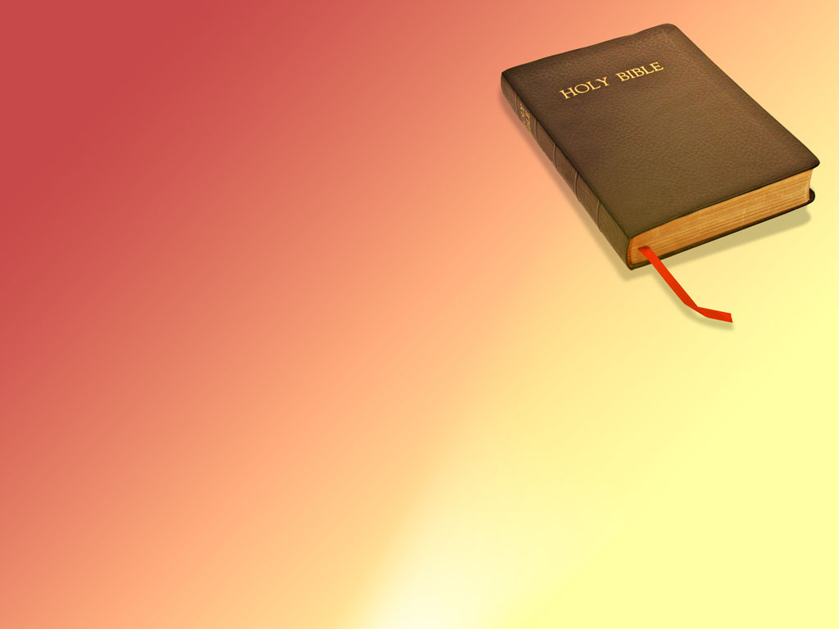
The Bible declares:
“So then faith cometh by hearing and hearing by the word of God.” Rom. 10:17

Slide 16
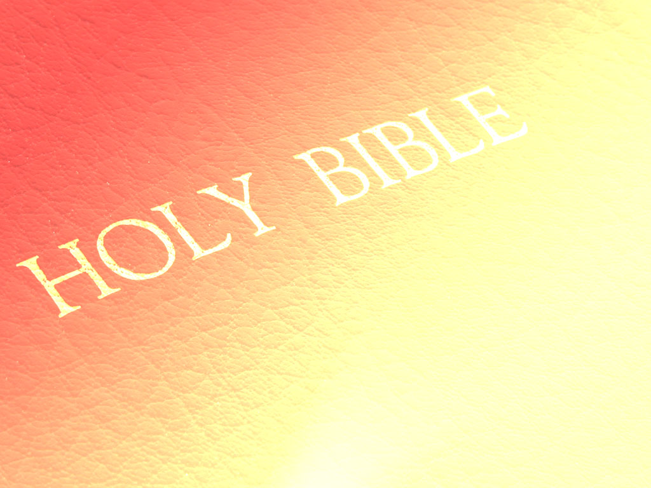
Remember: This is our annual (INDOOR)
Tent Meeting

Slide 17
Allow God’s Word, the Sword of the Spirit, to speak to your heart today.

