Slide 1
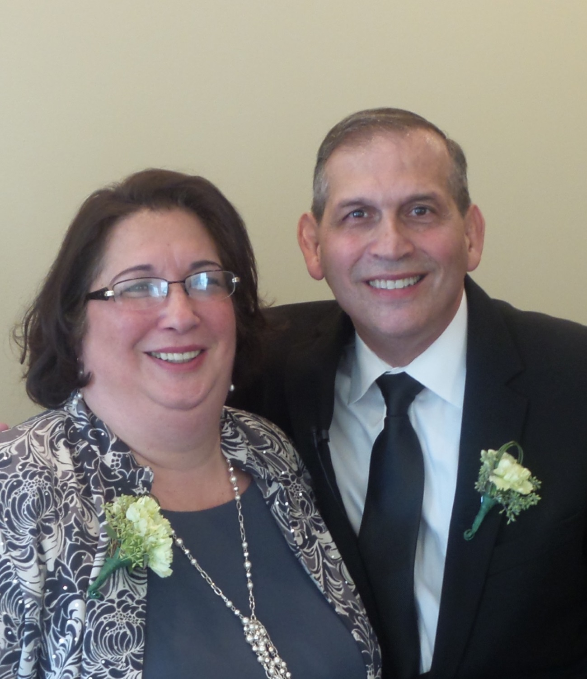
Pastor & Mrs. Guarneri
Welcome YOU
To Straightway Baptist Church
175

Slide 2
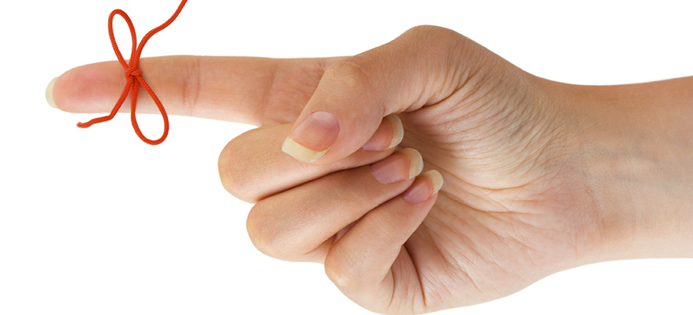
DON’T FORGET…
“LOVE MY CHURCH SUNDAY” IS FEBRUARY 7th

Slide 3
Our goal is…

Slide 5
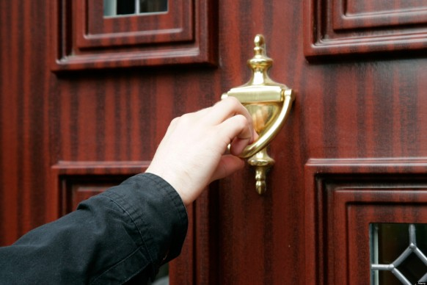
COME!
CALL OTHERS VISIT

Slide 6
is our number!

Slide 7
That is…

Slide 8
or
One Hundred & Seventy Five

Slide 9
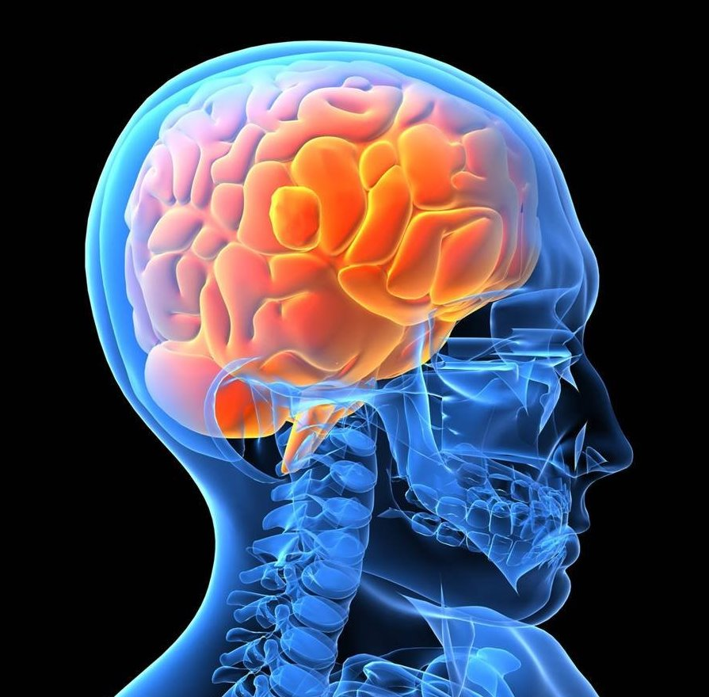
IMPRESS THAT NUMBER ON YOUR BRAIN!

Slide 10
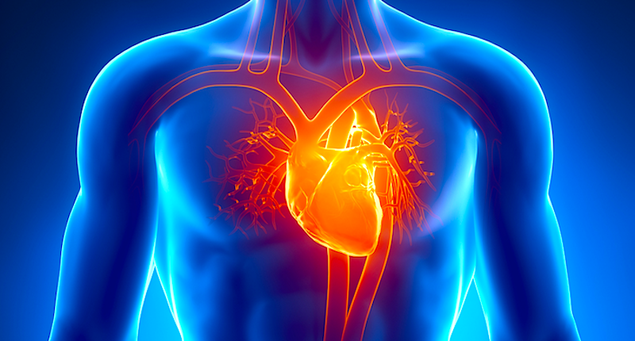
And in your heart!

Slide 11
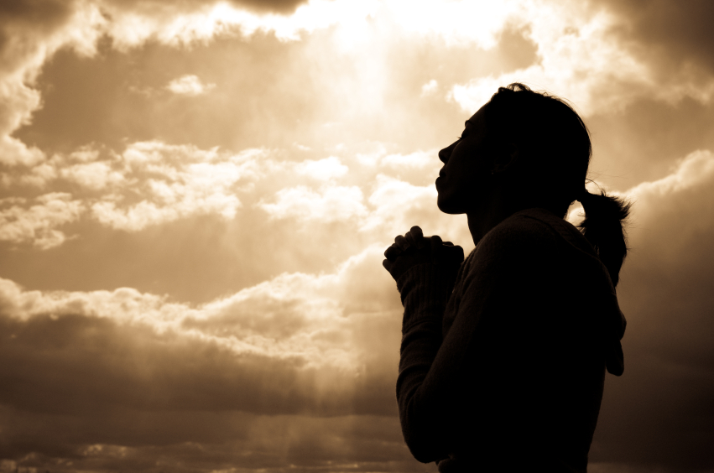
PRAY ABOUT IT!

Slide 12
THINK ABOUT IT!

Slide 13
WORK AT IT!

Slide 14
OF THE

Slide 15
BRING OTHERS WITH YOU

Slide 16
The date is Feb. 7th.
The number is

