Slide 1
The Role of Women in a Baptist Church
Gen. 1:27; Gal. 3:26

Slide 2
Gal. 3:26 For ye are all the children of God by faith in Christ Jesus. 27 For as many of you as have been baptized into Christ have put on Christ. 28 There is neither Jew nor Greek, there is neither bond nor free, there is neither male nor female: for ye are all one in Christ Jesus. Gen. 1:27 So God created man in his own image, in the image of God created he him; male and female created he them.

Slide 3
THE VALUE OF WOMEN:

Slide 4
1Pet. 3:7 Likewise, ye husbands, dwell with them according to knowledge, giving honour unto the wife, as unto the weaker vessel, and as being heirs together of the grace of life; that your prayers be not hindered. God made women different, not inferior!
THE WEAKNESS OF WOMEN:

Slide 5
The principle of leadership and submission. 1Tim. 2:12 But I suffer not a woman to teach, nor to usurp authority over the man, but to be in silence.

Slide 6
Restrictions on women in Baptist Churches. 1Tim. 2:12 But I suffer not a woman to teach, nor to usurp authority over the man, but to be in silence.

Slide 7
Restrictions: Women with short hair. 1 Cor. 5:5-15

Slide 8
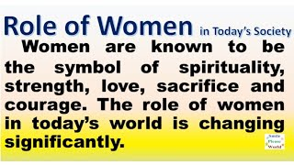
The biblical role of women is primarily family centered.

Slide 9
WIDOWS IN THE CHRUCH 1. “widows indeed” 2. “widows under 60”

