Slide 1
Pastor Charles Clark, Jr. & III Welcome YOU
To the Solid Rock School of the Scriptures

Slide 2
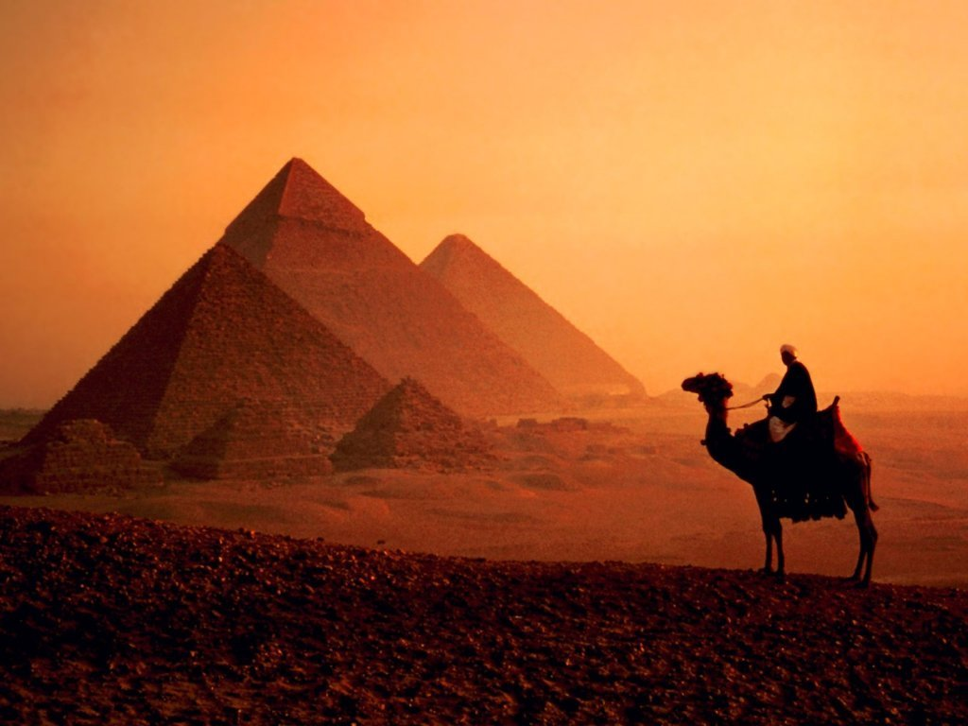
The Life & Times of Joseph

Slide 4
The 12 Sons of Jacob
6 sons with Leah
2 sons with Bilhah
2 sons with Zilpah
2 sons with Rachel

Slide 5
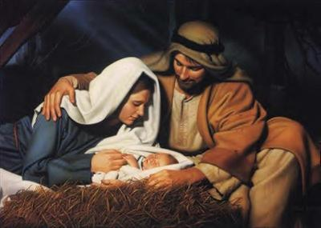
The Life & Times of Joseph
INTRODUCTION:
HISTORY
PICTURED
GREATER
INSPIRED
UNIQUE
PROMINENCE
EMULATE

Slide 6
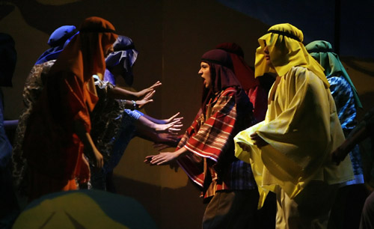
Joseph – the early years (A Dysfunctional Family) Genesis 29:18-35 – 30:24
The Patriarch Jacob:
His Background
His Blunders
His Blessings

Slide 7
Joseph – the early years (A Dysfunctional Family) Genesis 29:18-35 & 30:24
The Primacy of Joseph:
The Problem Areas
The Positive Areas

Slide 8
Joseph & His brothers (A Rose Among Thorns) Genesis 37-40
JOSEPH’S CHARACTER:
Purity, Integrity & Righteousness

Slide 9
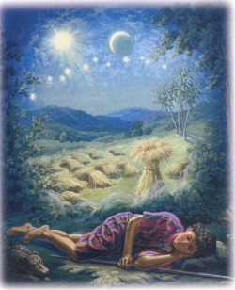
Joseph & His brothers (A Rose Among Thorns) Genesis 37-40
JOSEPH’S CELEBRITY:
His Revelations
His Rejection

Slide 10
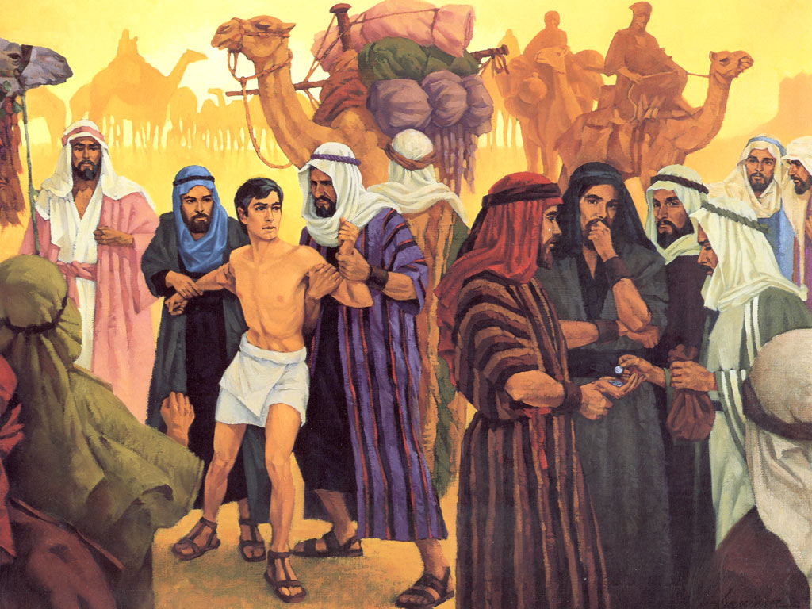
Joseph & His brothers (A Rose Among Thorns) Genesis 37-40
JOSEPH’S CRISIS:
His Father’s Request
A Stranger’s Response
The Brothers Revenge
The Father’s Remorse

Slide 11
About 200-250 miles

Slide 12
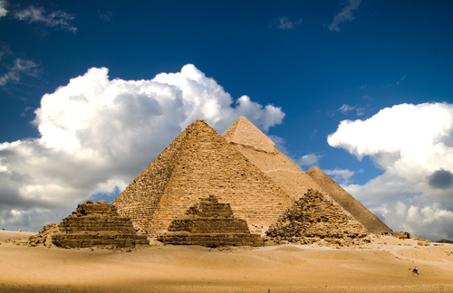
JOSEPH IN EGYPT (Down But Not Out) Genesis 39:1-6
JOSEPH’S PROTECTION:
Providential Protection

Slide 13
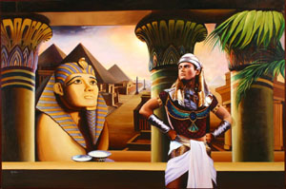
JOSEPH IN EGYPT (Down But Not Out) Genesis 39:1-6
JOSEPH’S PROSPERITY:
The Source

Slide 14
JOSEPH IN EGYPT (Down But Not Out) Genesis 39:1-6
JOSEPH’S PROMOTION:
God’s Grace

Slide 15
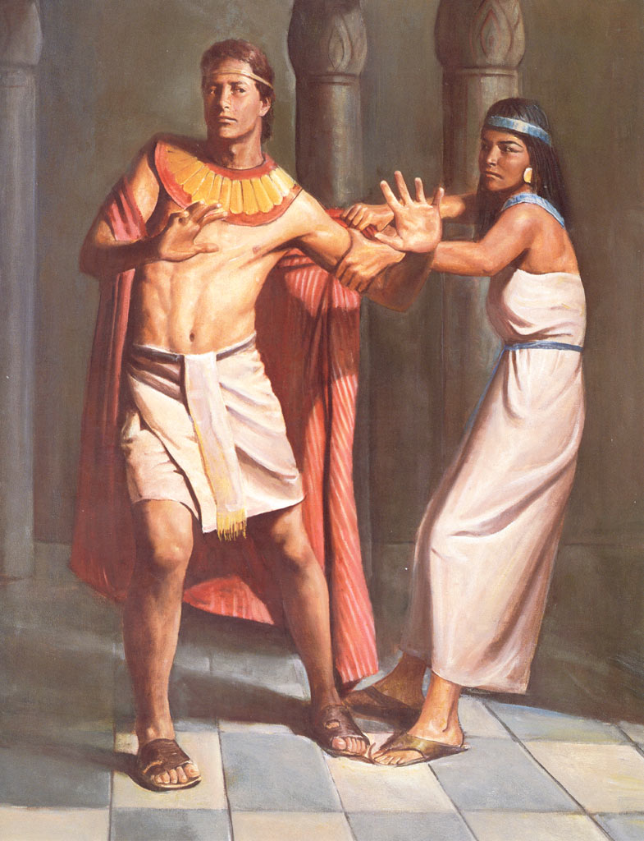
JOSEPH IN POTIPHAR’S HOUSE (The Ten Foot Pole Principle Genesis 39:7-19
WHEN YOU RESIST BUT DON’T AVOID:
You Create Suspicion
You Weaken Your Defenses

Slide 16
JOSEPH IN POTIPHAR’S HOUSE (The Ten Foot Pole Principle Genesis 39:7-19
WHEN YOU AVOID YOU DON’T HAVE TO RESIST:
It Is Better To Avoid Than To Resist
It Is More Dangerous To Only Resist

Slide 17
JOSEPH IN POTIPHAR’S HOUSE (The Ten-Foot Pole Principle) Genesis 39:7-19
WHEN YOU DON’T AVOID YOU SET YOURSELF UP FOR A FALL:
Avoid – No Sin!
Resist – Temptation!
Temptation – Sin!

Slide 18
JOSEPH IN POTIPHAR’S HOUSE- 2 (“Testing, 1,2,…”) Genesis 39:7-12
1. THE TEST OF HIS PURITY:
The Wicked Wife
The Steadfast Steward

Slide 19
JOSEPH IN POTIPHAR’S HOUSE - 2 (“Testing, 1,2…”) Genesis 39:7-12
2. THE TEST OF HIS INTEGRITY:
Joseph Sees Through Her Enticement
Joseph Leaves Himself Open to Accusations

Slide 20
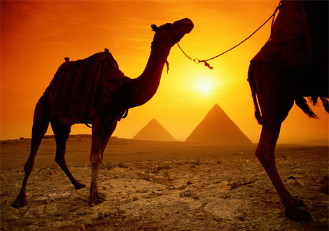
JOSEPH IN PRISON (Deserted or Delivered?) Genesis 39:20-23
A PLACE OF OPPRESSION:
In Pharaoh’s Prison
In God’s Prison
A PLACE OF OBSCURITY:
Isolation
Hostility

Slide 21
JOSEPH IN PRISON (Deserted or Delivered?) Genesis 39:20-23
A PLACE OF OPPORTUNITY:
God Elevates Joseph
Joseph Becomes a Blessing
A PLACE OF OBEDIENCE:
Joseph’s Humility
Joseph’s Reward

Slide 22
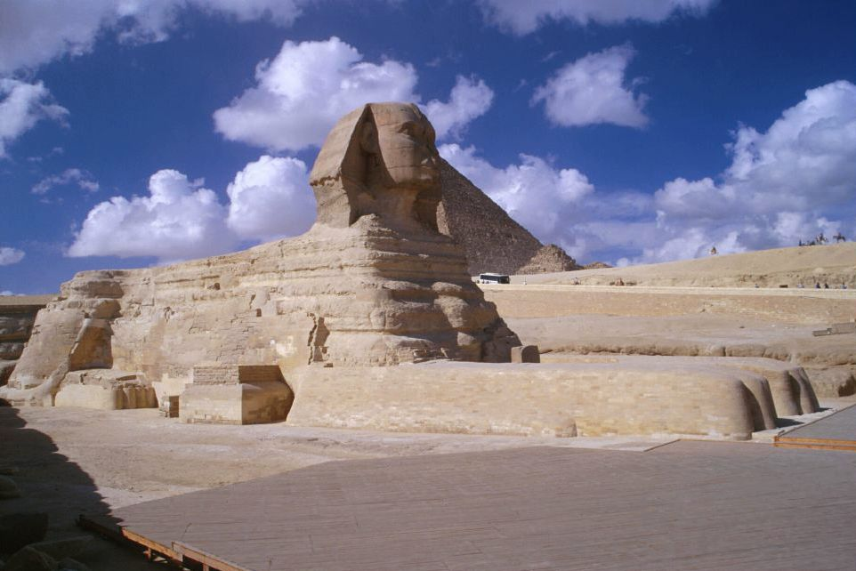
JOSEPH IN PRISON-2 (The Butler, Baker & Blesser) Genesis 40:1-23
PRISON PARTNERS:
The Butler & The Baker
The Blesser
PRISON DREAMS:
The Dreamers
The Dream Interpreter

Slide 23
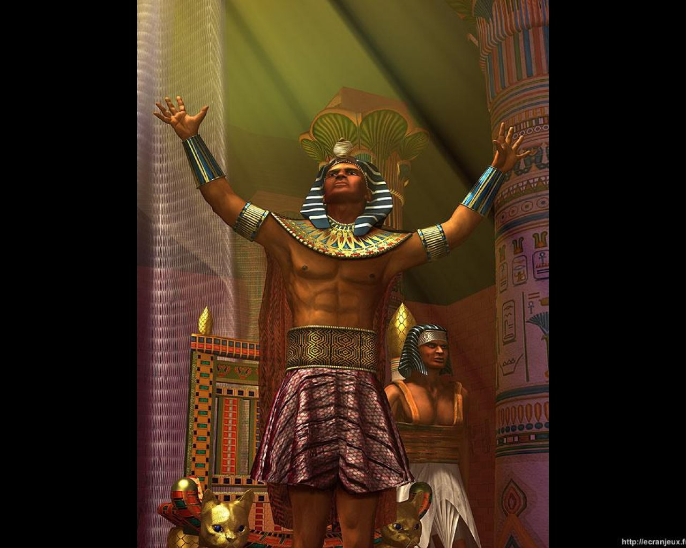
JOSEPH elevated (From the Pit, to the Prison, to the Palace) Genesis 41:1-44
JOSEPH & GOD’S PROVIDENCE:
Providential Delays
Providential Dreams
Providential Deliverance
Providential Elevation

Slide 24
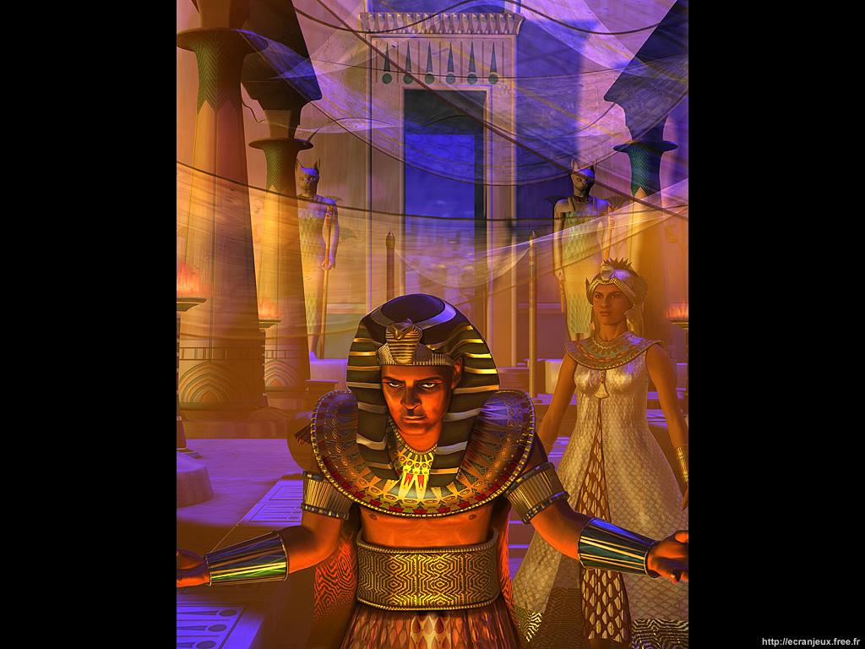
JOSEPH in the palace (Joseph’s Gentile Bride) Genesis 41:45 & 51,52
THE BRIDE’S PAST:
Her Name: “Asaneth”
Her Fame

Slide 25
JOSEPH in the palace (Joseph’s Gentile Bride) Genesis 41:45 & 51,52
THE BRIDE’S PLACE:
Her New Life
Her New Fame

Slide 26
JOSEPH in the palace (Joseph’s Gentile Bride) Genesis 41:45 & 51,52
THE BRIDE’S PART:
God’s Blessings
God’s Plan

Slide 27
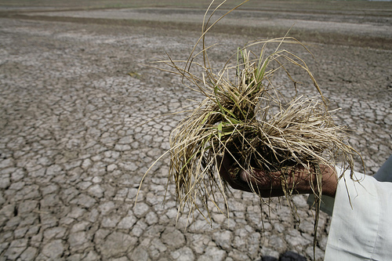
JOSEPH during the famine (The Savior of the World) Genesis 41:45-47
JOSEPH’S NEW NAME:
It’s Meaning
It’s Message

Slide 28
JOSEPH during the famine (The Savior of the World) Genesis 41:45-47
JOSEPH’S NEW FAME:
His Mission
His Ministry

Slide 29
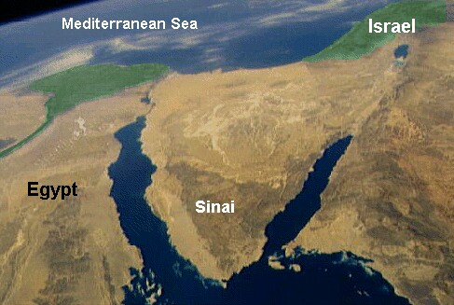
JOSEPH & his brothers (Joseph Dupes His Brothers) Genesis 42
Canaan
BACK HOME IN CANAAN:
Jacob’s Test
Jacob’s Failure

Slide 30
JOSEPH & his brothers (Joseph Dupes His Brothers) Genesis 42
Canaan
MEANWHILE IN EGYPT:
Joseph is “The Man”
Joseph has a Plan

Slide 31
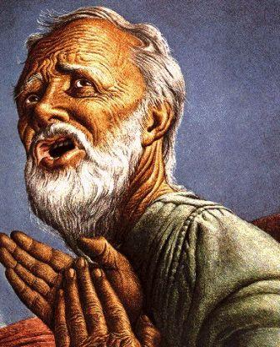
JOSEPH reunited with his brothers (Joseph the Sovereign Servant) Genesis 43
JACOB’S DILEMMA:
The Famine Worsens
The Problems Surface

Slide 32
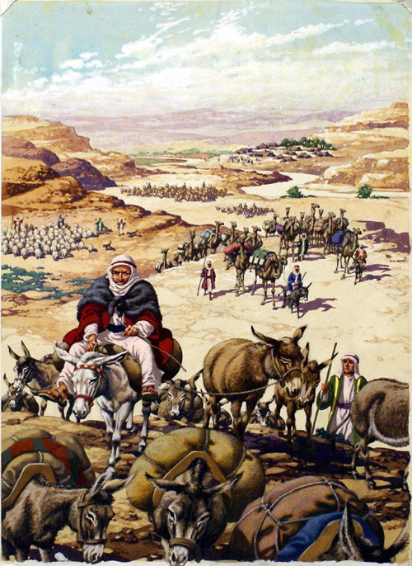
JOSEPH reunited with his brothers (Joseph the Sovereign Servant) Genesis 43
JACOB’S SONS DEPARTURE:
The Long Trip

Slide 33
Canaan

Slide 34
JOSEPH reunited with his brothers (Joseph the Sovereign Servant) Genesis 43
JACOB’S SONS DEPARTURE:
The Long Trip
The Guilt Trip

Slide 35
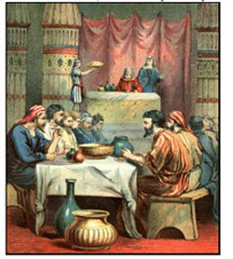
JOSEPH reunited with his brothers (Joseph the Sovereign Servant) Genesis 43
JOSEPH’S DELIGHT:
The Meeting
The Meal

Slide 36
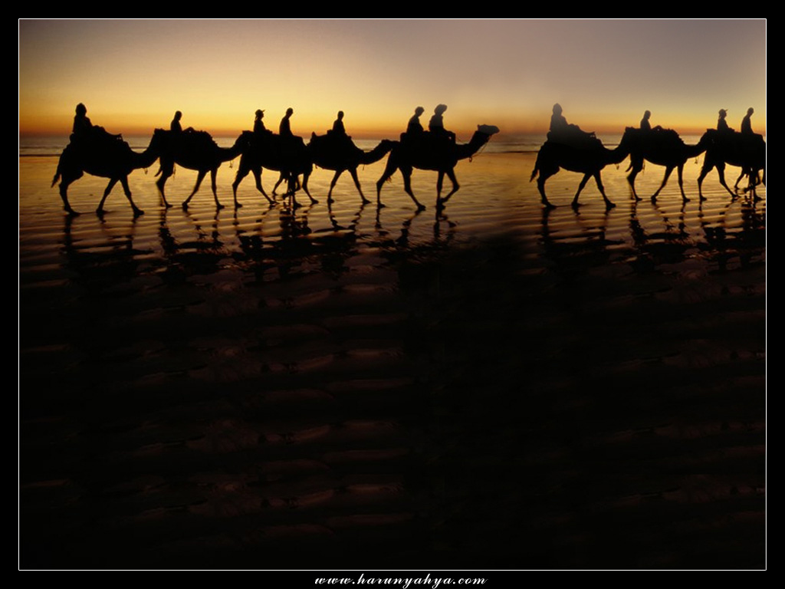
JOSEPH & his brothers - again (Back to Canaan – Almost!) Genesis 43

Slide 37
Canaan

Slide 38
JOSEPH & his brothers - again (Back to Canaan – Almost!) Genesis 43
SILVER IN THE SACKS:
Joseph’s Plot
The Brother’s Plight

Slide 39
JOSEPH & his brothers - again (Back to Canaan – Again!) Genesis 43
SEARCHING SACKS & HEARTS :
First the Sacks
Now the Hearts

Slide 40
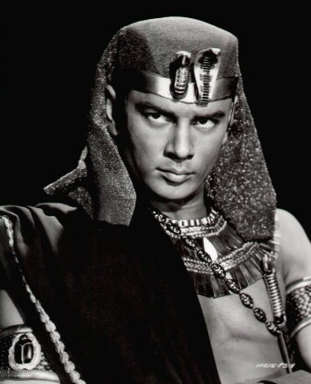
JOSEPH & his brothers - again (Back to Canaan – Almost!) Genesis 43
TESTIMONY AT THE TRIAL :
Joseph the Judge
Judah the Defendant

Slide 41
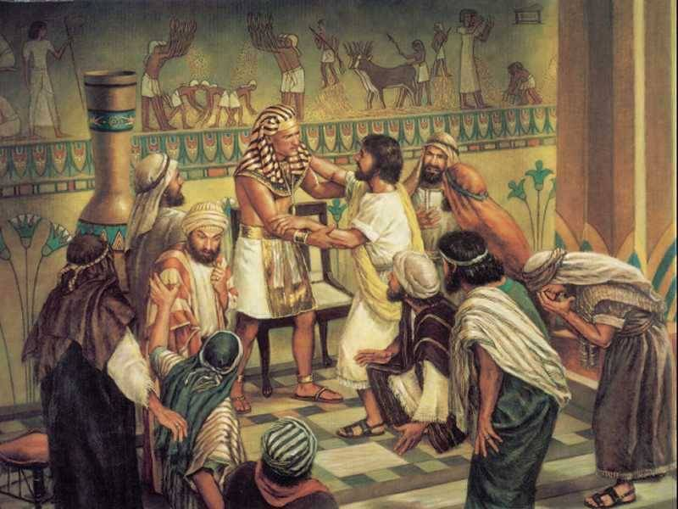
JOSEPH & his brothers – finally! (Grace to the Guilty) Genesis 45:1-15
THE REVELATION :
The Mask is Removed

Slide 42
JOSEPH & his brothers – finally! (Grace to the Guilty) Genesis 45:1-15
THE RECONCILIATION:
The Plan
The Peace

Slide 43
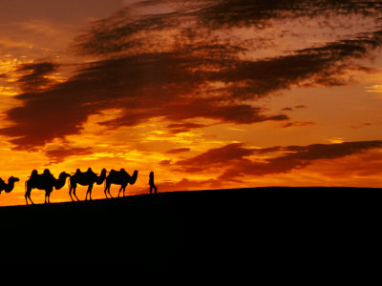
Back to canaan - again! (Joseph Commands: “Go Get My Father!”) Genesis 45:16-28
PHARAOH & JOSPEH:
Pharaoh is Pleased
Pharaoh Commands Joseph

Slide 44
Back to canaan - again! (“Go Get My Father!”) Genesis 45:16-28
JOSEPH & HIS BROTHERS:
Joseph Carries Out Pharaoh’s Orders
The Brothers Carry Out Joseph’s Orders

Slide 45
Canaan

Slide 46
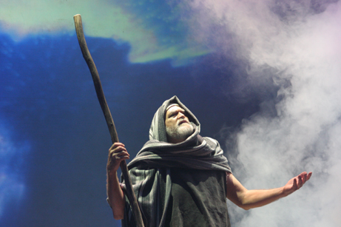
JOSEPH & JACOB (Glad Reunion Day!) Genesis 46:1-34
JACOB’S VISION:
God Speaks to Jacob
Jacob Obeys God

Slide 47
Canaan

Slide 48
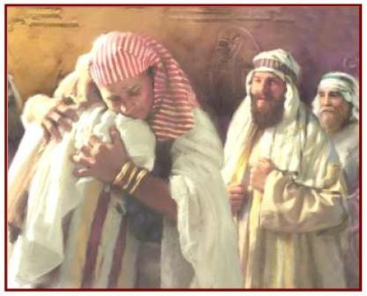
JOSEPH & JACOB (Glad Reunion Day!) Genesis 46:1-34
JACOB’S & JOSEPH’S VICTORY:
The Long Wait
The Longed-for Reunion

Slide 49
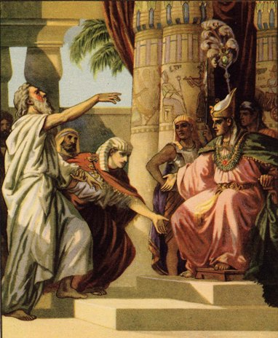
JOSEPH brings news to pharaoh (Jacob Blesses Pharaoh)
JACOB BLESSES PHARAOH:
Role Reversal

Slide 50
JOSEPH brings news to pharaoh (Jacob Blesses Pharaoh)
PHARAOH BLESSES JACOB:
The Blessing Received

Slide 51
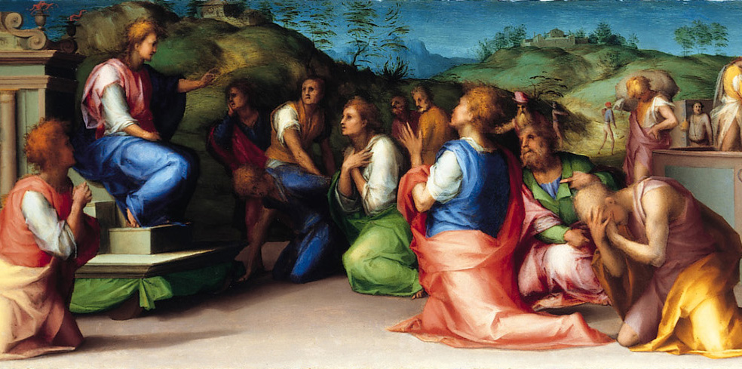
JOSEPH during the years of faminne (Joseph Blessing Egypt) Genesis 47:13-26
THE PEOPLE’S SITUATION:
Famine in the Land
A Starving People in the Land

Slide 52
JOSEPH during the years of faminne (Joseph Blessing Egypt) Genesis 47:13-26
THE SAVIOR’S SATISFACTION:
Joseph to the Rescue

Slide 53
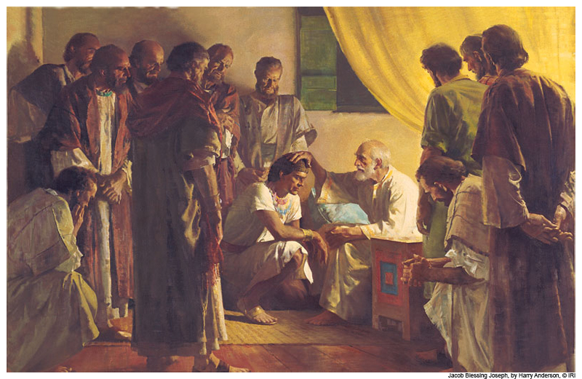
JOSEPH - & jacob’s death (Jacob’s Birthday & Jacob’s Deathday) Genesis 47:27 – 49:33
JACOB’S BIRTHDAY:
Jacob Celebrates 17 Years in Egypt
Jacob’s Last Will & Testament

Slide 54
JOSEPH - & jacob’s death (Jacob’s Birthday & Jacob’s Deathday) Genesis 47:27 – 49:33
JACOB’S DEATHDAY:
The Bad News
The Good News
More Good News Mixed with Some More Bad News

Slide 55
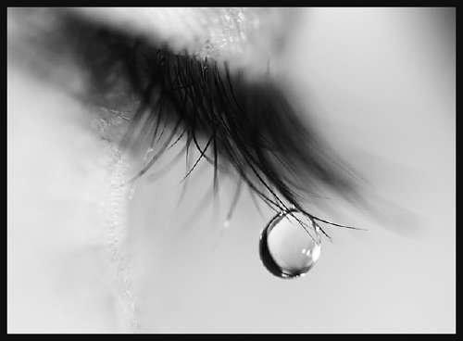
JOSEPH - & jacob’s funeral (Jacob Gathered to His People) Genesis 50:1-13
JOSEPH’S TEARS OVER HIS FATHER: v.1
Joseph Weeps Over Jacob
Joseph Kisses His Father Goodbye

Slide 56
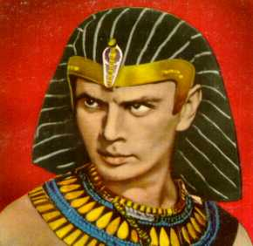
JOSEPH - & jacob’s funeral (Jacob Gathered to His People) Genesis 50:1-13
JOSEPH’S COMMAND TO HIS SERVANTS: vv.2,3

Slide 57
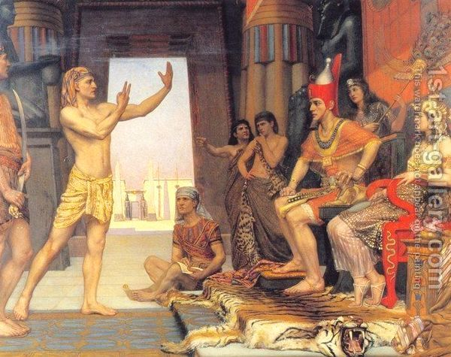
JOSEPH - & jacob’s funeral (Jacob Gathered to His People) Genesis 50:1-13
JOSEPH’S PLEA TO HIS KING:
Joseph’s Request
Pharaoh’s Response

Slide 58
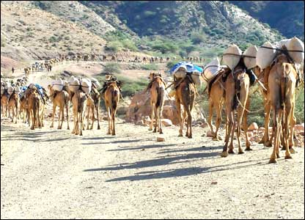
JOSEPH - & jacob’s funeral (Jacob Gathered to His People) Genesis 50:1-13
JOSEPH’S PROCESSION TO CANAAN:
The Journey Back Home
The Impact on Canaan

Slide 59
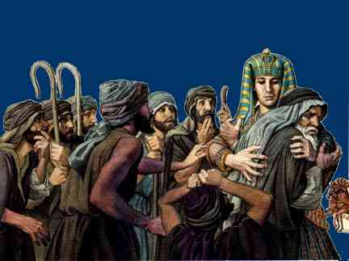
JOSEPH & his brothers – one more time! (B.G.M.I.F.G.) Genesis 50:14-21
JOSEPH’S FINEST HOUR:
Guilty Consciences
Concocted Stories
Broken Heartedness
Great Grace

Slide 60
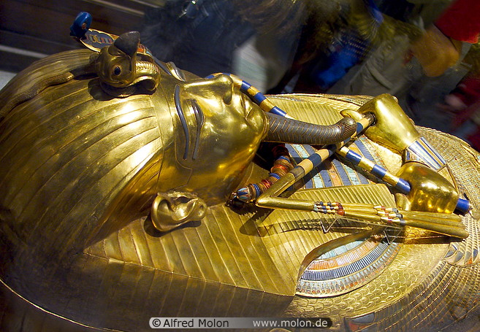
JOSEPH & his brothers – one more time! (B.G.M.I.F.G.) Genesis 50:14-21
JOSEPH’S FINAL HOUR:
A Comfortable Life
A Purposeful Life

Slide 61
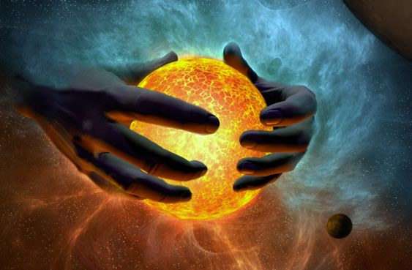
GENESIS OPENS WITH: “IN THE BEGINNNING god created…”

Slide 62
GENESIS CLOSES WITH:
“A COFFIN IN EGYPT!”

