Slide 1
“IF I SHOULD DIE BEFORE I WAKE…” James 4:14
jj

Slide 3
James 4:14 Whereas ye know not what shall be on the morrow. For what is your life? It is even a vapour, that appeareth for a little time, and then vanisheth away.

Slide 4
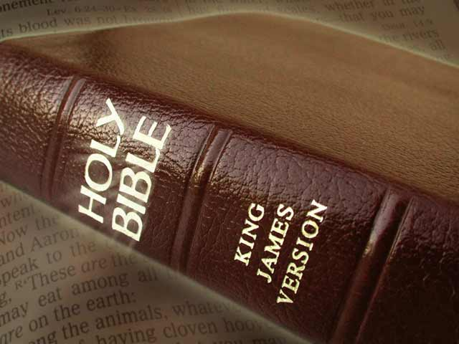
The Metaphors of Death in the Bible
The Bible Reveals the Brevity of Life:
A Vapor – James 4:14
Grass or Flower – 1 Pet. 1:24
Wind – Job 7:7,8
Smoke – Ps. 102:3
(King of Terrors – Job 18:14)

Slide 5
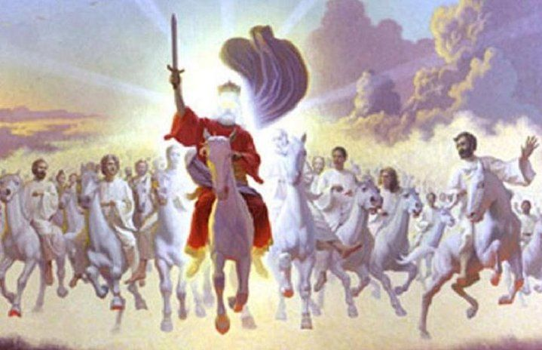
1Thes. 4:14 For if we believe that Jesus died and rose again, even so them also which sleep in Jesus will God bring with him.

Slide 6
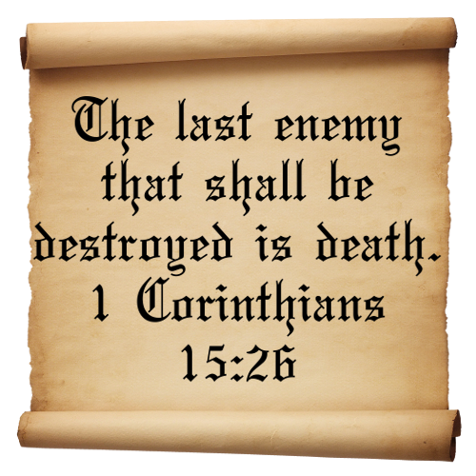

Slide 7
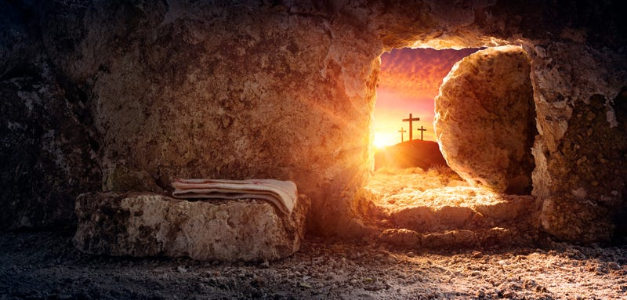
CHRIST IS RISEN…
We Too Shall Rise Again!
(1 Cor. 15:21-23)
For since by man came death, by man came also the resurrection of the dead. For as in Adam all die, even so in Christ shall all be made alive, But every man in his own order: Christ the firstfruits; afterward they that are Christ's at his coming.

Slide 8
2 Cor. 5:1,2 For we know that if our earthly house of this tabernacle were dissolved, we have a building of God, an house not made with hands, eternal in the heavens. For in this we groan, earnestly desiring to be clothed upon with our house which is from heaven:

Slide 9
CHRIST IS RISEN…
We Too Shall Rise Again!
(1 Cor. 15:21-23)
How is this possible?
Col.2:11 – Spiritual Circumcision

Slide 10
Colossians 2:11 In whom also ye are circumcised with the circumcision made without hands, in putting off the body of the sins of the flesh by the circumcision of Christ:

Slide 11
Philippians 3:3 For we are the circumcision, which worship God in the spirit, and rejoice in Christ Jesus, and have no confidence in the flesh.

Slide 12
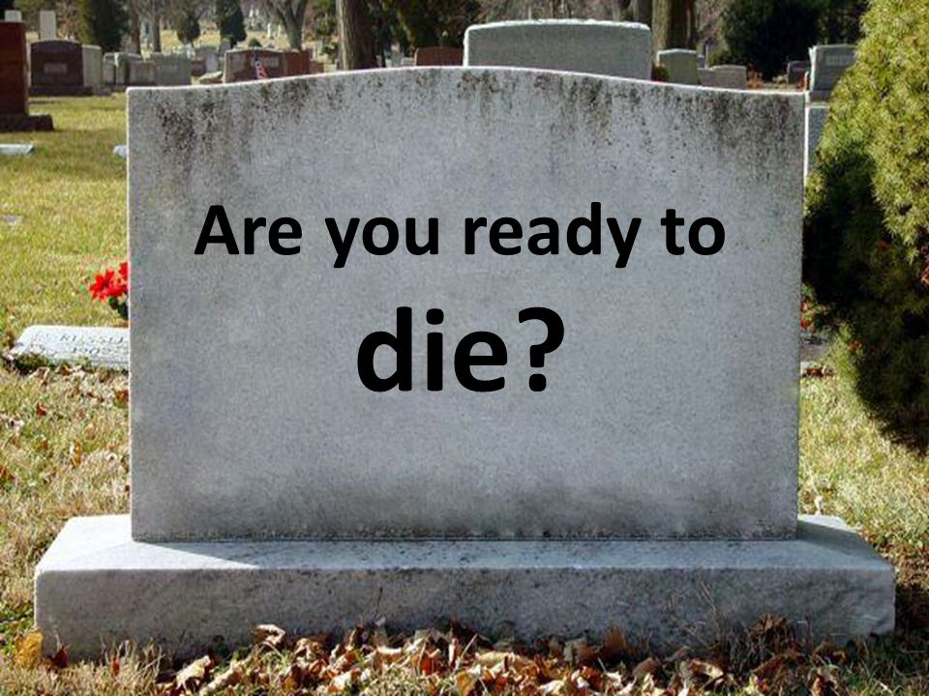
Tonight?!

